Slide 1
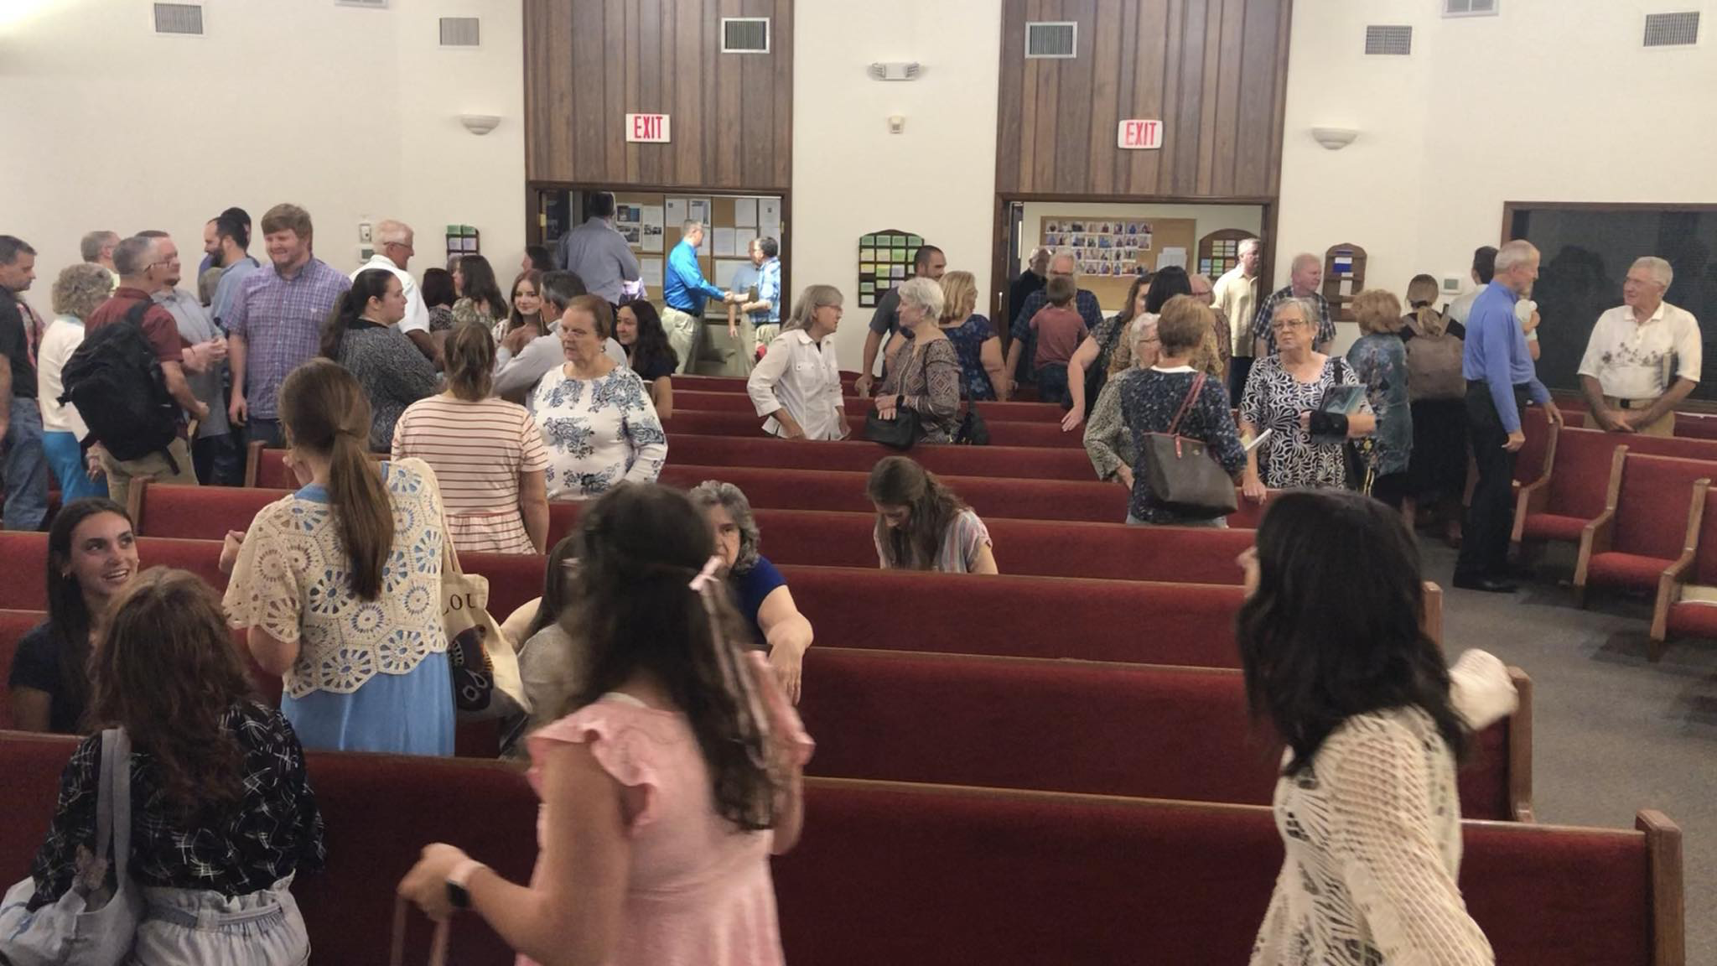
A Church of Christ
~ Romans 16:16-20

Slide 2

There Should Be Truth
The church is called the pillar & ground of the truth (1 Tim. 3:15).
The commitment of any church to the truth can be shown in different ways.
  Not accepting those who hold destructive beliefs (Rev. 2:14-15).
  Not accepting those who teach false doctrine (Rev. 2:20-23).
  Must be aware of them and reject them (Acts 20:29-30; 2 Pet. 2:1-3; Rev. 2:2).
Seeing to it that what is taught in classes and in the public worship is truth.

Slide 3
There Should Be Truth
The church is called the pillar & ground of the truth (1 Tim. 3:15).
The commitment of any church to the truth can be shown in different ways.
  Not accepting those who hold destructive beliefs (Rev. 2:14-15).
  Not accepting those who teach false doctrine (Rev. 2:20-23).
  Must be aware of them and reject them (Acts 20:29-30; 2 Pet. 2:1-3; Rev. 2:2).
Seeing to it that what is taught in classes and in the public worship is truth.

Slide 4
There Should Be Truth
The church is called the pillar & ground of the truth (1 Tim. 3:15).
The commitment of any church to the truth can be shown in different ways.
  Not accepting those who hold destructive beliefs (Rev. 2:14-15).
  Not accepting those who teach false doctrine (Rev. 2:20-23).
  Must be aware of them and reject them (Acts 20:29-30; 2 Pet. 2:1-3; Rev. 2:2).
Seeing to it that what is taught in classes and in the public worship is truth.

Slide 5
There Should Be Truth
The church is called the pillar & ground of the truth (1 Tim. 3:15).
The commitment of any church to the truth can be shown in different ways.
  Not accepting those who hold destructive beliefs (Rev. 2:14-15).
  Not accepting those who teach false doctrine (Rev. 2:20-23).
  Must be aware of them and reject them (Acts 20:29-30; 2 Pet. 2:1-3; Rev. 2:2).
Seeing to it that what is taught in classes and in the public worship is truth.

Slide 6
There Should Be Truth
The church is called the pillar & ground of the truth (1 Tim. 3:15).
The commitment of any church to the truth can be shown in different ways.
  Not accepting those who hold destructive beliefs (Rev. 2:14-15).
  Not accepting those who teach false doctrine (Rev. 2:20-23).
  Must be aware of them and reject them (Acts 20:29-30; 2 Pet. 2:1-3; Rev. 2:2).
Seeing to it that what is taught in classes and in the public worship is truth.

Slide 7
There Should Be Truth
The church is called the pillar & ground of the truth (1 Tim. 3:15).
The commitment of any church to the truth can be shown in different ways.
  Not accepting those who hold destructive beliefs (Rev. 2:14-15).
  Not accepting those who teach false doctrine (Rev. 2:20-23).
  Must be aware of them and reject them (Acts 20:29-30; 2 Pet. 2:1-3; Rev. 2:2).
Seeing to it that what is taught in classes and in the public worship is truth.

Slide 8

There Should Be Love
If we do not act from a motive of love, then all we do is vain (13:1-3).
Paul does more than to define love, he describes it in all its beauty (13:4-7).
The things that so intrigued the Corinthians, their spiritual gifts of various sorts, were but temporary. The things that remain are faith, hope, love; these three, and the greatest of these is love (13:8-13).

Slide 9
There Should Be Love
If we do not act from a motive of love, then all we do is vain (13:1-3).
Paul does more than to define love, he describes it in all its beauty (13:4-7).
The things that so intrigued the Corinthians, their spiritual gifts of various sorts, were but temporary. The things that remain are faith, hope, love; these three, and the greatest of these is love (13:8-13).

Slide 10
There Should Be Love
If we do not act from a motive of love, then all we do is vain (13:1-3).
Paul does more than to define love, he describes it in all its beauty (13:4-7).
The things that so intrigued the Corinthians, their spiritual gifts of various sorts, were but temporary. The things that remain are faith, hope, love; these three, and the greatest of these is love (13:8-13).

Slide 11

4 Love suffers long and is kind; love does not envy; love does not parade itself, is not puffed up;
5 does not behave rudely, does not seek its own, is not provoked, thinks no evil;
6 does not rejoice in iniquity, but rejoices in the truth;
7 bears all things, believes all things, hopes all things, endures all things.
~ 1 Corinthians 13:4-7

Slide 12
4 Love suffers long and is kind; love does not envy; love does not parade itself, is not puffed up;
5 does not behave rudely, does not seek its own, is not provoked, thinks no evil;
6 does not rejoice in iniquity, but rejoices in the truth;
7 bears all things, believes all things, hopes all things, endures all things.
~ 1 Corinthians 13:4-7

Slide 13
4 Love suffers long and is kind; love does not envy; love does not parade itself, is not puffed up;
5 does not behave rudely, does not seek its own, is not provoked, thinks no evil;
6 does not rejoice in iniquity, but rejoices in the truth;
7 bears all things, believes all things, hopes all things, endures all things.
~ 1 Corinthians 13:4-7

Slide 14
4 Love suffers long and is kind; love does not envy; love does not parade itself, is not puffed up;
5 does not behave rudely, does not seek its own, is not provoked, thinks no evil;
6 does not rejoice in iniquity, but rejoices in the truth;
7 bears all things, believes all things, hopes all things, endures all things.
~ 1 Corinthians 13:4-7

Slide 15
4 Love suffers long and is kind; love does not envy; love does not parade itself, is not puffed up;
5 does not behave rudely, does not seek its own, is not provoked, thinks no evil;
6 does not rejoice in iniquity, but rejoices in the truth;
7 bears all things, believes all things, hopes all things, endures all things.
~ 1 Corinthians 13:4-7

Slide 16
4 Love suffers long and is kind; love does not envy; love does not parade itself, is not puffed up;
5 does not behave rudely, does not seek its own, is not provoked, thinks no evil;
6 does not rejoice in iniquity, but rejoices in the truth;
7 bears all things, believes all things, hopes all things, endures all things.
~ 1 Corinthians 13:4-7

Slide 17
4 Love suffers long and is kind; love does not envy; love does not parade itself, is not puffed up;
5 does not behave rudely, does not seek its own, is not provoked, thinks no evil;
6 does not rejoice in iniquity, but rejoices in the truth;
7 bears all things, believes all things, hopes all things, endures all things.
~ 1 Corinthians 13:4-7

Slide 18
4 Love suffers long and is kind; love does not envy; love does not parade itself, is not puffed up;
5 does not behave rudely, does not seek its own, is not provoked, thinks no evil;
6 does not rejoice in iniquity, but rejoices in the truth;
7 bears all things, believes all things, hopes all things, endures all things.
~ 1 Corinthians 13:4-7

Slide 19
4 Love suffers long and is kind; love does not envy; love does not parade itself, is not puffed up;
5 does not behave rudely, does not seek its own, is not provoked, thinks no evil;
6 does not rejoice in iniquity, but rejoices in the truth;
7 bears all things, believes all things, hopes all things, endures all things.
~ 1 Corinthians 13:4-7

Slide 20
4 Love suffers long and is kind; love does not envy; love does not parade itself, is not puffed up;
5 does not behave rudely, does not seek its own, is not provoked, thinks no evil;
6 does not rejoice in iniquity, but rejoices in the truth;
7 bears all things, believes all things, hopes all things, endures all things.
~ 1 Corinthians 13:4-7

Slide 21
4 Love suffers long and is kind; love does not envy; love does not parade itself, is not puffed up;
5 does not behave rudely, does not seek its own, is not provoked, thinks no evil;
6 does not rejoice in iniquity, but rejoices in the truth;
7 bears all things, believes all things, hopes all things, endures all things.
~ 1 Corinthians 13:4-7

Slide 22
4 Love suffers long and is kind; love does not envy; love does not parade itself, is not puffed up;
5 does not behave rudely, does not seek its own, is not provoked, thinks no evil;
6 does not rejoice in iniquity, but rejoices in the truth;
7 bears all things, believes all things, hopes all things, endures all things.
~ 1 Corinthians 13:4-7

Slide 23
4 Love suffers long and is kind; love does not envy; love does not parade itself, is not puffed up;
5 does not behave rudely, does not seek its own, is not provoked, thinks no evil;
6 does not rejoice in iniquity, but rejoices in the truth;
7 bears all things, believes all things, hopes all things, endures all things.
~ 1 Corinthians 13:4-7

Slide 24
4 Love suffers long and is kind; love does not envy; love does not parade itself, is not puffed up;
5 does not behave rudely, does not seek its own, is not provoked, thinks no evil;
6 does not rejoice in iniquity, but rejoices in the truth;
7 bears all things, believes all things, hopes all things, endures all things.
~ 1 Corinthians 13:4-7

Slide 25
4 Love suffers long and is kind; love does not envy; love does not parade itself, is not puffed up;
5 does not behave rudely, does not seek its own, is not provoked, thinks no evil;
6 does not rejoice in iniquity, but rejoices in the truth;
7 bears all things, believes all things, hopes all things, endures all things.
~ 1 Corinthians 13:4-7

Slide 26
There Should Be Love
If we do not act from a motive of love, then all we do is vain (13:1-3).
Paul does more than to define love, he describes it in all its beauty (13:4-7).
The things that so intrigued the Corinthians, their spiritual gifts of various sorts, were but temporary. The things that remain are faith, hope, love; these three, and the greatest of these is love (13:8-13).

Slide 27
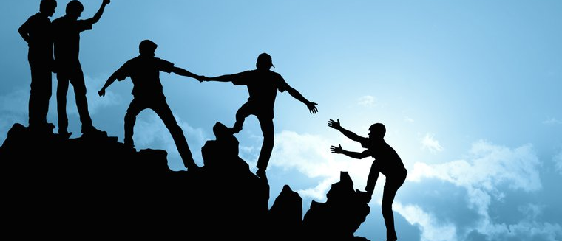
There Should Be a Place for Everyone
We should welcome those of all backgrounds (Jas. 2:1-9).
Abilities are from God (1 Cor. 12:4-11; Rom. 12:3-4).
We need different functions (1 Cor. 12:12-20; Rom. 12:5).
We must have appreciation for what each one does (1 Cor. 12:21-27).
Let each one do diligently what he does (Rom. 12:6-8).

Slide 28
A Church of Christ
There Should Be Truth
There Should Be Love
There Should Be a Place for Everyone

