Slide 1

A Common Approach to Life
Eccl. 2:24-26; 5:18-20; 8:14-15

Slide 2


Slide 3
If there is no life after death (Acts 17:16-34).

Slide 4
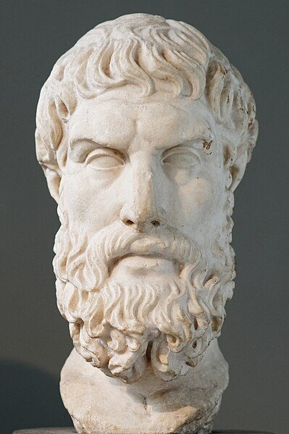
Epicurus was an atomic materialist, following in the steps of Democritus. His materialism led him to a general attack on superstition and divine intervention. Epicureanism was originally a challenge to Platonism. Later its main opponent became Stoicism. Although Epicureanism is a form of hedonism insofar as it declares pleasure to be its sole intrinsic goal, the concept that the absence of pain and fear constitutes the greatest pleasure, and its advocacy of a simple life, make it very different from "hedonism" as colloquially understood. Following the Cyrenaic philosopher Aristippus, Epicurus believed that the greatest good was to seek modest, sustainable pleasure in the form of a state of ataraxia (tranquility and freedom from fear) and aponia (the absence of bodily pain) through knowledge of the workings of the world and limiting desires. Correspondingly, Epicurus and his followers generally withdrew from politics because it could lead to frustrations and ambitions that would conflict with their pursuit of virtue and peace of mind.
~ Wilson, Catherine (2015). Epicureanism: a very short introduction (First ed.). Oxford, United Kingdom.
Roman Epicurus Bust

Slide 5
Epicureanism bases its ethics on a hedonistic set of values, seeing pleasure as the chief good in life. Hence, Epicurus advocated living in such a way as to derive the greatest amount of pleasure possible during one's lifetime yet doing so moderately to avoid the suffering incurred by overindulgence in such pleasure. Epicurus actively recommended against passionate love and believed it best to avoid marriage altogether. He viewed recreational sex as a natural, but not necessary, desire that should be generally avoided. Since the political life could give rise to desires that could disturb virtue and one's peace of mind, such as a lust for power or a desire for fame, participation in politics was discouraged. Further, Epicurus sought to eliminate the fear of the gods and of death, seeing those two fears as chief causes of strife in life.
~ O'Keefe, Tim (2010). Epicureanism. University of California Press.
~ Sharples, R. W. (1996). Stoics, Epicureans, and Sceptics: An Introduction to Hellenistic Philosophy. New York, NY: Routledge. p. 84.
Roman Epicurus Bust

Slide 6
If there is no life after death (Acts 17:16-34).
If the dead are not raised (1 Cor. 15:12-19, 32).

Slide 7
Epicureanism rejects immortality. It believes in the soul, but suggests that the soul is mortal and material, just like the body. Epicurus rejected any possibility of an afterlife, while still contending that one need not fear death: "Death is nothing to us; for that which is dissolved, is without sensation, and that which lacks sensation is nothing to us." From this doctrine arose the Epicurean Epitaph: Non fui, fui, non sum, non curo ("I was not; I have been; I am not; I do not mind."), which is inscribed on the gravestones of his followers and seen on many ancient gravestones of the Roman Empire.
~ Russel, Bertrand. A History of Western Philosophy, pp. 239-40
Roman Epicurus Bust

Slide 8
If there is no life after death (Acts 17:16-34).
If the dead are not raised (1 Cor. 15:12-19, 32).

Slide 9
If there is no life after death (Acts 17:16-34).
If the dead are not raised (1 Cor. 15:12-19, 32).
If there is a God who will judge living & dead, and if there is life after death (Lk. 12:13-21; Jas. 4:13-15)?

Slide 10
If there is no life after death (Acts 17:16-34).
If the dead are not raised (1 Cor. 15:12-19, 32).
If there is a God who will judge living & dead, and if there is life after death (Lk. 12:13-21; Jas. 4:13-15)?
What if God is calling for repentance (Isa. 22:12-13; Amos 6:3-6)?

Slide 11
If there is no life after death (Acts 17:16-34).
If the dead are not raised (1 Cor. 15:12-19, 32).
If there is a God who will judge living & dead, and if there is life after death (Lk. 12:13-21; Jas. 4:13-15)?
What if God is calling for repentance (Isa. 22:12-13; Amos 6:3-6)?
There is one sense in which to eat, drink, & be merry is exactly what we should do (Eccl. 2:24-26; 5:18-20; 8:14-15; Matt. 6:33)!

Slide 12
Life Consists Of…
Securing for ourselves food, drink, clothes, & shelter.
Securing those things that make this life, this existence more pleasant.
Finding a mate & rearing a family.
Fearing God, loving Him, & serving Him (Eccl. 12:13).
Loving our neighbor & doing good to Him (Matt. 22:34-40).

