Slide 1

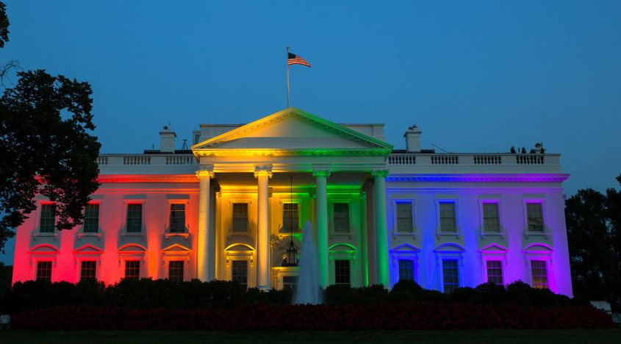
Homosexuality
~ God’s View
~ Tolerance
~ Loving People, Hating Sin

Slide 2

God’s View of Homosexuality
Now before they lay down, the men of the city, the men of Sodom, both old and young, all the people from every quarter, surrounded the house. 5 And they called to Lot and said to him, “Where are the men who came to you tonight? Bring them out to us that we may know them carnally.”6 So Lot went out to them through the doorway, shut the door behind him, 7 and said, “Please, my brethren, do not do so wickedly! 8 See now, I have two daughters who have not known a man; please, let me bring them out to you, and you may do to them as you wish; only do nothing to these men, since this is the reason they have come under the shadow of my roof.”
Genesis 19:4-8
(NKJV)

Slide 3
God’s View of Homosexuality
You shall not lie with a male as with a woman. It is an abomination. 23 Nor shall you mate with any animal, to defile yourself with it. Nor shall any woman stand before an animal to mate with it. It is perversion.24 ‘Do not defile yourselves with any of these things; for by all these the nations are defiled, which I am casting out before you.
Leviticus 18:22-24
(NKJV)

Slide 4
God’s View of Homosexuality
If a man lies with a male as he lies with a woman, both of them have committed an abomination. They shall surely be put to death. Their blood shall be upon them.
Leviticus 20:13
(NKJV)

Slide 5
God’s View of Homosexuality
As they were enjoying themselves, suddenly certain men of the city, perverted men, surrounded the house and beat on the door. They spoke to the master of the house, the old man, saying, “Bring out the man who came to your house, that we may know him carnally!”23 But the man, the master of the house, went out to them and said to them, “No, my brethren! I beg you, do not act so wickedly! Seeing this man has come into my house, do not commit this outrage. 24 Look, here is my virgin daughter and the man’s concubine; let me bring them out now. Humble them, and do with them as you please; but to this man do not do such a vile thing!” 25 But the men would not heed him. So the man took his concubine and brought her out to them. And they knew her and abused her all night until morning; and when the day began to break, they let her go.
Judges 19:22-25
(NKJV)

Slide 6
God’s View of Homosexuality
And there were also perverted persons in the land. They did according to all the abominations of the nations which the Lord had cast out before the children of Israel.
1 Kings 14:4
(NKJV)

Slide 7
God’s View of Homosexuality
Asa did what was right in the eyes of the Lord, as did his father David. 12 And he banished the perverted persons from the land, and removed all the idols that his fathers had made.
1 Kings 15:11-12
(NKJV)

Slide 8
God’s View of Homosexuality
And he brought out the wooden image from the house of the Lord, to the Brook Kidron outside Jerusalem, burned it at the Brook Kidron and ground it to ashes, and threw its ashes on the graves of the common people. 7 Then he tore down the ritual booths of the perverted persons that were in the house of the Lord, where the women wove hangings for the wooden image
2 Kings 23:6-7
(NKJV)

Slide 9
God’s View of Homosexuality
For this reason God gave them up to vile passions. For even their women exchanged the natural use for what is against nature. 27 Likewise also the men, leaving the natural use of the woman, burned in their lust for one another, men with men committing what is shameful, and receiving in themselves the penalty of their error which was due. 28 And even as they did not like to retain God in their knowledge, God gave them over to a debased mind, to do those things which are not fitting;
Romans 1:26-28
(NKJV)

Slide 10
God’s View of Homosexuality
Do you not know that the unrighteous will not inherit the kingdom of God? Do not be deceived. Neither fornicators, nor idolaters, nor adulterers, nor homosexuals, nor sodomites, 10 nor thieves, nor covetous, nor drunkards, nor revilers, nor extortioners will inherit the kingdom of God. 11 And such were some of you. But you were washed, but you were sanctified, but you were justified in the name of the Lord Jesus and by the Spirit of our God.
1 Corinthians 6:9-11
(NKJV)

Slide 11
God’s View of Homosexuality
Let brotherly love continue. 2 Do not forget to entertain strangers, for by so doing some have unwittingly entertained angels. 3 Remember the prisoners as if chained with them—those who are mistreated—since you yourselves are in the body also. 4 Marriage is honorable among all, and the bed undefiled; but fornicators and adulterers God will judge. 5 Let your conduct be without covetousness; be content with such things as you have. For He Himself has said, “I will never leave you nor forsake you.”
Hebrews 13:1-5
(NKJV)

Slide 12
God’s View of Homosexuality
But I want to remind you, though you once knew this, that the Lord, having saved the people out of the land of Egypt, afterward destroyed those who did not believe. 6 And the angels who did not keep their proper domain, but left their own abode, He has reserved in everlasting chains under darkness for the judgment of the great day; 7 as Sodom and Gomorrah, and the cities around them in a similar manner to these, having given themselves over to sexual immorality and gone after strange flesh, are set forth as an example, suffering the vengeance of eternal fire. 8 Likewise also these dreamers defile the flesh, reject authority, and speak evil of dignitaries.
Jude 5-8
(NKJV)

Slide 13
TOLERANT:
(1) a fair, objective, and permissive attitude toward those whose opinions, beliefs, practices, racial or ethnic origins, etc., differ from one's own; freedom from bigotry: We are an international, multifaith, and multiracial school where the pupils are taught tolerance and respect for those they may consider different from themselves.
(2) a fair, objective, and permissive attitude toward opinions, beliefs, and practices that differ from one's own: The cleric preached religious tolerance and separation of church and state.
(3) interest in and concern for ideas, opinions, practices, etc., foreign to one's own; a liberal, undogmatic viewpoint: Tolerance presupposes taking the other's perspective, not just being aware of it.
https://www.dictionary.com/browse/tolerance

Slide 14

1 Cor. 5:1 (NIV) It is actually reported that there is sexual immorality among you, and of a kind that even pagans do not tolerate: A man is sleeping with his father’s wife.
2 Cor. 11:4 (NASB20) For if one comes and preaches another Jesus whom we have not preached, or you receive a different spirit which you have not received, or a different gospel which you have not accepted, this you tolerate very well!
2 Cor. 11:16 (NIV) I repeat: Let no one take me for a fool. But if you do, then tolerate me just as you would a fool, so that I may do a little boasting.
2 Cor. 11:19-20 (NASB20) For you, being so wise, tolerate the foolish gladly. 20 For you tolerate it if anyone enslaves you, if anyone devours you, if anyone takes advantage of you, if anyone exalts himself, if anyone hits you in the face.

Slide 15
2 Tim. 4:3 (NASB20) For the time will come when they will not tolerate sound doctrine; but wanting to have their ears tickled, they will accumulate for themselves teachers in accordance with their own desires,
Rev. 2:2 (NASB20) I know your deeds and your labor and perseverance, and that you cannot tolerate evil people, and you have put those who call themselves apostles to the test, and they are not, and you found them to be false;
Rev. 2:20-21 (NASB20) But I have this against you, that you tolerate the woman Jezebel, who calls herself a prophetess, and she teaches and leads My bond-servants astray so that they commit sexual immorality and eat things sacrificed to idols. 21 I gave her time to repent, and she does not want to repent of her sexual immorality.

Slide 16
Develop genuine love for people, while growing to hate sin:
Mk. 10:6-9: Jesus spoke of male & female.
Jn. 8:7-12: Jesus compassionately told woman to sin no more.
1 Cor. 6:17-20: The word for sexual immorality here is porneia; includes all forms of sexual perversion.
1 Cor. 7:2: Man is to have wife; a woman her own husband.
Rom. 13:8-10: We will never fully discharge the debt of love toward others.
Gal. 5:13-15: Some principles to apply when dealing with those who are not (yet) Christians?

Slide 17
Homosexuality
~ God’s View
~ Tolerance
~ Loving People, Hating Sin

