Slide 1
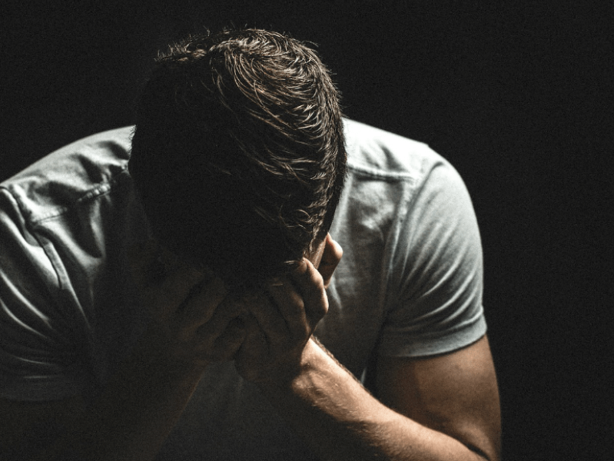
I Have Sinned

Slide 2

I Have Sinned
Become deeply depressed (Matt. 27:3-10).
Get angry (Acts 7:51-54; Cf. 2 Chron. 16:7-10; 1 Ki. 22:27-28; 2 Chron. 24:20-22).
Be sorry for getting caught (1 Sam. 15:24).
Be like David (2 Sam. 11; 12:1-13; Psa. 51).
Two kinds of sorrow for sin:
  Godly sorrow (2 Cor. 7:10a; Cf. Heb. 6:6).
  Sorrow of this world (2 Cor. 7:10b).

Slide 3

Becoming a Christian
Jesus teaches that we must believe in Him, or we will die in our sins.
Jesus says that we must repent of our sins.
Jesus teaches that we must confess Him before others.
Jesus teaches baptism as a necessity.
Jesus says if one remains faithful, one can receive a crown of eternal life!

