Slide 1
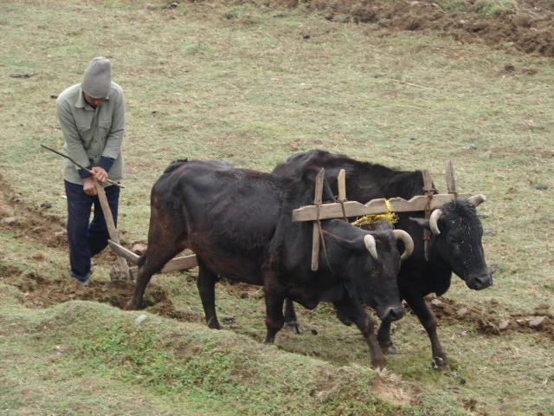
No Turning Back
Luke 9:62

Slide 2
Introduction
Jesus never sugarcoated discipleship.
Luke 9:62 is not a casual call—it’s a serious challenge.
Key Image: Plowman focused on the field ahead.
Main Idea: Following Christ demands unwavering commitment.

Slide 3
Purpose of the Lesson
Explore the cost and reward of steadfast devotion to Christ.
Learn through:
  Biblical examples
  Supporting scriptures
  Real-life applications

Slide 4
A Plow Requires Focus
Proverbs 4:25–27 – “Let your eyes look straight ahead…”
A plowman must stay focused to keep the line straight.
Looking back = crooked furrow → compromised harvest.

Slide 5
Spiritual Implication
Looking back = divided loyalty, second thoughts.
Distraction = Destruction.
Jesus calls us to a forward-facing life.

Slide 6
Illustrations & Application
Lot’s wife (Gen. 19:26; Luke 17:32): looked back—turned to salt.
Israel in the wilderness (Num. 11:4–6): longed for Egypt → delayed blessings.
Driving with eyes in the rearview = disaster.
Living in the past (pleasures, failures, identity) hinders faith.
Jesus says: "Look ahead."

Slide 7
The Call Is All or Nothing
Luke 9:23; Matt. 16:24 – “Deny yourself, take up your cross, follow Me.”
No such thing as partial discipleship.
Jesus gave all—we must do the same.

Slide 8
Illustrations & Application
Matthew 4:19–22: Apostles immediately left nets, family, and comforts.
  They answered the call—fully.
You can’t straddle the fence.
James 1:8 – Double-mindedness is unstable.
Burn the bridges behind you—full commitment.

Slide 9
Looking Back Can Lead to Losing Forward
Philippians 3:13–14 – “Forgetting what lies behind… I press on.”
Paul’s past didn’t paralyze him.
The Christian life is a forward press.

Slide 10
Illustrations & Application
Demas (2 Tim. 4:10): forsook Paul, loved the present world.
Guilt, shame, or temptations to return to old habits hinder progress.
Hebrews 12:1–2 – Fix your eyes on Jesus.

Slide 11
The Kingdom Requires Fit Workers
Luke 9:62 – “Not fit for the kingdom…”
It’s not about being perfect, but being focused, faithful, and forward-looking.
1 Corinthians 15:58 – “Be steadfast, immovable…”
God wants steadfast workers in His field.

Slide 12
Illustrations & Application
Nehemiah’s builders (Neh. 4:6, 17): One hand on the weapon, one on the work.
No room for part-time kingdom workers.
God needs plowmen with purpose.
Ask yourself:
  Am I dreaming of my old life?
  Do I make excuses?
  Am I weary in doing good?

Slide 13
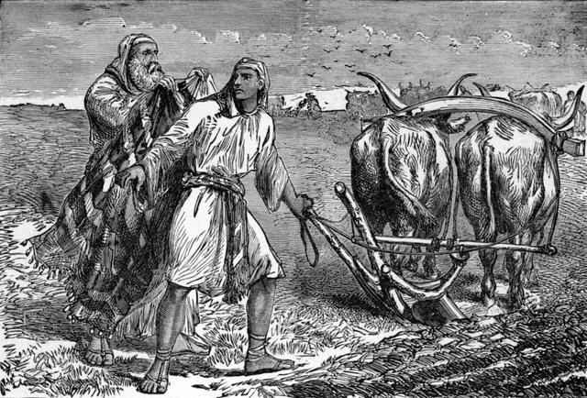
Conclusion: Burn the Plows!
Elisha (1 Kings 19:19–21): Burned the plow, slaughtered the oxen.
He made a clean break—no turning back.
Stay the course – if you’ve begun the journey.
Repent and return – if you’ve looked back.
Start today – if you’ve never put your hand to the plow.

