Slide 1


Slide 2
Song of Solomon
Scholars have had difficulty interpreting the book, but there was a reason why it was included in the Bible.
We proceed on the basis that Solomon is the author.
There have been two primary interpretations given for the book (an allegory of Christ & His church), with the second one (a love poem) broken down into two different views.
The Allegorical View: Assumes that love (married or mating) is not a proper spiritual subject, but marriage and all aspects of love are dealt with at length in the scriptures. Moreover, the New Testament never quotes the Song of Solomon or applies it to Christ and the church. Therefore, we cannot use assumptions to argue that the book is not what it claims to be.

Slide 3
Song of Solomon
2) The book is a love poem, but there are two positions among those who see it as such. One is that the groom is Solomon, who fancies himself as a shepherd wooing his bride. The other is that there are three main characters: Solomon, the Shulammite maiden, and a shepherd.
A. Married Love. Love between Solomon & his bride: Some argue that the poem describes the love between a newlywed couple, as they describe each other and woo each other. However, this interpretation strained. Solomon was born & reared in a palace in a city & never spent time as a shepherd or farmer. Additionally, why would a maiden who accepted a king's proposal want to describe him as a shepherd? It seems logical to assume that any maiden who accepted a king's proposal would want the pomp & ceremony that would come to the wife of a wealthy king.
B. Mating Love. A courtship as Solomon tries to win a young maiden: Of a young maiden who rejects the advances of King Solomon, who competes with a shepherd for the young lady's heart. The book is a celebration of love & commitment, showing that true love is not for sale, a gift that cannot be bought with wealth or power. The book is included in the Bible because it deals with the subject of mating love and the proper wooing & winning of a mate, which is part of God's plan for marriage!

Slide 4
Song of Solomon
The poem is written like a play, and it is difficult to understand who is speaking at times. It is a love poem that is nearly 3,000 years old, so some of the compliments seem strange to us.
However, the poem teaches us about pure and loyal love; it can withstand the lures of riches and pomp and not be willing to sell itself to the highest bidder.
Let us lift our own attitudes above those portrayed by Hollywood and look at the MESSAGE OF THE BOOK.

Slide 5
Song of Solomon
The poem is written like a play, and it is difficult to understand who is speaking at times. It is a love poem that is nearly 3,000 years old, so some of the compliments seem strange to us.
However, the poem teaches us about pure and loyal love; it can withstand the lures of riches and pomp and not be willing to sell itself to the highest bidder.
Let us lift our own attitudes above those portrayed by Hollywood and look at the MESSAGE OF THE BOOK.

Slide 6
Possible Actors in This Play
Solomon: Mighty king who has great riches to offer a young maiden. Can give her everything money can provide. Can give her a life of luxury. Describes her with elaborate compliments.
The Shulammite maiden: Has grown up working in fields and vineyards. Solomon has seen her, brought her to his court, and is trying to win her love.
The Shepherd: Young man from the Shulammite's hometown. He is not present in the court of the king but is very present in the young maiden's heart. Shulammith longs for, dreams of, and searches for him. When he speaks in the first chapters, it is only in her mind as she remembers their conversations, or as she daydreams about him.
The ladies of the court (the chorus): Ladies of the harem; either the maids who take care of all the wives, or the wives themselves. Since they show no jealousy of this pretty young maiden the king is wooing, it seems they were not the other wives. These ladies of the court cannot understand how any girl could turn down the opportunity to be the wife of the king. They cannot understand her longing for her shepherd.
Narrator: There are spots in the poem that seem to be explanations. If so, then those words are spoken by a narrator who is supplying information to the reader.
The Shulammite’s brothers: Her brothers speak in the last chapter.

Slide 7
King Solomon: In Relation to S. O. S.
Solomon requested/was granted wisdom but did not always utilize the gift correctly (1 Ki 3:1-28; 2 Chron 1:1-17; Ecclesiastes)
  Use of empty/superficial speech/flattery?
Pride evident in amassing army, causing others to sin, multiplying wives & riches for himself (Duet 17:14-20; 1 Ki 10:26-29; 11:1-13; 2 Chron 9:1-28)
  Such men are often tyrants and feel they can take whatever (and whomever) they wish.
World enamored by the size of his army, number of women, wealth (1 Ki 10:1-13; 2 Chron 9:1-12)
  World (still) views such as a marks of “wisdom/success.”

Slide 8
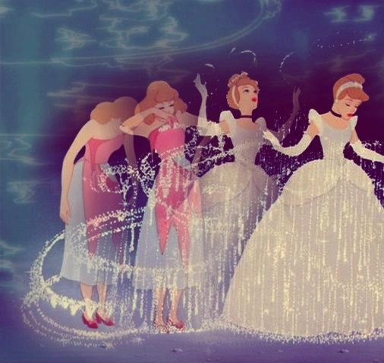
The Shulamite’s Example
Do not fall for the superficial, being charmed by the world’s delight (Song of Solomon 1:9-10; Gen. 3:1-8; 1 Jn. 2:15-17)!
Many have fallen prey to the promise of pleasure, only to be brought to ruin; use wisdom in both selecting a mate & overcoming the allurement of empty pleasures (Gen. 6:1-8; Prov. 7:1-27).

Slide 9
~ Part 2

Slide 10
Song of Solomon
The poem is written like a play, and it is difficult to understand who is speaking at times. It is a love poem that is nearly 3,000 years old, so some of the compliments seem strange to us.
However, the poem teaches us about pure and loyal love; it can withstand the lures of riches and pomp and not be willing to sell itself to the highest bidder.
Let us lift our own attitudes above those portrayed by Hollywood and look at the MESSAGE OF THE BOOK.

Slide 11
Possible Actors in This Play
Solomon: Mighty king who has great riches to offer a young maiden. Can give her everything money can provide. Can give her a life of luxury. Describes her with elaborate compliments.
The Shulammite maiden: Has grown up working in fields and vineyards. Solomon has seen her, brought her to his court, and is trying to win her love.
The Shepherd: Young man from the Shulammite's hometown. He is not present in the court of the king but is very present in the young maiden's heart. Shulammith longs for, dreams of, and searches for him. When he speaks in the first chapters, it is only in her mind as she remembers their conversations, or as she daydreams about him.
The ladies of the court (the chorus): Ladies of the harem; either the maids who take care of all the wives, or the wives themselves. Since they show no jealousy of this pretty young maiden the king is wooing, it seems they were not the other wives. These ladies of the court cannot understand how any girl could turn down the opportunity to be the wife of the king. They cannot understand her longing for her shepherd.
Narrator: There are spots in the poem that seem to be explanations. If so, then those words are spoken by a narrator who is supplying information to the reader.
The Shulammite’s brothers: Her brothers speak in the last chapter.

Slide 12
Song of Solomon
Though Solomon initially wanted wisdom for good reason(s), he displeased the LORD through his prideful pursuits.
His biggest asset(s) became his biggest liability (both personally, and for the kingdom of God’s people).
Is it hard to imagine such a scenario (of this woman refusing his advances)? How it could intrigue such a man, challenging his pride, thus prompting him to pursue her with more intensity?

Slide 13
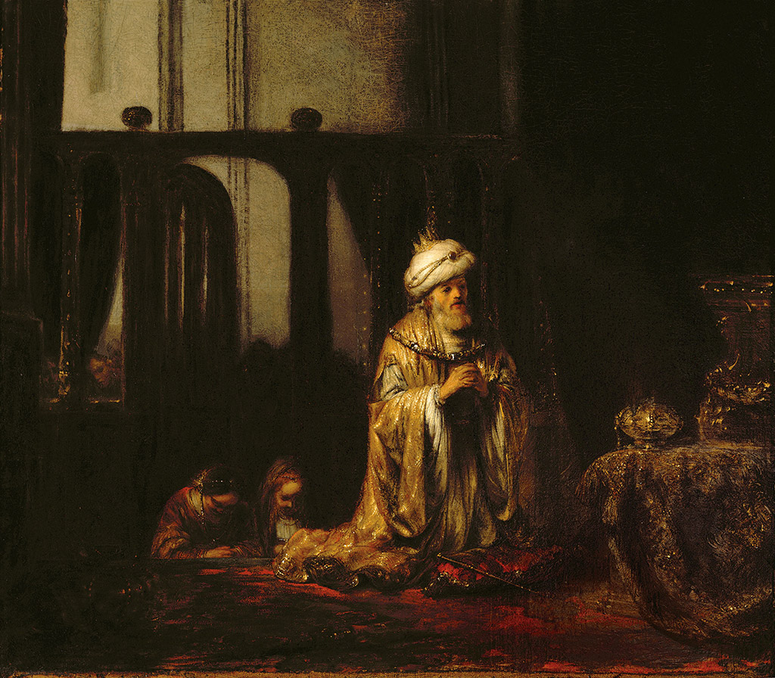
Song of Solomon & Ecclesiastes:
Books of reflection & regret?
  Eccl. 2:12-13; 4:13; 7:25-29
God’s first great gift!
  Gen. 2:18, 24; Eccl. 5:18; 9:7-9

Slide 14
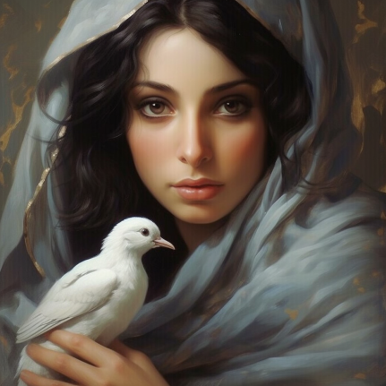
Who Are the Lovers?
The woman is a “Shulamite” [6:13]. A girl of the country, a keeper of vineyards [1:6].
Her “beloved” is a shepherd [1:7-8]. She is his “spouse” or bride (to be) [4:8]. He is likewise from the north country [8:5] and longs to take his love “away” from Solomon’s chambers and live with her in the country as his wife [2:10] [1:4].

Slide 15
Song of Solomon: Chapter 1
1 The song of songs, which is Solomon’s.
2 Let him kiss me with the kisses of his mouth— For your love is better than wine.
Kiss: Romantic implications.
Wine: It could intoxicate a person. True love is said to surpass the intoxication of wine (1:2; 4:10)

Slide 16
Song of Solomon: Chapter 1
3 Because of the fragrance of your good ointments, Your name is ointment poured forth; Therefore the virgins love you.
Name: She is not only attracted to looks, but by character (Cf. Prov. 22:1)!
The virgins love you? If beloved is not the king, why would daughters be drawn to him (some shepherd from the country? Cf. 5:9; 6:1) Her testimony of his attractiveness has convinced them of his worthiness. They have become sympathetic to her plight as the story continues (back & forth in chronology).

Slide 17
Song of Solomon: Chapter 1
(NKJV) 4 Draw me away! We will run after you. The king has brought me into his chambers. We will be glad and rejoice in you. We will remember your love more than wine. Rightly do they love you.
(ASV) 4 Draw me; we will run after thee: The king hath brought me into his chambers; We will be glad and rejoice in thee; We will make mention of thy love more than of wine: Rightly do they love thee.
(ESV) 4 Draw me after you; let us run. The king has brought me into his chambers. We will exult and rejoice in you; we will extol your love more than wine; rightly do they love you.
(KJV) 4 Draw me, we will run after thee: the king hath brought me into his chambers: we will be glad and rejoice in thee, we will remember thy love more than wine: the upright love thee.

Slide 18
Song of Solomon: Chapter 1
5 I am dark, but lovely, O daughters of Jerusalem, Like the tents of Kedar, Like the curtains of Solomon.
6 Do not look upon me, because I am dark, Because the sun has tanned me. My mother’s sons were angry with me; They made me the keeper of the vineyards, But my own vineyard I have not kept.
Do not look upon me: Do not look down on me, daughters of Jerusalem because I am burned black by the sun. She is black, but beautiful.
My mother’s sons were angry with me: Mother referenced (3:4; 6:9; 8:1-2; Cf. 3:11; 8:5); brothers (8:8-9); but no father mentioned. Brothers made her work in vineyard. Feels mistreated by her brothers? Consider her upbringing & how she a became virtuous, intelligent, hardworking, and desirable woman.

Slide 19
Song of Solomon: Chapter 1
7 Tell me, O you whom I love, Where you feed your flock, Where you make it rest at noon. For why should I be as one who veils herself By the flocks of your companions?
8 If you do not know, O fairest among women, Follow in the footsteps of the flock, And feed your little goats Beside the shepherds’ tents.
Tell me, O you whom I love: To her beloved, where do you feed your flock? For why should I come looking for you as a stranger?
If you do not know: Chorus in response, “If you do not know where your lover is, O you fairest among women, go follow the trail of the flock and feed your kids beside the shepherd’s tent.”

Slide 20
Song of Solomon: Chapter 1
9 I have compared you, my love, To my filly among Pharaoh’s chariots.
10 Your cheeks are lovely with ornaments, your neck with chains of gold.
11 We will make you ornaments of gold with studs of silver.
To my filly among Pharaoh’s chariots: An odd compliment? To Solomon, the height of flattery (2 Chron. 9:25). Hard not to hear implication that the Shulamite is object of king’s desire as another beautiful and prized possession.
We will make you: Promise of jewelry? Appeal to riches.

Slide 21
Song of Solomon: Chapter 1
12 While the king is at his table, My spikenard sends forth its fragrance.
13 A bundle of myrrh is my beloved to me, That lies all night between my breasts.
14 My beloved is to me a cluster of henna blooms In the vineyards of En Gedi.
While the king is at his table: Reminder of the beloved; He is present, even at the king’s table! Her heart is with the SHEPHERD!!
En Gedi: See map and Picture on following slide.

Slide 22

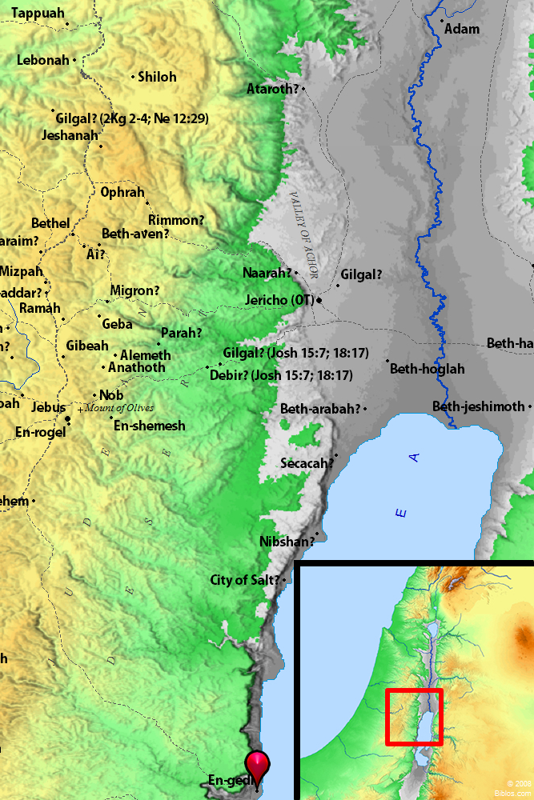
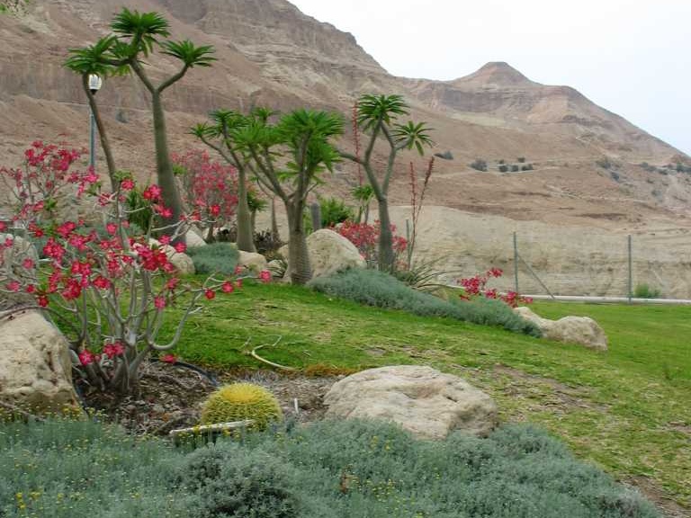
En Gedi
Known for its beautiful falls.
An area where David and his men fled from King Saul.

Slide 23
Song of Solomon: Chapter 1
15 Behold, you are fair, my love! Behold, you are fair! You have dove’s eyes.
You have dove’s eyes: But it stands in reference to it if her eyes are called doves; and so the likeness to doves' eyes is attributed to them, because purity and gentleness, longing and simplicity, express themselves therein (Keil and Delitzsch).
This is either the voice of Solomon or the shepherd. The imagery is from nature and does not fit with the highly polished compliments that we find another actor in this play giving the Shulamite. This voice is that of the shepherd. Remember that he is not actually present in the company of the king, but she is remembering how he would speak to her (Waldron).

Slide 24
Song of Solomon: Chapter 1
16 Behold, you are handsome, my beloved! Yes, pleasant! Also our bed is green.
17 The beams of our houses are cedar, And our rafters of fir.
The meaning is not that their houses are built of cedar, but that the cedar trees and fir trees form the roof over their heads as they seek shelter under them. Perhaps the plural houses may be significant. They have not one, but many palaces in the forest glades. The country maiden speaks as a country maiden whose couch was often in the green grass, and who had cedars and cypresses for walls and roof at her meetings with her lover. (Cambridge Bible)
The Shulammite returns her lover’s compliment and, in her thoughts, is with him in the forest, away from the splendid palace of Solomon. (Waldron)

Slide 25
Song of Solomon: Chapter 1
Be careful with the blessings God provides (Lk. 16:1-13; 19:11-27).
  Solomon wasn’t the best steward of his blessings (wisdom, riches, etc.).
Solomon had lots of regret in later years (Cf. Isa. 48:17-19; 2 Tim. 4:7).
  God seeks to prevent (and save) us from such heartache(s).
Celebration of love & commitment (Prov. 5:18; Eph. 5:22-33).
  Enjoy the God-given pleasures with purity.

Slide 26
Song of Solomon: Chapter 1
Seek & treasure a mate with character (Gen. 6:2; Duet. 7:3-4; 1 Cor. 7:39).
  Not all about one’s “looks.”
Be thankful for upbringing/circumstances that cultivate character (Prov. 30:8-9; 1 Tim. 6:6-10).
  Hard times = strength; Easy times = soft/weak.
Women are not merely prized possessions (Gen. 1:27; Eph. 5:25; 1 Pet. 3:7).
  Some (such as Solomon) will use, abuse, & lose.
Pure & loyal love can withstand the lures of riches and pomp (Prov. 2:16-20; 5:20; 6:24; 7:5).
  Satan wants you to feel unsatisfied, unfulfilled, discontent in your relationship(s)!

Slide 27
~ Part 3

Slide 28
Song of Solomon: Chapter 2
1 I am the rose of Sharon, And the lily of the valleys.
2 Like a lily among thorns, So is my love among the daughters.
  Rose:
    Strong: “chăbatstseleth (khab-ats-tseh'-leth)-- Of uncertain derivation; probably meadow saffron.”
    “The Hebrew word can hardly mean a rose. The LXX, Vulg., and Targ. to Isa_35:1 translate it ‘lily,’ but as we have shôshannâh for lily in the next clause, it is probably some other flower” (Cambridge).
    “I am a mere wild-flower of the plains: a flower found in great profusion” (Bullinger).
    Clarke: “She with a becoming modesty, represents her beauty as nothing extraordinary, and compares herself to a common flower of the field.”

Slide 29
Song of Solomon: Chapter 2
1 I am the rose of Sharon, And the lily of the valleys.
2 Like a lily among thorns, So is my love among the daughters.
Sharon: “Designates a flowery district, which extends from the foot of Carmel, and slopes gently towards the Mediterranean. Cf. Isaiah 35:2” (Reville).
Lily: Cambridge Bible identifies it with identifies it with Anemone coronaria. “It is found everywhere, on all soils and in all situations.”
  Seems clear these are self-descriptions from the Shulamite. NOT a boast, but a statement of self-deprecation. A moment of self-consciousness, self-doubt.
  This self-deprecating statement may grow out of the King’s efforts to change her. Her experience in Solomon’s house makes her feel acutely out of place.
  In a sense, she is “out of place,” but NOT inferior!

Slide 30
Song of Solomon: Chapter 2
1 I am the rose of Sharon, And the lily of the valleys.
2 Like a lily among thorns, So is my love among the daughters.
Her shepherd lover will not accept her disparagement of herself. She stands out above other women as a lily stands out among thorns. (Waldron)
She knows she is SUPREMELY VALUED in the eyes of her Beloved. She is BEYOND comparison to him! Importance of protecting a woman’s self-esteem. (Fathers, husbands can BUILD OR DESTROY self-respect, self-worth, Wes Brown).

Slide 31
Song of Solomon: Chapter 2
3 Like an apple tree among the trees of the woods, So is my beloved among the sons. I sat down in his shade with great delight, And his fruit was sweet to my taste.
4 He brought me to the banqueting house, And his banner over me was love.
5 Sustain me with cakes of raisins, Refresh me with apples, For I am lovesick.
6 His left hand is under my head, And his right hand embraces me.
7 I charge you, O daughters of Jerusalem, By the gazelles or by the does of the field, Do not stir up nor awaken love Until it pleases.

Slide 32
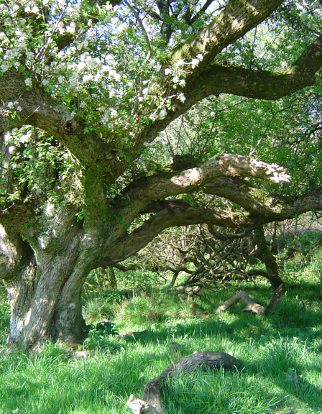
Like an apple tree… So is my beloved
Shade & Sweetness!
Women value being protected and treasured.
“Women boast, not about what they have done for their man, but what HE has done for her!” (WB)
With the beloved is safety and happiness.

Slide 33
Song of Solomon: Chapter 2
3 Like an apple tree among the trees of the woods, So is my beloved among the sons. I sat down in his shade with great delight, And his fruit was sweet to my taste.
4 He brought me to the banqueting house, And his banner over me was love.
5 Sustain me with cakes of raisins, Refresh me with apples, For I am lovesick.
6 His left hand is under my head, And his right hand embraces me.
7 I charge you, O daughters of Jerusalem, By the gazelles or by the does of the field, Do not stir up nor awaken love Until it pleases.

Slide 34

… And his banner over me was love.
What is the “banner” over our mate/spouse?
  More than mere physical attraction (outward beauty is temporal). More than possessiveness (self-centered).
  Love is selfless, deep, sacrificial, consistent. Cf. prevalence of abuse (mental, physical, verbal, emotional, financial).
  Research shows that abusive behavior is most always displayed EARLY in a relationship.
Contrast with the material splendor & finery of Solomon.

Slide 35
Song of Solomon: Chapter 2
3 Like an apple tree among the trees of the woods, So is my beloved among the sons. I sat down in his shade with great delight, And his fruit was sweet to my taste.
4 He brought me to the banqueting house, And his banner over me was love.
5 Sustain me with cakes of raisins, Refresh me with apples, For I am lovesick.
6 His left hand is under my head, And his right hand embraces me.
7 I charge you, O daughters of Jerusalem, By the gazelles or by the does of the field, Do not stir up nor awaken love Until it pleases.

Slide 36
… Do not stir up nor awaken love Until it pleases.
There are a couple of questions in this section that make it difficult. Is Shulammith sick from love in the sense that she is deprived of her sweetheart’s company, and she pines for him, or is she faint from the ecstasy and joy of being with her lover? Perhaps the latter fits the language better. The second question concerns 2:7, which appears to be a refrain. It appears again in 3:5 and in 8:4. Is the Shulammite telling the maidens not to interrupt her time with her beloved or is she asking them not to prompt him to come to her? Probably the former (Waldron).
“The adjuration does not refer to the rousing of a lover, but of the passion of love. The meaning is this. The speaker adjures the daughters of Jerusalem not to attempt any more to arouse or awake love. It should be allowed to rest until it awake of itself… The daughters of Jerusalem had been attempting to awake love for Solomon in her heart by fulsome praises of him, and she adjures them thus in order that they may cease from their vain attempt. This beautiful verse recurs at Song 3:5 and 8:4” (Cambridge).

Slide 37
Song of Solomon: Chapter 2
8 The voice of my beloved! Behold, he comes Leaping upon the mountains, Skipping upon the hills.
9 My beloved is like a gazelle or a young stag. Behold, he stands behind our wall; He is looking through the windows, Gazing through the lattice.
10 My beloved spoke, and said to me: “Rise up, my love, my fair one, And come away.
11 For lo, the winter is past, The rain is over and gone.
12 The flowers appear on the earth; The time of singing has come, And the voice of the turtledove Is heard in our land.
13 The fig tree puts forth her green figs, And the vines with the tender grapes Give a good smell. Rise up, my love, my fair one, And come away!

Slide 38
The voice of my beloved… he comes… My beloved spoke, and said to me…
The section 2:7-3:5 expresses the daydreams of Shulammith. The Shulammite hears the voice of her beloved. He was not with her as Solomon was; her beloved is coming from afar. The context makes it clear he is not really there, so the maiden must be dreaming or imagining his coming for her. When he comes, the Shulammite’s sweetheart speaks to her, asking her to come away with him. It is spring, and the earth is putting forth. He tenderly calls her his love, his fair one, his dove (Waldron).

Slide 39
Song of Solomon: Chapter 2
14 “O my dove, in the clefts of the rock, In the secret places of the cliff, Let me see your face, Let me hear your voice; For your voice is sweet, And your face is lovely.”
15 Catch us the foxes, The little foxes that spoil the vines, For our vines have tender grapes.
16 My beloved is mine, and I am his. He feeds his flock among the lilies.
17 Until the day breaks And the shadows flee away, Turn, my beloved, And be like a gazelle Or a young stag Upon the mountains of Bether.

Slide 40
Song of Solomon: Chapter 2
In verse15 the Shulammite is thinking of her rural surroundings, of the vineyards where she worked, where she came to know and to love her shepherd. She says, “Let us capture the foxes that spoil the vineyard.” Then she professes her love for her sweetheart and thinks of him feeding his flock among the flowers. She closes her reverie wishing he would come to her. (Waldron)

Slide 41
Song of Solomon: Chapter 2
14 “O my dove, in the clefts of the rock, In the secret places of the cliff, Let me see your face, Let me hear your voice; For your voice is sweet, And your face is lovely.”
15 Catch us the foxes, The little foxes that spoil the vines, For our vines have tender grapes.
16 My beloved is mine, and I am his. He feeds his flock among the lilies.
17 Until the day breaks And the shadows flee away, Turn, my beloved, And be like a gazelle Or a young stag Upon the mountains of Bether.

Slide 42
Song of Solomon: Chapter 2
“My beloved is mine, and I am his.”
  A monogamous relationship as God created it to be (Cp. Matt. 19:5-6; 1 Cor. 7:2-5).
“He feeds his flock among the lilies.”
  Sexual reference?
  Symbol of his emotional satisfaction with her alone. “She herself is a lily, and the beloved one feeds upon her beauty, purity, and perfection.” (Pulpit)
  Literal reference to his ACTIVITIES (Cp. 1:7; 6:1-3).
  A statement of confidence. She knows her beloved is taking care of his business. No concern he might occupy his time in some forbidden place in some forbidden way. His loyalty is secure (Prov. 7:8-20).

Slide 43
Song of Solomon: Chapter 2
14 “O my dove, in the clefts of the rock, In the secret places of the cliff, Let me see your face, Let me hear your voice; For your voice is sweet, And your face is lovely.”
15 Catch us the foxes, The little foxes that spoil the vines, For our vines have tender grapes.
16 My beloved is mine, and I am his. He feeds his flock among the lilies.
17 Until the day breaks And the shadows flee away, Turn, my beloved, And be like a gazelle Or a young stag Upon the mountains of Bether.

Slide 44
Song of Solomon: Chapter 2
“Before the dawn comes and the shadows flee away, come back to me, my love” (NLT).
Bether:
  “Bether = cleft… a mountainous region in Palestine, site unknown.” (Brown-Driver-Biggs)
  “It is doubtful if a proper name is intended.” (ISBE)
  (ESV) Until the day breathes and the shadows flee, turn, my beloved, be like a gazelle or a young stag on cleft mountains.
  “The mountains that separate us” could represent more than literal acreage. It is her plea to the Beloved to not give up, despite what divides them! Overcome!
  Her plea/encouragement to her beloved not to give up on their relationship. They were currently facing the night, but the dawn would come, a time when the troubles and dangers of the night are past (Wes Brown).

Slide 45

Song of Solomon:
Lessons from Chapter 2
You may feel out of place; but NOT inferior!!
Men can either build/destroy woman’s self esteem.
Women value being protected & treasured.
What is the banner over your mate?
Speak tenderly toward your significant other (remember the time of courtship).
Cherish those simple treasures of life!
Seek, cherish, and nurture your trustworthy companion.
True love/commitment demands weathering/overcoming of difficult times, challenges, etc.

Slide 46
~ Part 4

Slide 47
Song of Solomon: 3:1-5
1 By night on my bed I sought the one I love; I sought him, but I did not find him.
2“I will rise now,” I said, “And go about the city; In the streets and in the squares I will seek the one I love.” I sought him, but I did not find him.
3 The watchmen who go about the city found me; I said, “Have you seen the one I love?”
4 Scarcely had I passed by them, When I found the one I love. I held him and would not let him go, Until I had brought him to the house of my mother, And into the chamber of her who conceived me.
5 I charge you, O daughters of Jerusalem, By the gazelles or by the does of the field, Do not stir up nor awaken love Until it pleases.

Slide 48
Song of Solomon: 3:1-5
The maiden is dreaming, and in her dream, she rises to find her lover. She goes out into the streets of the city, not the rural setting she speaks of so fondly, to search for him. It is highly unlikely that a young woman under the care of the Jerusalem’s daughters would actually have done such a thing. Also, if it were Solomon she was seeking, she looked for him in a strange place - go out and look for the king, who lives in the palace, in the streets?
~ Bob Waldron

Slide 49
Song of Solomon: 3:6-11
6 Who is this coming out of the wilderness Like pillars of smoke, Perfumed with myrrh and frankincense, With all the merchant’s fragrant powders?
7 Behold, it is Solomon’s couch, With sixty valiant men around it, Of the valiant of Israel.
8 They all hold swords, Being expert in war. Every man has his sword on his thigh Because of fear in the night.
9 Of the wood of Lebanon Solomon the King Made himself a palanquin:
10 He made its pillars of silver, Its support of gold, Its seat of purple, Its interior paved with love By the daughters of Jerusalem.
11 Go forth, O daughters of Zion, And see King Solomon with the crown With which his mother crowned him On the day of his wedding, The day of the gladness of his heart.

Slide 50
Song of Solomon: 3:6-11
From the wilderness Solomon comes in stately procession. Does he come to the maiden's home? There is nothing to indicate this. Instead the daughters of Jerusalem are told to go out and behold King Solomon with the crown his mother has given him for his wedding. If there are only two main characters in the play, this might be when Solomon brough the Shulammite to become his wife. Is it a flashback to 1:4, when Solomon brought the Shulammite to his chambers? Or has there been some time, and now Solomon has fetched her to marry him? The word "espousal,” is best translated, “wedding, or "betrothal.” There is no mention whatever of his bride to be. The attention is wholly upon the king. Perhaps it is best to think that he has been gone and has returned, thinking to make the Shulammite his bride. Some would argue that this would explain the Shulammite’s lonesomeness and longing for her lover. The only problem is that the imagery she uses to express her longings does not fit Solomon at all. This scene simply plays up the tension that builds as Shulammith is pressured to become one of Solomon’s wives, while her shepherd remains her true love.
~ Bob and Sandra Waldron

Slide 51
Song of Solomon: 3:6-11
Holman Illustrated Bible Dictionary on Polygamy
(under heading of “Family,” p.557):
“Polygamy (more specifically ‘polygyny’) was one of the abnormal developments of the family in the OT and was first practiced by Lamech, a descendant of Cain. IT IS NEVER CAST IN A POSITIVE LIGHT IN SCRIPTURE BUT IS A SOURCE OF RIVALRY AND BICKERING, as it seen in the lives of Abraham and Jacob… The harems of the kings of Israel are presented as excess that is rebuked in the monarchy (Deut. 17:17). Because of polygamy the kings of Israel were persuaded to worship false gods (1 Kings 11:1-10). The normal family unit in Israel was never polygamous, nor was polygamy widely practiced outside of the monarchy.”
Cf. Gen. 16:1-5; 29:30-34; 30:15, 19-20

Slide 52
Song of Solomon: 3:6-11
The New Bible Dictionary on “Marriage”:
“Monogamy is implicit in the story of Adam and Eve, since God created only ONE wife for Adam. Yet polygamy is adopted from the time of Lamech (Genesis 4:19), and is not forbidden in Scripture. It would seem that God left it to man to discover by experience that His original institution of monogamy was the proper relationship. It is shown that polygamy brings trouble, and often results in sin, e.g. Abraham (Gen. 21); Gideon (Judges 8:29—9:57); David (2 Samuel 11; 13); Solomon (1 Kings 11:1-8). In view of oriental customs Hebrew kings are warned against it (Dt. 17:17)…
Family jealousies arise from it, as with Elkanah’s two wives, one of whom was an adversary to the other (1 Sam. 1:6; cf. Lv. 18:18). It is difficult to know how far polygamy was practiced, but on economic grounds it is probable that it was found more among the well-to-do than among the ordinary people.”

Slide 53
Song of Solomon: 3:6-11
ISBE on “Polygamy”:
“Polygamy has been and is the open blazon by the human race of sex vice. The very term is a misnomer... It is an attempt to cover up by the term ‘plural marriage’ what is not marriage and cannot be marriage… We have now no longer the ‘HELP-MEET’ originally destined for man – ‘BONE OF MY BONES AND FLESH OF MY FLESH’ - for whom he would ‘leave his father and his mother’ and to whose single self he would ‘CLEAVE’ for life (Gen_2:18, Gen_2:24; Mat_19:5, Mat_19:6)…
Monogamy, with its unity in labor, thought and feeling, with its immeasurable modifying influences of moral, ideal and spiritual cast, is gone. WOMAN is reduced to the position of ministrant to man's unmodified sensuality…. It can be demonstrated scientifically, even mathematically, that polygamy is a moral wrong… the wrong to woman in denying to her the rights and privileges of monogamous marriage, the interference with the rights of MAN to such marriage.”

Slide 54
Song of Solomon: 4:1-5
1 Behold, you are fair, my love! Behold, you are fair! You have dove’s eyes behind your veil. Your hair is like a flock of goats, Going down from Mount Gilead.
2 Your teeth are like a flock of shorn sheep Which have come up from the washing, Every one of which bears twins, And none is barren among them.
3 Your lips are like a strand of scarlet, And your mouth is lovely. Your temples behind your veil Are like a piece of pomegranate.
4 Your neck is like the tower of David, Built for an armory, On which hang a thousand bucklers, All shields of mighty men.
5 Your two breasts are like two fawns, Twins of a gazelle, Which feed among the lilies.

Slide 55
Song of Solomon: 4:1-5
Solomon praises Shulammith's beauty, her teeth, her lips, her mouth, her neck, and her breasts. He compares her neck to the tower of David. In this chapter there are two passages praising the Shulammite’s beauty: verses 1-5,and verses 7-15. Does all this praise come from Solomon, or from the shepherd, or does part of it come from one and part from the other? Note there is no direct response from the Shulammite to the praise in verses1-5. Compare her statement in verse 6 with her reply to the praise in verses7-15. One must believe that she does not care for the praise of the first lover. The figures in verses1-5 contain a mixture of some agricultural features, but there is also the reference to the tower of David, upon which there hang a thousand bucklers. This imagery sounds much more as if it comes from Solomon.
~ Bob & Sandra Waldron

Slide 56
Song of Solomon: 4:1-5
COMPLIMENTS:
  (ESV) Behold, you are beautiful, my love, behold, you are beautiful!
  (ASV) Thine eyes are as doves behind thy veil.
  (CEV) Your hair tosses about as gracefully as goats coming down from Gilead.
  (CEV) Your teeth are whiter than sheep freshly washed; they match perfectly, not one is missing.
  (CEV) Your lips are crimson cords, your mouth is shapely; behind your veil are hidden beautiful rosy cheeks.
  (GNB) Your neck is like the tower of David, round and smooth, with a necklace like a thousand shields hung around it.
  (ESV) Your two breasts are like two fawns, twins of a gazelle, that graze among the lilies.
Solomon notes her perfect proportion, symmetry, aesthetic beauty.
  That is what he sees (and he may be correct!) It is NOT wrong (in some circumstances) to NOTICE! Physical attraction IS a God-given phenomenon.
  But the OUTWARD seems to be ALL he sees. (No intellectual compatibility. No spiritual connection. Rather a trophy, a conquest).
  It is at this moment the words of her BELOVED call to the Shulamite…

Slide 57
Song of Solomon: 4:6-8
6 Until the day breaks And the shadows flee away, I will go my way to the mountain of myrrh And to the hill of frankincense.
7 You are all fair, my love, And there is no spot in you.
8 Come with me from Lebanon, my spouse, With me from Lebanon. Look from the top of Amana, From the top of Senir and Hermon, From the lions’ dens, From the mountains of the leopards.
SPOUSE
  A married woman or one to be married (Cf. Joel 2:16).
  “My PROMISED bride” (Amp.).

Slide 58
Song of Solomon: 4:9-15
9 You have ravished my heart, My sister, my spouse; You have ravished my heart With one look of your eyes, With one link of your necklace.
10 How fair is your love, My sister, my spouse! How much better than wine is your love, And the scent of your perfumes Than all spices!
11 Your lips, O my spouse, Drip as the honeycomb; Honey and milk are under your tongue; And the fragrance of your garments Is like the fragrance of Lebanon.
12 A garden enclosed Is my sister, my spouse, A spring shut up, A fountain sealed.
13 Your plants are an orchard of pomegranates With pleasant fruits, Fragrant henna with spikenard,
14 Spikenard and saffron, Calamus and cinnamon, With all trees of frankincense, Myrrh and aloes, With all the chief spices—
15 A fountain of gardens, A well of living waters, And streams from Lebanon.

Slide 59
Song of Solomon: 4:9-15
Again, MY SPOUSE (“My promised bride”—JB).
MY SISTER ('âchôth/aw-khoth')
  “BROTHER and SISTER as terms of endearment between lovers is well attested in the literature from the ancient Near East. There is no incestuous relationship being discussed here. This is simply conventional lover’s talk to express the closeness and permanence they desire in their union. In 8:1 the free expression of familiarity between siblings expresses the girl’s feelings” [Carr].
  It is a word that takes us outside of sexuality. It suggests familial bond, belonging, partnership, fellowship on a deep level.
  Used in Ezekiel 1:23 of “the OTHER” outstretched wing of the Cherub (a true match!)
  In this context it suggests a long and focused relationship of a devoted pair.

Slide 60
Song of Solomon: 4:9-15
9 You have ravished my heart, My sister, my spouse; You have ravished my heart With one look of your eyes, With one link of your necklace.
10 How fair is your love, My sister, my spouse! How much better than wine is your love, And the scent of your perfumes Than all spices!
11 Your lips, O my spouse, Drip as the honeycomb; Honey and milk are under your tongue; And the fragrance of your garments Is like the fragrance of Lebanon.
12 A garden enclosed Is my sister, my spouse, A spring shut up, A fountain sealed.
13 Your plants are an orchard of pomegranates With pleasant fruits, Fragrant henna with spikenard,
14 Spikenard and saffron, Calamus and cinnamon, With all trees of frankincense, Myrrh and aloes, With all the chief spices—
15 A fountain of gardens, A well of living waters, And streams from Lebanon.

Slide 61
Song of Solomon: 4:9-15
MY SISTER… SPOUSE… A GARDEN OF DELIGHT!
  “Garden” and “vineyard” do have a literal use in the Song [cf. 6:11; 8:11]. The word brings to mind a place pleasant to the senses, fruitful. A place to be enjoyed, guarded, valued.
  Also used, as here, as a symbol for the Shulamite herself, her person—physical and emotional, body and spirit. She brings delight to his life. Refreshing. Sweet to the senses. She is the object of his desire.
  SHE is to her beloved an ORCHARD (Heb. pardês/par-dace'—“park” or “paradise”) of everything good. A delight to the senses, on every level.
  ~Wes Brown

Slide 62
Song of Solomon: 4:9-15
A GARDEN ENCLOSED…
  “You are a locked garden—a locked garden and a sealed spring” [HCSB].
  This testifies to her purity/virginity. In God’s design, there is a part of a human being the is not meant to be widely shared, but reserved.
  The importance of such a moral commitment has been all but lost in our society. Its absence has a DIRECT relationship to the lack of committed, long-term, successful relationships.
  That SHE is an enclosed garden speaks to her claim: “I am HIS!” Is there not a reciprocal expectation in the assertion “He is MINE!” Cf. [2:16; 6:3; 7:10].
  This relationship is based on MUTUAL purity and EXCLUSIVE commitment. It cannot describe polygamy.

Slide 63
Song of Solomon: 4:16
16 Awake, O north wind,
And come, O south!
Blow upon my garden,
That its spices may flow out.
Let my beloved come to his garden
And eat its pleasant fruits.

Slide 64
Song of Solomon: 4:16
Shulammith responds intensely and passionately to the words of her shepherd lover. This passage furnishes a good opportunity to make this point. Some interpretations of the Song of Songs turn it into a marriage manual. Many of the expressions are exaggerated to make them sexually explicit in content. Such an approach is a distortion of the book. The jaded, sensual views of modem America are injected into a love song written 3,000 years ago.
There is nothing shameful about the sexual relationship. In its place it is wonderful, but it is not nearly everything in a relationship. When a couple is very much in love, and planning marriage, they are conscious of the sexual attraction they have for one another. They anticipate the sexual aspect of marriage, but that is not all there is for a young man to enjoy about his sweetheart, or for a young woman to enjoy about her love done. There is no need therefore to make 4:7-16 exclusively a sexual passage. The anticipation of marriage includes the contemplation of the sexual relationship, but it includes everything else that a couple loves about one another as well.
~ Bob & Sandra Waldron

Slide 65

Song of Solomon
Lessons from Chapters 3-4
God’s original intention for marriage involves one man & one woman, for life.
Polygamy is an invention of man & illustrates an abuse of God’s design for man & woman’s relationship.
True love cannot be bought, nor fulfilled, through means of mere outward extravagance(s).
Physical attraction is a God-given phenomenon, but what about spiritual compatibility???
Closeness/devotion/permanence bring comfort, partnership, and fellowship on deep level.
In its place, the sexual relationship is wonderful, but it is not everything in a relationship.
Moral commitment between sexes is to be enjoyed, guarded, and valued.

Slide 66
~ Part 5

Slide 67
Song of Solomon: 4:16-5:1
16 Awake, O north wind, And come, O south! Blow upon my garden, That its spices may flow out. Let my beloved come to his garden And eat its pleasant fruits.
1 I have come to my garden, my sister, my spouse; I have gathered my myrrh with my spice; I have eaten my honeycomb with my honey; I have drunk my wine with my milk. Eat, O friends! Drink, yes, drink deeply, O beloved ones!

Slide 68
Song of Solomon: 4:16-5:1
As Cambridge points out, “This last clause of the verse is spoken, it should be remembered, by a loving woman shut up in a royal dwelling away from her lover and expresses her longing for the time when she shall be wholly his.”
There is no need to see fornication here, rather an unshakeable longing for consummation in its proper context, at the proper time.
The Beloved responds…
  It could be an expression of firm resolution (there union is sure, as real as if already accomplished).
  It could be an anachronism of poetry (looking ahead to the end, the crisis being past). Telling the end of the story (union), then coming back to the days when they were apart.
The next scene seems to take us back to a time of painful separation.

Slide 69
Song of Solomon: 5:2-8
2 I sleep, but my heart is awake; It is the voice of my beloved! He knocks, saying, “Open for me, my sister, my love, My dove, my perfect one; For my head is covered with dew, My locks with the drops of the night.”
3 I have taken off my robe; How can I put it on again? I have washed my feet; How can I defile them?
4 My beloved put his hand By the latch of the door, And my heart yearned for him.
5 I arose to open for my beloved, And my hands dripped with myrrh, My fingers with liquid myrrh, On the handles of the lock.
6 I opened for my beloved, But my beloved had turned away and was gone. My heart leaped up when he spoke. I sought him, but I could not find him; I called him, but he gave me no answer.
7 The watchmen who went about the city found me. They struck me, they wounded me; The keepers of the walls Took my veil away from me.
8 I charge you, O daughters of Jerusalem, If you find my beloved, That you tell him I am lovesick!

Slide 70
Song of Solomon: 5:2-8
The Shulammite dreams of her lover, but he is not there. She hears his voice. The description is exactly that of a dream. She thinks of the inconvenience of getting up. Everything seems real but when she gets up, filled with ecstasy at the thought of seeing her loved one, there is no one. Some have this lover to be Solomon. He comes asking to be let into his bride’s bedroom, but when she does not readily open to him, he leaves. The course of true love is not running smoothly. But this interpretation just does not seem to fit She goes out searching the streets – for Solomon? She asks the watchmen if they have seen- Solomon? The watchmen slap her, apparently having no idea that she has any connection with Solomon. They take her mantle from her, cruelly teasing her, but she does not find her lover. The refrain of 5:8 is a little different this time. This time she adjures the daughters of Jerusalem that if they find her beloved to tell him that she is faint from love. The context here demands the idea that she loves him very much, but she cannot express her love to him, she cannot enjoy the love she has for him. She is lovesick. (Bob & Sandra Waldron)

Slide 71
Song of Solomon: 5:9-16a
9 What is your beloved More than another beloved, O fairest among women? What is your beloved More than another beloved, That you so charge us?
10 My beloved is white and ruddy, Chief among ten thousand.
11 His head is like the finest gold; His locks are wavy, And black as a raven.
12 His eyes are like doves by the rivers of waters, washed with milk, and fitly set.
13 His cheeks are like a bed of spices, Banks of scented herbs. His lips are lilies, Dripping liquid myrrh.
14 His hands are rods of gold Set with beryl. His body is carved ivory Inlaid with sapphires.
15 His legs are pillars of marble Set on bases of fine gold. His countenance is like Lebanon, Excellent as the cedars.
16 His mouth is most sweet, Yes, he is altogether lovely. This is my beloved, And this is my friend, O daughters of Jerusalem!

Slide 72
Song of Solomon: 5:16b-6:3
16 His mouth is most sweet, Yes, he is altogether lovely. This is my beloved, And this is my friend, O daughters of Jerusalem!
1 Where has your beloved gone, O fairest among women? Where has your beloved turned aside, That we may seek him with you?
2 My beloved has gone to his garden, To the beds of spices, To feed his flock in the gardens, And to gather lilies.
3 I am my beloved’s, And my beloved is mine. He feeds his flock among the lilies.

Slide 73
Song of Solomon: 5:16b-6:3
(CEV, v.2) My darling has gone down to his garden of spices, where he will feed his sheep and gather lilies.
As Adeney put it, “He is away at his work on his far-off farm, feeding his flock and perhaps gathering a posy of flowers for his bride. He is far away—that sad truth cannot be denied; and yet he is not really lost, for love laughs at time and distance.”
(ESV, v.3) I am my beloved's and my beloved is mine; he grazes among the lilies.
As said earlier, “feeding” here is not a sexual reference. She knows what he is doing (and not doing) because of the mutual loyalty that exists between them!
I belong to my beloved and he belongs to me (LEB).
This God given arrangement is KEY to happiness and fulfillment. [Cf. 7:10].

Slide 74
Song of Solomon: 6:4-7
4 O my love, you are as beautiful as Tirzah, Lovely as Jerusalem, Awesome as an army with banners!
5 Turn your eyes away from me, For they have overcome me. Your hair is like a flock of goats Going down from Gilead.
6 Your teeth are like a flock of sheep Which have come up from the washing; Every one bears twins, And none is barren among them.
7 Like a piece of pomegranate Are your temples behind your veil.

Slide 75
Song of Solomon: 6:4-7
She IS beautiful, but also…
“Awesome” ('âyôm) is used only here, 6:10, and Habakkuk 1:7, where it refers to the Babylonian army!
  (BBE) You are to be feared like an army with flags.
  Cambridge is here undecided “Whether… we have here praise of the Shulammite’s beauty, or whether we have praise of her inaccessibility as frowning upon her flatterers.”
  Conviction is INTIMIDATING to ungodliness!

Slide 76
Song of Solomon: 6:4-7
4 O my love, you are as beautiful as Tirzah, Lovely as Jerusalem, Awesome as an army with banners!
5 Turn your eyes away from me, For they have overcome me. Your hair is like a flock of goats Going down from Gilead.
6 Your teeth are like a flock of sheep Which have come up from the washing; Every one bears twins, And none is barren among them.
7 Like a piece of pomegranate Are your temples behind your veil.

Slide 77
Song of Solomon: 6:4-7
“OVERCOME” (râhab/raw-hab')
  “1b) To disturb, alarm, awe, confuse, make bold or proud” [K&D].
  Used three other times in the O.T.:
    Isaiah 3:5 ESV And the people will oppress one another, every one his fellow and every one his neighbor; the youth will be insolent to the elder, and the despised to the honorable.
    Proverbs 6:3 GW Do the following things, my son, so that you may free yourself, because you have fallen into your neighbor's hands: Humble yourself, and pester your neighbor.
    Psalms 138:3 NKJV In the day when I cried out, You answered me, And made me bold with strength in my soul. (Thus making ENEMIES uncomfortable).
  Rahab describes that which will create a feeling of DISCOMFORT, AGITATION in others.
“Turn aside those eyes of yours, they daunt me” [Moffatt]. (“Daunt”: make someone feel intimidated or apprehensive).
This Shulamite was surely DIFFERENT! She was no swooning “fangirl”!

Slide 78
Song of Solomon: 6:8-10
8 There are sixty queens And eighty concubines, And virgins without number.
9 My dove, my perfect one, Is the only one, The only one of her mother, The favorite of the one who bore her. The daughters saw her And called her blessed, The queens and the concubines, And they praised her.
10 Who is she who looks forth as the morning, Fair as the moon, Clear as the sun, Awesome as an army with banners?

Slide 79
Song of Solomon: 6:8-10
[ISV] There are sixty queens and eighty mistresses, and too many young women to count, (9) but my dove, my perfect one, is unique. She's unique to her mother, she's pure to the one who gave birth to her. Young women see her and call her blessed, queens and mistresses praise her.
  The fact that the numbers were reported as larger in [1 Kings 11:3] suggests that the story in this Song takes place at a time much earlier in Solomon’s reign.
  The larger totals that came later make clear that there was no change in Solomon’s lifestyle in the years to come. (Greatest song?)
  However, we are sure the king was correct, this Shulamite is UNLIKE the other women in his life!

Slide 80
Song of Solomon: 6:8-10
8 There are sixty queens And eighty concubines, And virgins without number.
9 My dove, my perfect one, Is the only one, The only one of her mother, The favorite of the one who bore her. The daughters saw her And called her blessed, The queens and the concubines, And they praised her.
10 Who is she who looks forth as the morning, Fair as the moon, Clear as the sun, Awesome as an army with banners?

Slide 81
Song of Solomon: 6:8-10
Even though some of the references in this section sound like the shepherd (for example, the pastoral references in verses 5b-6,and the reference to "my dove"), the speaker in this passage is probably Solomon. Some of the expressions match those in 4:1-5. The terms in verses4-5a, and the references to the queens and concubines would point to Solomon. He would be the one to know the reaction of these women to the Shulammite maiden, not the shepherd. Solomon wants her to become another of his wives- one among many, even though he says she stands unique among them. With her shepherd, she will be his, and he will be hers. (Bob & Sandra Waldron)

Slide 82
Song of Solomon: 6:11-13
11 I went down to the garden of nuts To see the verdure of the valley, To see whether the vine had budded And the pomegranates had bloomed.
12 Before I was even aware, My soul had made me As the chariots of my noble people.
13 Return, return, O Shulamite; Return, return, that we may look upon you! What would you see in the Shulamite— As it were, the dance of the two camps?
Perhaps the most challenging passage in the Song to translate/interpret. Wide variety of translations that cannot agree on the identity of the speaker(s).
The Shulamite is speaking in the first person in verses 11 and 12, recounting her first encounter with Solomon’s entourage and how she came into his circle.
Verse 13a is taken as a call by Solomon’s retinue to the Shulamite not to flee away but return. In response, the Shulamite humbly asks, “What do you want with me?” (13b).

Slide 83
Song of Solomon: 6:11-13
My noble people (lit. “noble people”)
  ‛AM –“From AMAM; a people, as a congregated unit; specifically a tribe (as those of Israel); hence (collectively) troops or attendants; figuratively a flock.” Plus NÂDÎYB/naw-deeb'—“From NADAB (volunteer); properly voluntary, that is, generous; hence, magnanimous; as noun, a grandee.” This part of the compound word is the same as “prince’s” in 7:1.
  Proper name?
  Touch of NOBILITY.
    (JPS) Before I was aware, my soul set me upon the chariots of my princely people.
    (RSV) Before I was aware, my fancy set me in a chariot beside my prince.
    (ESV) Before I was aware, my desire set me among the chariots of my kinsman, a prince.

Slide 84
Song of Solomon: 6:11-13
SHULAMITE (shûlammı̂yth/shoo-lam-meeth')
  Here is the only use (x2) in the O.T., and the only such description tying the female protagonist of the story to a place.
  “Peaceful… The name given to the bride in Cant. Vi. 13” [Smith’s Bible Dictionary].
  Tied with the name Solomon?
    “E.J. Goodspeed and H.H. Rowley deny any connection with Shunem but view the word as a feminine counterpart of Solomon, ‘the Solomoness’” [New Bible Dictionary (2nd edition, Tyndale]. Cf. Clarke.
  Variant spelling of SHUNEM?
    “The interchangeableness of the two liquids LAMED and NUN is common in Sem. Languages. Hence, that ‘Shulamite equals Shunamite’ seems to be the most plausible explanation concerning the slight difference in these two names” [ZPBE]. So also ISBE, Harper’s, etc.. (Cf. Connection with Abishag?)
    “The LXX. has ἡ Σοοναμῖτις, i.e. ‘she who is from Shunem.’ Abishag was exceedingly beautiful, and she came from the same district. It is the country in the tribe of Issachar… southeast of Nazareth, southwest of Tabor” [Pulpit].
  A village otherwise UNKNOWN?
    “Some (e.g. Koehler’s Lexicon) have connected it with an unknown town, Shulam.”

Slide 85
Song of Solomon: 6:11-13
Dance of the two camps
  “Dances” (mechôlâh/mekh-o-law')
    Used total of 8 times in the O.T.. The other seven times it is translated “dances” or “dancing.”
    “A dance: - company, dances” [Strong].
    “A feminine noun referring to dancing, a dance. It is used of a joyous celebration featuring rhythmic bodily movements by groups or individuals (Jdg_21:21; 1Sa_18:6; 1Sa_21:11 [12]; 1Sa_29:5), especially in praise of the Lord (Exo_15:20); but on any joyous occasion (Jdg_11:34; Son_6:13 [7:1])” [WSD].
  “Two camps” (machăneh/makh-an-eh')
    “From CHANAH; an encampment (of travellers or troops); hence an army, whether literally (of soldiers) or figuratively (of dancers, angels, cattle, locusts, stars; or even the sacred courts)” [Strong].
    “The R.V. gives as ‘upon the dance of Mahanaim?’ and probably this is the right translation. As she endeavors to escape, the Shulammite asks, would they stare at her as at a public spectacle… The probability, therefore, is that after Jacob’s vision Mahanaim became a holy place, if it was not one before, and that God was there praised in the dance (cp. Jdg_21:21), and that these dances had become famous either for their gracefulness or for their splendor.” [Cambridge].

Slide 86
Song of Solomon: 6:11-13
The chorus praises the dancing of Shulammith, saying it is like the dancing of Mahanaim. The reference is to some common festival held at Mahanaim, at which excellent dancing was beheld, or the reference may be a way of saying that the maiden's dancing was like that of angels, since Mahanaim was associated with the hosts of angels (Gen.32:1-2). The Shulammite proceeds to dance, and the daughters of Jerusalem praise her beauty. (Bob & Sandra Waldron)

Slide 87
Song of Solomon: A Love That Takes Work
Work, effort, tending is required in a loving relationship!
Love will be TESTED by trials, made STRONGER by endurance. Cf. [2:10-11, 15] [3:2] [5:6] [8:7]. Enduring the “winter” and removing the “foxes that spoil.” It involves “seeking” our beloved and bridging divides.
Note on “mountains” in the Song (two images):
  Mountains of dangerous CHALLENGE [2:8, 17] [4:8]. Mountains as a barrier, an obstacle to happiness.
  Mountains of sweet REWARD/VICTORY [4:6] [8:14].
“The victory of love of which the Song of Songs sings has little to do with the sentimental platitude of minor poets… their love is a hard-won thing that emerges victorious and triumphant in spite of everything that would hinder and prevent it” [Interp. Bib.].

Slide 88
Song of Solomon: A Love That Takes Work
Many relationships fail because SIMPLE THINGS are neglected. Men like Gary Chapman have made millions by reminding couples of basic points of courtesy and care that represent “love languages.” They are based on Bible wisdom, and GOD gives the best blueprint…
  Be careful how you SPEAK [Proverbs 18:21] [Proverbs 12:25].
  Feel and express GRATITUDE [Proverbs 31:11-12, 27-30].
  Importance of FORGIVENESS (and all its “associates”) [Ephesians 4:31-32].
  HUMILITY is essential! [Ephesians 4:2-3].
  Never neglect their GREATEST respective NEEDS [Ephesians 5:25-33].

Slide 89
~ Part 6

Slide 90
Song of Solomon: 7:1-9a
1 How beautiful are your feet in sandals, O prince’s daughter! The curves of your thighs are like jewels, The work of the hands of a skillful workman.
2 Your navel is a rounded goblet; It lacks no blended beverage. Your waist is a heap of wheat set about with lilies.
3 Your two breasts are like two fawns, Twins of a gazelle.
4 Your neck is like an ivory tower, Your eyes like the pools in Heshbon By the gate of Bath Rabbim. Your nose is like the tower of Lebanon Which looks toward Damascus.
5 Your head crowns you like Mount Carmel, And the hair of your head is like purple; A king is held captive by your tresses.
6 How fair and how pleasant you are, O love, with your delights!
7 This stature of yours is like a palm tree, And your breasts like its clusters.
8 I said, “I will go up to the palm tree, I will take hold of its branches.” Let now your breasts be like clusters of the vine, The fragrance of your breath like apples,
9 And the roof of your mouth like the best wine.

Slide 91
Song of Solomon: 7:9b-13
… The wine goes down smoothly for my beloved, Moving gently the lips of sleepers.
10 I am my beloved’s, And his desire is toward me.
11 Come, my beloved, Let us go forth to the field; Let us lodge in the villages.
12 Let us get up early to the vineyards; Let us see if the vine has budded, Whether the grape blossoms are open, And the pomegranates are in bloom. There I will give you my love.
13 The mandrakes give off a fragrance, And at our gates are pleasant fruits, All manner, new and old, Which I have laid up for you, my beloved.
This represents great BOLD DEFIANCE on her part. After all, she will NOT be swayed! “I belong to my beloved, and his desire is for me” [NIV, v.10].
Modern views to the contrary: it IS possible to say NO to sexual advances! (Even if from a handsome and powerful rich guy!)

Slide 92
Song of Solomon: 8:1-4
1 Oh, that you were like my brother, Who nursed at my mother’s breasts! If I should find you outside, I would kiss you; I would not be despised.
2 I would lead you and bring you Into the house of my mother, She who used to instruct me. I would cause you to drink of spiced wine, Of the juice of my pomegranate.
3 His left hand is under my head, And his right hand embraces me.
4 I charge you, O daughters of Jerusalem, Do not stir up nor awaken love Until it pleases.

Slide 93
Song of Solomon: 8:5
5 Who is this coming up from the wilderness, Leaning upon her beloved? I awakened you under the apple tree. There your mother brought you forth; There she who bore you brought you forth.
(ASV) Under the apple-tree I awakened thee.
Could be a literal awakening from slumber. But cp. (2:7; 3:5); Also, an awakening of passions. (CEV) I stirred up your passions under the apple tree where you were born.
“What a contrast between Solomon’s coming up from the wilderness with all his wealth and pomp (3:6-11) and these two sweethearts coming up together.” (B. & S. Waldron)
“The girl recalls to him that she has conquered his heart under the apple-tree, that is to say, under the auspices of sincere and mutual affection. From this comes her unalterable fidelity and the strength of her attachment” (Reville).
Sentimental place where they fell in love, where hearts were won.

Slide 94
Song of Solomon: 8:6-7
6 Set me as a seal upon your heart, As a seal upon your arm; For love is as strong as death, Jealousy as cruel as the grave; Its flames are flames of fire, A most vehement flame.
7 Many waters cannot quench love, Nor can the floods drown it. If a man would give for love All the wealth of his house, It would be utterly despised.
“Jealousy (NEB ‘passion’) is not to be understood in a negative sense (‘the green-eyed monster’), but rather as an assertion of the rightful claims of possession. Cf. the cognate adjective in Exodus 20:5; 34:14, etc.” [Carr].
“JEALOUSY” is rightly and inseparably tied to true love!
  Cp. “Open marriage” concept. If one does not care whom their partner is “sleeping with,” they do not have a true love!
  If one does not hesitate to cheat on their “partner,” they do not have a true love.
  Real romantic love is EXCLUSIVE by nature!
  God is a “JEALOUS GOD” because He truly LOVES His people…

Slide 95
Song of Solomon: 8:8-9
8 We have a little sister, And she has no breasts. What shall we do for our sister In the day when she is spoken for?
9 If she is a wall, We will build upon her A battlement of silver; And if she is a door, We will enclose her With boards of cedar.
“The quote from the brothers take us back to the younger days of the Shulamite. Before she was of marriageable age. The brothers seem to be in the forefront of her upbringing (Father deceased?)
To their credit, they looked ahead to the kind of person she might grow up to be. Child rearing demands such vision to be done right!
Note: Despite the power of external influences, each must make their OWN choice (good or bad)!
The Shulamites strong affirmation in the following verse (v. 10): I AM A WALL!” (Wes Brown)

Slide 96
Song of Solomon: 8:10-14
10 I am a wall, And my breasts like towers; Then I became in his eyes As one who found peace.
The maiden has grown up. She has become beautiful. No one has to do anything to help her attract a suitor. She has found him.
11 Solomon had a vineyard at Baal Hamon; He leased the vineyard to keepers; Everyone was to bring for its fruit A thousand silver coins.
12 My own vineyard is before me. You, O Solomon, may have a thousand, And those who tend its fruit two hundred.
It seems that here the shepherd is speaking of one of the vineyards of Solomon, which he leases, but the shepherd has his own vineyard, the Shulammite, which is sufficient for him.
13 You who dwell in the gardens, The companions listen for your voice— Let me hear it!
As indicated, we believe this is the shepherd’s voice. He is speaking to the maiden. Her companions, the daughters of Jerusalem, listen for her voice, but he is the one who will hear her words now (WHO IS REALLY THE RICH ONE??).
14 Make haste, my beloved, And be like a gazelle Or a young stag On the mountains of spices.
The maiden calls for her sweetheart to hurry to her.

Slide 97

Song of Solomon
Celebration of love & commitment.
True love cannot be bought with wealth/power.
Women are not merely prized possessions.
Mating love is proper & part of God's plan for marriage!
Pure & loyal love can withstand the lures of riches & pomp.
There can be both purity & honor within young love.
Example(s) of purity, honor in courtship, anticipation of consummation in love.
Loyalty, honor, and virtue in face of temptation(s)!

Slide 98
Song of Solomon
Love between the sexes is God-given (not to be perverted).
Though physical attraction can be natural, that is not an all-encompassing view of love.
Stresses honor in/need for godly people to seek/stay true to a godly minded mate.
Lessons in true romance: contrasted with fairy-tales, television, and movies (so often those stories resonate, but then exploit/poison/ruin expectations/reality/relationships).
Seeing past the superficial & honoring the real thing… Believing in/loving someone because of real & deep connections.
Not being lured by, nor giving in, to that fleeting moment that seems to promise so much.
Real relationship(s) are built upon/maintained by trust (Prov. 31)!!

