Slide 1

Sources of Trouble Among God’s People
~ Number 11:4-6

Slide 2
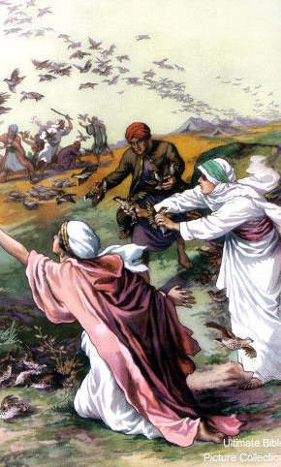
Sources of Trouble
Desire for variety (Num. 11:4-6; 21:5).
Dissatisfaction/complaining (Num. 12; 16).
Thinking that God hasn’t thought/planned/revealed enough (1 Sam. 15).
Applications:
  Worship.
  Organization.
  Work/Activities.

Slide 3
Sources of Trouble Among God’s People
~ Number 11:4-6

