Slide 1
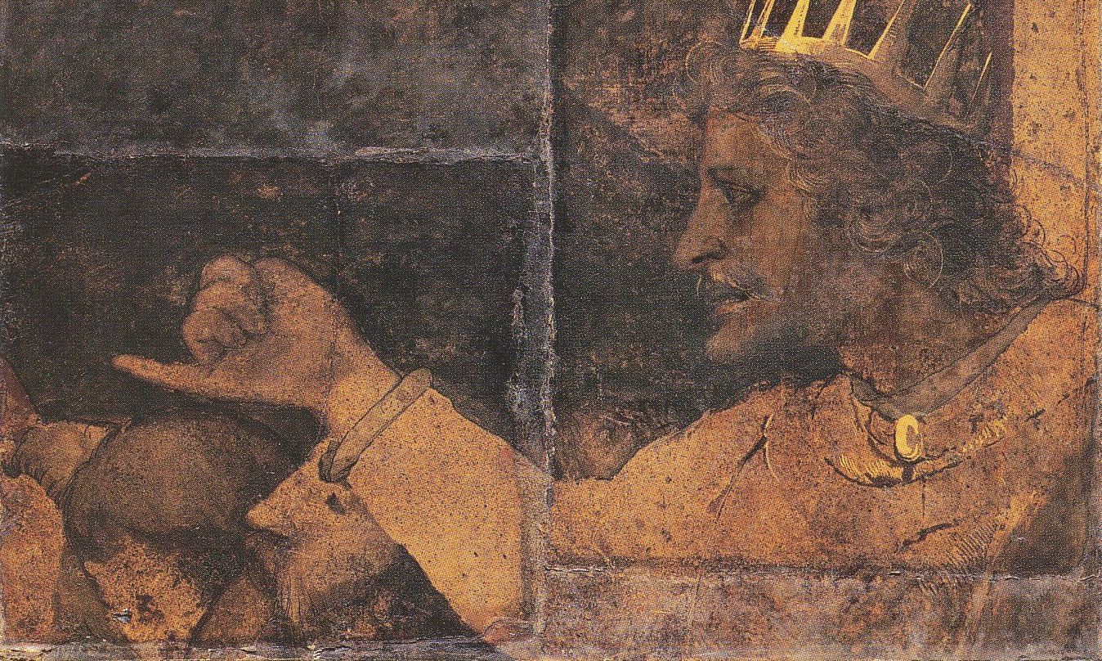
The High Cost of Foolish Counsel
~ 1 Kings 12:1–16

Slide 2

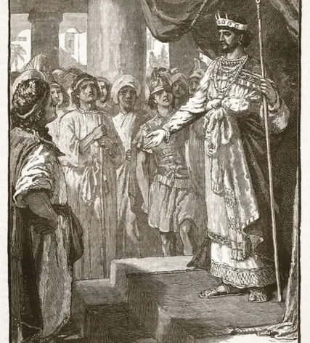
Introduction
After Solomon’s death, Rehoboam takes throne.
Israel was prosperous but restless.
The people ask for lighter labor & taxes.
Rehoboam seeks two types of counsel:
  Elders: Urged mercy & gentleness.
  Younger men: Urged harshness & power.
He follows the foolish advice → Kingdom divides.

Slide 3
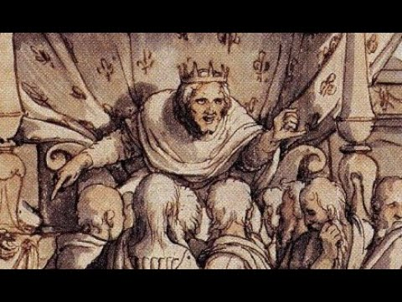
The High Cost of Foolish Counsel
Not just a political story — a spiritual warning.
About leadership, pride, and the voices we follow.
True leadership requires:
  Humility
  Discernment
  Godly counsel

Slide 4
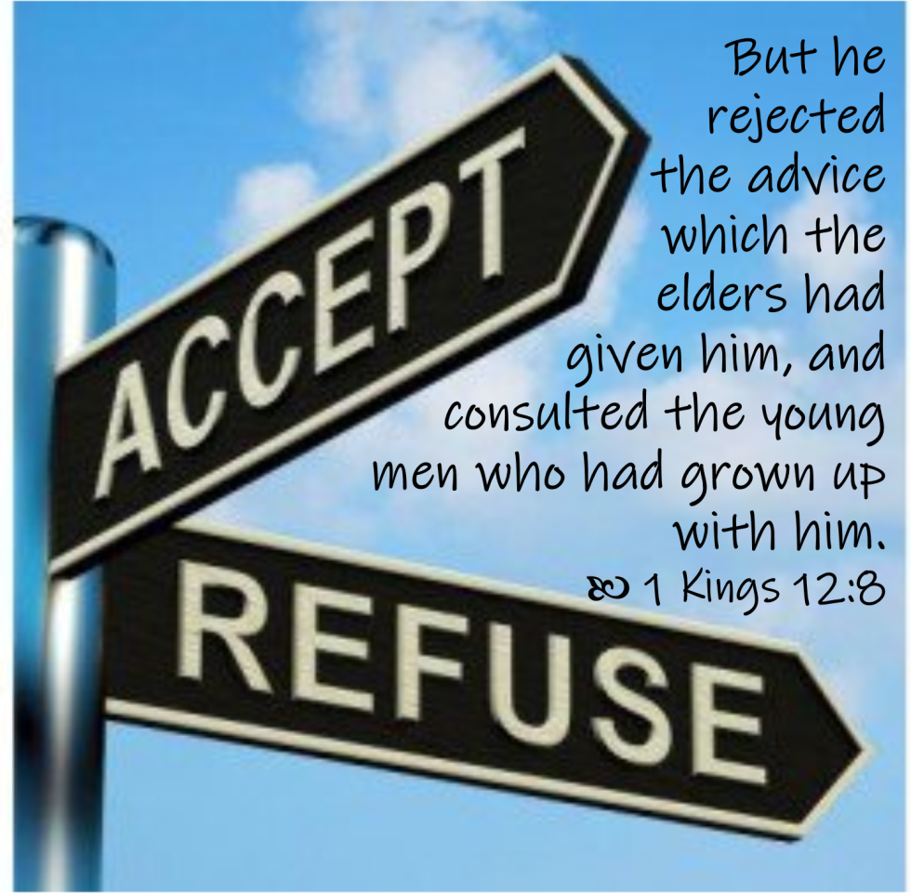
Rejecting Godly Counsel Leads to Ruin
Wisdom is available.
1 Ki. 12:6-8; Prov. 11:14; Jas. 1:19; 1 Sam. 15; Exod. 18:17–24
Leaders fail when isolated from accountability.
Who speaks into your life—wise mentors or flattering peers?

Slide 5
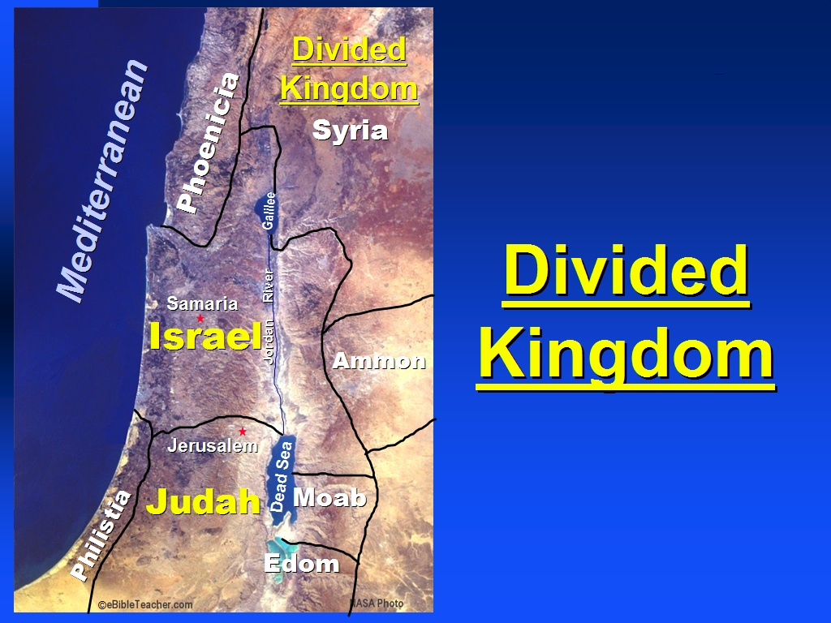
Pride Divides, Humility Unites
Rehoboam used power to dominate, not serve → Division.
1 Ki. 12:13-16; Prov. 16:18–19; Phil. 2:3–4; Isa. 14:12–15; Jn. 13:1–17; Phil. 2:5–8
Pride divides, humility unites.
True followers of Christ pursue peace, not pride.

Slide 6
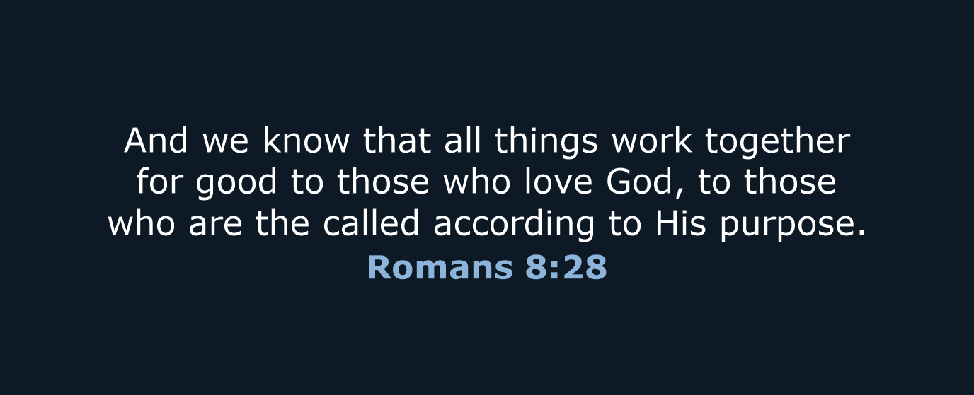
God Redeems Our Failures for His Purpose
Even in Rehoboam’s failure, God’s plan stood firm.
  1 Ki. 12:15; Rom. 8:28; Gen. 50:20
Leadership failure ≠ Final failure.
The same hand that allowed the kingdom to split can rebuild your life.

Slide 7
Conclusion
Rehoboam’s tragedy:
Not lack of wisdom, but rejection of wisdom.
God calls us to:
Seek counsel from Him.
Walk humbly in leadership & relationships.
Trust Him to redeem even our worst mistakes.
Ask yourself this week:
Whose counsel am I following?
Am I walking in humility—or pride?
Am I allowing God to redeem my failures for His glory?

