Slide 1

Transgenderism:
What Does God Say?

Slide 2
Transgenderism
Gender expressions continue changing…
Causing concern in how to respond.
Much information is available in making arguments to accept…
Does God’s word provide guidance in this matter?

Slide 3
Transgender & Gender Identity
Transgender is an umbrella term for persons whose gender identity, gender expression or behavior does not conform to that typically associated with the sex to which they were assigned at birth. Gender identity refers to a person’s internal sense of being male, female or something else; gender expression refers to the way a person communicates gender identity to others through behavior, clothing, hairstyles, voice or body characteristics. “Trans” is sometimes used as shorthand for “transgender.” While transgender is generally a good term to use, not everyone whose appearance or behavior is gender-nonconforming will identify as a transgender person. The ways that transgender people are talked about in popular culture, academia and science are constantly changing, particularly as individuals’ awareness, knowledge and openness about transgender people and their experiences grow. https://www.apa.org/topics/lgbtq/transgender

Slide 4
Gender Binary
Definition: (1) a classification system consisting of two genders, male and female. (2) a concept or belief that there are only two genders and that one's sex or gender assigned at birth will align with traditional social constructs of masculine and feminine identity, expression, and sexuality. https://www.dictionary.com/browse/gender-binary

Slide 5
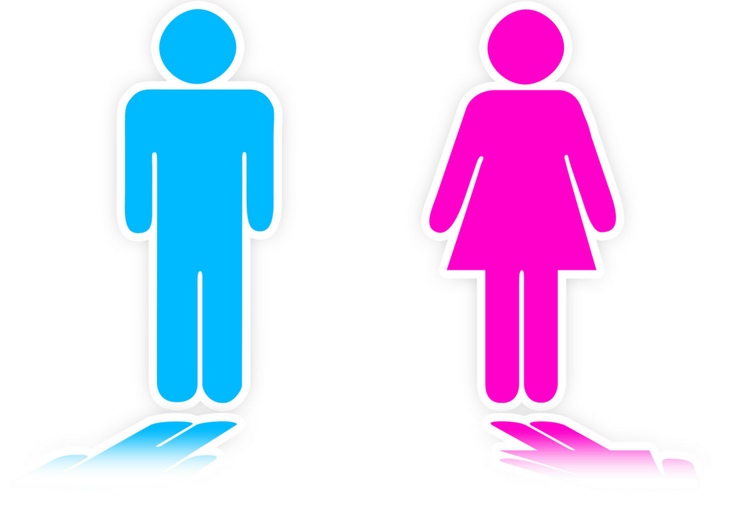
Gender Binary
Scripture operates with the binary categories of men & women (Matt. 19:4-5, 11-12)
When God created humans, He created them male & female (Gen. 1:27; 2:18-22; Cf. 1 Tim. 2:8-15)
When male & female engage in sexual relations, the two become one flesh (Gen. 1:28; 2:23-24)
Birth defects are a reality to grapple with in a broken world (Gen. 3:17-18)

Slide 6
Gender Identity
Gender identity refers to a person’s internal sense of being male, female or something else; gender expression refers to the way a person communicates gender identity to others through behavior, clothing, hairstyles, voice or body characteristics. “Trans” is sometimes used as shorthand for “transgender.” While transgender is generally a good term to use, not everyone whose appearance or behavior is gender-nonconforming will identify as a transgender person. https://www.dictionary.com/browse/gender-binary

Slide 7
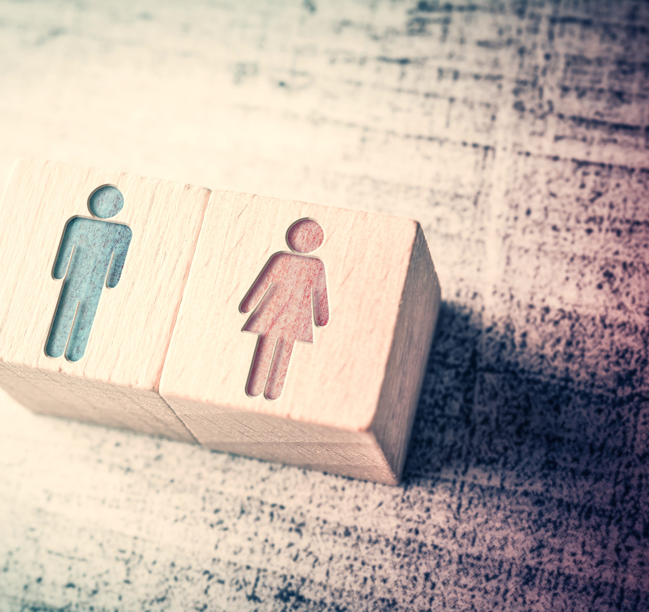
Gender Identity
Following Christ means to deny ourselves (Matt. 16:24-25)
We are not be conformed to this world but transformed by the renewing of our minds (Rom. 12:2)
We are instructed to no longer walk as we once did (Eph. 4:17-24)
God teaches the unity of biological sex & gender identity (Gen. 1:27; 2:18, 20, 24)
The unity of biological sex & gender identity is why homosexuality is a sin (Lev. 18:22; 1 Cor. 6:9)
The Apostle Paul spoke of homosexual relations as deviating from natural relations (Rom. 1:26-27)

Slide 8
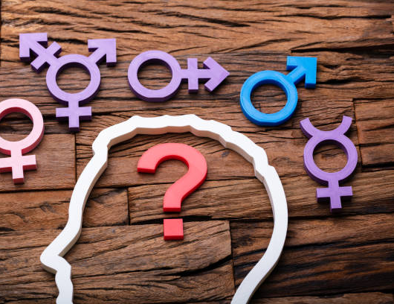
Gender Confusion?
God is not the author of confusion (1 Cor. 14:33)
Men should not act sexually as women (Lev. 18:22; Rom. 1:18-32; 1 Cor. 6:9-10)
Men are not to dress like women (Duet. 22:5)
When men & women embrace other-gendered expressions of identity it is a disgrace (1 Cor. 11:14-15)
We do not have a right to do whatever we wish with our bodies (1 Cor. 6:19-20)

Slide 9
Transgenderism:
What Does God Say?

