Slide 1
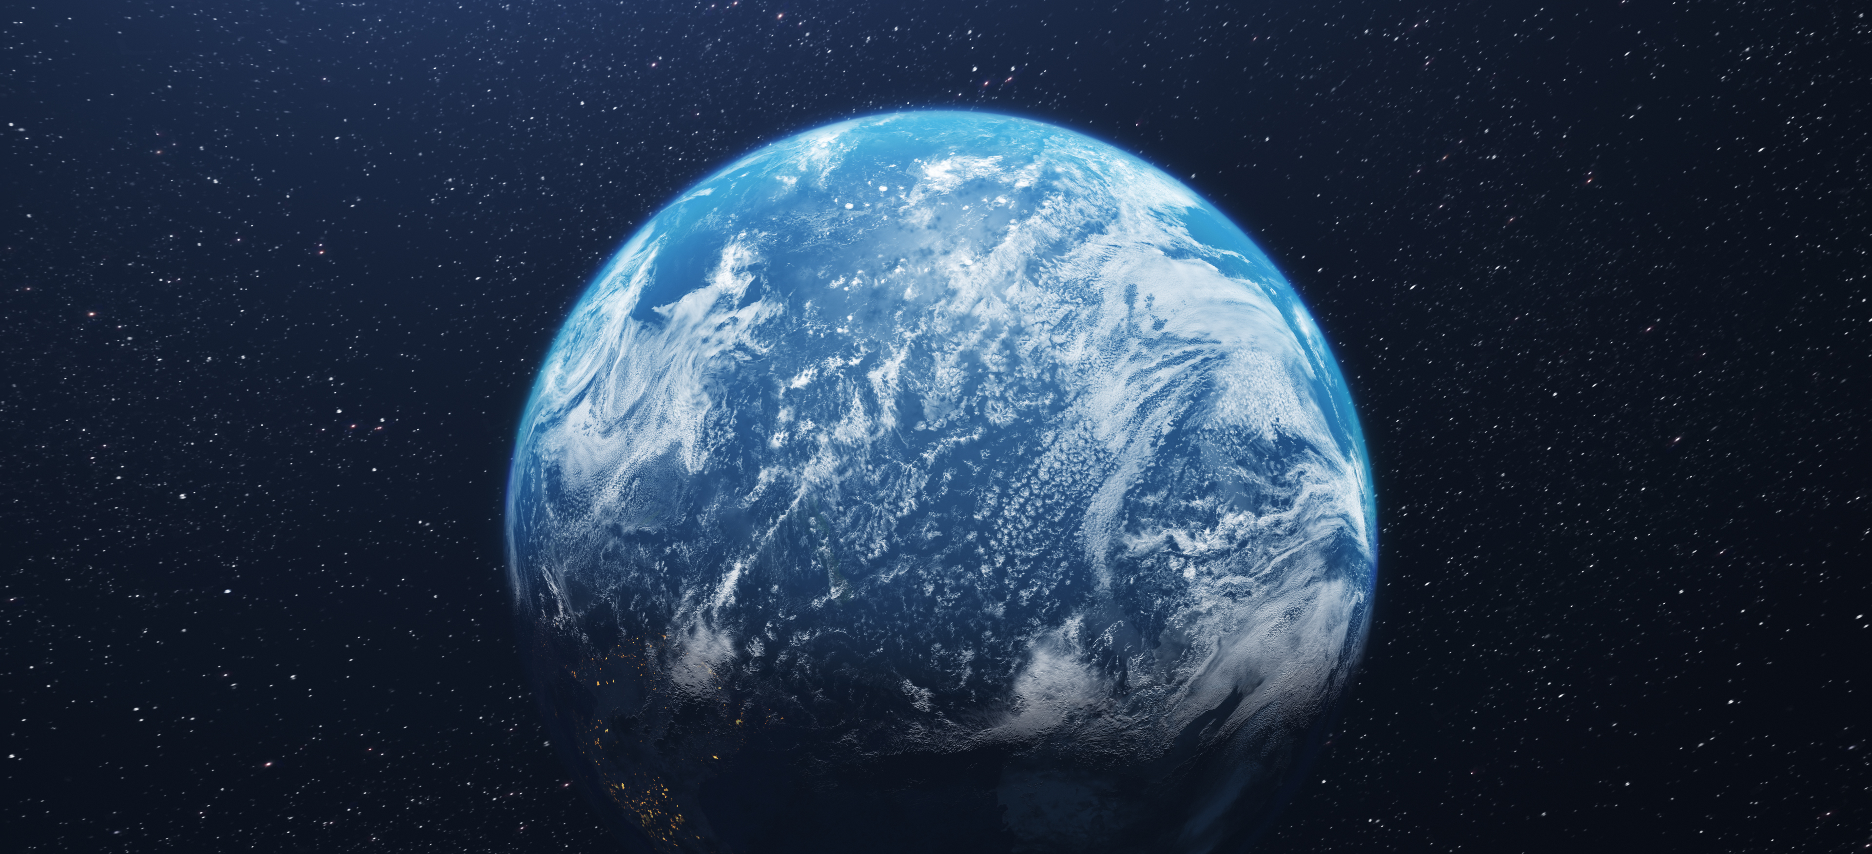
We Wish to See Jesus
In Creation & Providence

Slide 2
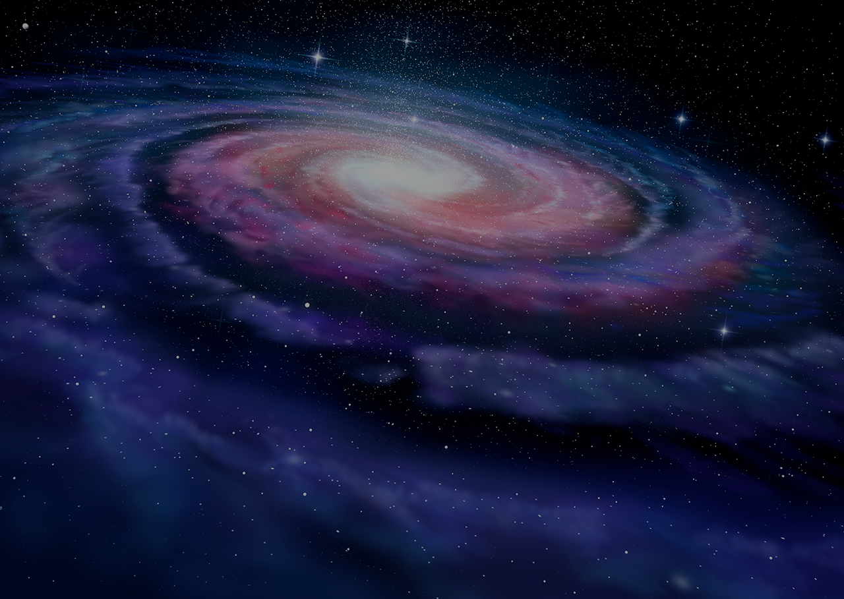
1 In the beginning was the Word, and the Word was with God, and the Word was God.
2 He was in the beginning with God.
3 All things were made through Him, and without Him nothing was made that was made.
4 In Him was life, and the life was the light of men.
5 And the light shines in the darkness, and the darkness did not comprehend it.
~ John 1:1-5, NKJV

Slide 3
God spoke light into existence, day one (Gen 1:3-5).
Firmament, day two (Gen 1:6-8).
Dry land, day three (Gen 1:9-13).
Lights in the firmament of the heavens, day four (Gen 1:14-19).
Birds & sea creatures, day five (Gen 1:20-23).
Both beasts & mankind, sixth day (Gen 1:24-31).
When God said, “Let Us make man in Our image” (Gen 1:26), to whom did He speak?
  "God" in chapter is “Elohim,” plural in form.
  Commonly referring to the Godhead.
  Subsequent revelation of God's threefold existence in the Father, the Son, and the Holy Spirit. All three are Deity & were involved in creation (Job 26:13; John 1:1-3).
  Simply put, three divine beings compose God, thus the plural term, "Elohim," even though it refers to the one Godhead.

Slide 4
11 For in six days the LORD made the heavens and the earth, the sea, and all that is in them, and rested the seventh day. Therefore the LORD blessed the Sabbath day and hallowed it.
~ Exodus 20:11, NKJV
6 You covered it with the deep as with a garment; The waters stood above the mountains.
7 At Your rebuke they fled; At the voice of Your thunder they hastened away.
8 They went up over the mountains; They went down into the valleys, to the place which You founded for them.
9 You have set a boundary that they may not pass over, that they may not return to cover the earth.
~ Psalm 104:6-9, NKJV
5 Thus says God the LORD, Who created the heavens and stretched them out, Who spread forth the earth and that which comes from it, Who gives breath to the people on it, and spirit to those who walk on it:
~ Isaiah 42:5, NKJV

Slide 5
14 But when the apostles Barnabas and Paul heard this, they tore their clothes and ran in among the multitude, crying out
15 and saying, “Men, why are you doing these things? We also are men with the same nature as you, and preach to you that you should turn from these useless things to the living God, who made the heaven, the earth, the sea, and all things that are in them,
16 who in bygone generations allowed all nations to walk in their own ways.
~ Acts 14:14-16, NKJV

Slide 6
24 “God, who made the world and everything in it, since He is Lord of heaven and earth, does not dwell in temples made with hands.
25 Nor is He worshiped with men’s hands, as though He needed anything, since He gives to all life, breath, and all things.
26 And He has made from one blood every nation of men to dwell on all the face of the earth, and has determined their preappointed times and the boundaries of their dwellings,
27 so that they should seek the Lord, in the hope that they might grope for Him and find Him, though He is not far from each one of us;
28 for in Him we live and move and have our being, as also some of your own poets have said, ‘For we are also His offspring.’”
~ Acts 17:24-28, NKJV

Slide 7
Application:
Do you have honest questions about the inequities of life? Christ can increase your faith (Mark 9:24)!
Do you struggle with pains, heartaches, and temptation? Jesus can sympathize with your weaknesses and grant strength for you to overcome (Hebrews 4:14-16)!
Fixing a faithful gaze upon Him leads us through the storms of life (Matthew 14:22-33)
Christ promises that even through death, He will provide for all our spiritual needs and desires (Revelation 3:21).
Seeing Jesus in all creation is therefore worthy of meditation: If God can create everything in the universe through six days, imagine what He can do for you, personally!

Slide 8
Creation & Providence
“God is called Elohim from Genesis 2:4 through 3:24. God is emphasizing that Elohim the Creator is also the God who manifests Himself to man and deals with man in a personal way. The word Jehovah is developed from the Hebrew imperfect of the verb “to be.” Jehovah is the “manifested One,” the one who shows Himself to man throughout history. The combination of the two names shows that Jehovah, who manifests Himself from time to time in the affairs of men, is also the eternal god who made the heavens and the earth. That is: Elohim, the God of eternity, is also Jehovah, the God of time and history. This refutes any theory that indicates God, or some Supreme Being, created the earth and life, and then left it to its own devices.”
~ Page 22 of Bob & Sandra Waldron’s book, “In the Beginning, God.”

Slide 9
Oxford Languages
Miracle: "a surprising and welcome event that is not explicable by natural or scientific laws and is therefore considered to be the work of a divine agency.”
Providence: "the protective care of God or nature as a spiritual power.” (b) “timely preparation for future eventualities.”

Slide 10
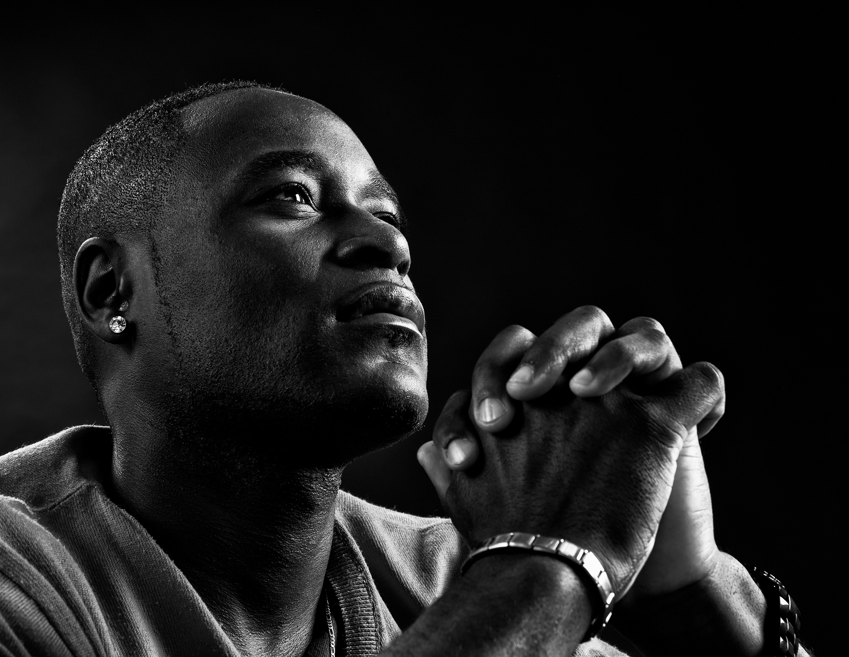
Providence
Despite the dreams that foretold future events and the miraculous ability to interpret dreams, Joseph's life largely unfolded through natural events (Genesis 50:19-20).
Another example is the story of Esther (Esther 4:14).
James emphasizes that Elijah, a mortal man, prayed and received answers (James 5:13-20).
We can be confident that God not only has the ability but also the willingness to intervene in our lives today.

Slide 11
“Then the Lord said to Joshua, 'This day I have rolled away the reproach of Egypt from you.' Therefore, the name of the place is called Gilgal to this day. Now the children of Israel camped in Gilgal, and kept the Passover on the fourteenth day of the month at twilight on the plains of Jericho. And they ate of the produce of the land on the day after the Passover, unleavened bread and parched grain, on the very same day. Then the manna ceased on the day after they had eaten the produce of the land; and the children of Israel no longer had manna, but they ate the food of the land of Canaan that year.” ~ Joshua 5:9-12

Slide 12
16 For by him all things were created, in heaven and on earth, visible and invisible, whether thrones or dominions or rulers or authorities—all things were created through him and for him.
17 And he is before all things, and in him all things hold together.
~ Colossians 1:16-17, ESV

Slide 13
We Wish to See Jesus
In Creation & Providence

