Slide 1
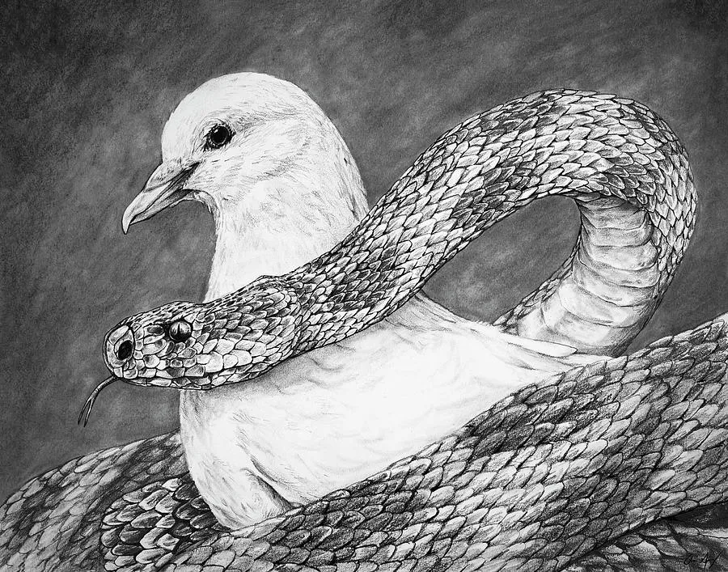
Wise and Harmless: Living the Gospel in a Hostile World
~ Matthew 10:16

Slide 2
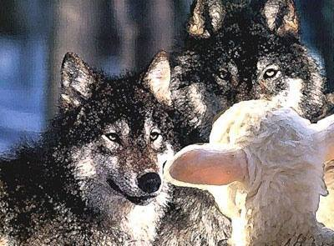
We Are Sent into a Dangerous World
Matthew 10:16: Behold, I send you out as sheep in the midst of wolves. Therefore be wise as serpents and harmless as doves.
  Sheep alone among wolves—unnatural, vulnerable, but sent with purpose and protection.
Biblical Examples: Daniel (Dan. 1-6), Jesus (Jn 1:11).
Application: Expect opposition, but take heart (Jn. 17:18).

Slide 3
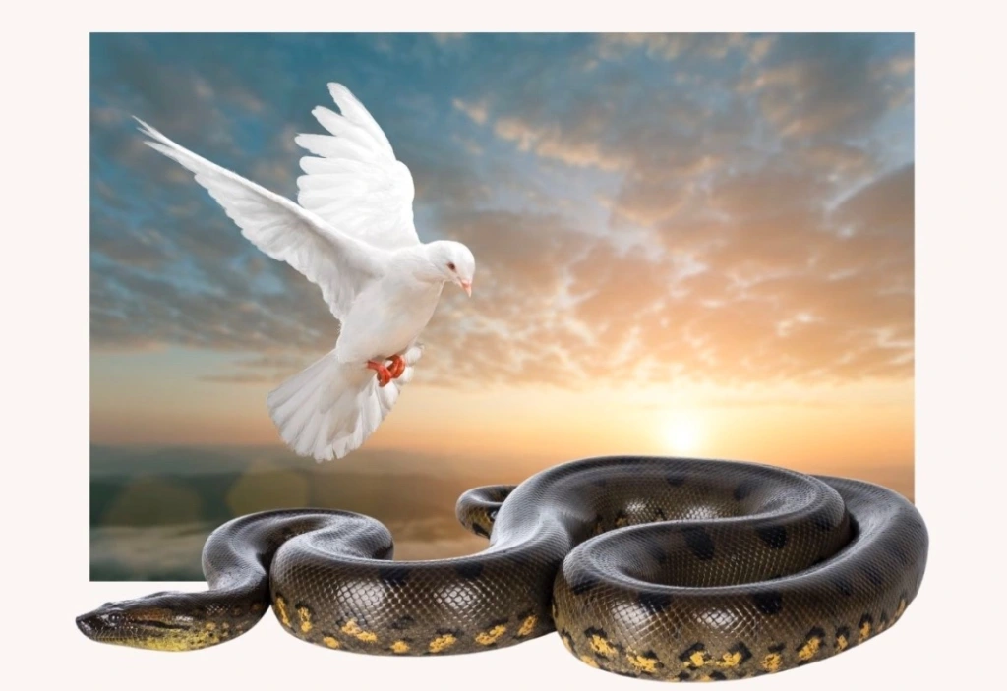
Be Wise as Serpents
Matthew 10:16: Behold, I send you out as sheep in the midst of wolves. Therefore be wise as serpents and harmless as doves.
  Serpents symbolize shrewdness—Jesus calls for awareness, not deceit.
Biblical Examples: David (1 Sam. 18:14-15), Paul (Acts 23:6), Nehemiah (Neh. 2:11–20). See (Prov. 4:7; Col. 4:5).
Application: Be thoughtful, not reckless (Jas. 1:5; Matt. 10:16–20).

Slide 4
Be Harmless as Doves
Matthew 10:16: Behold, I send you out as sheep in the midst of wolves. Therefore be wise as serpents and harmless as doves.
  Doves symbolize innocence and peace—strength under control.
Biblical Examples: Stephen (Acts 7:60), Joseph (Gen. 50:20). See (Prov. 15:1; Phil. 2:14–15; Rom. 12:21).
Application: Keep your heart pure under pressure. Never let others’ hostility compromise your character.

Slide 5

Conclusion
Jesus calls us to a hard but holy balance:
  Sharp minds: wise as serpents!
  Soft hearts: harmless as doves!!
  Brave obedience: sheep among wolves!!!

Slide 6

Final Challenge
Reflection Questions:
  Are you wise without losing your innocence?
  Gentle without being gullible?
  Walking like Christ—in wisdom and love?
Call to Action:
  Let your life pierce darkness with both truth AND grace!

