Slide 1

Review of the Bible Story
From Genesis to Revelation

Slide 2
17 Periods of Bible History
Before the Flood
The Flood
The Scattering of the People
The Patriarchs
The Exodus
Wandering in the Wilderness
Invasion and Conquest
The Judges
United Kingdom
Divided Kingdom
Judah Alone
The Captivity
Return from Captivity
Years of Silence
Life of Christ
Early Church
Letters to the Christians

Slide 3
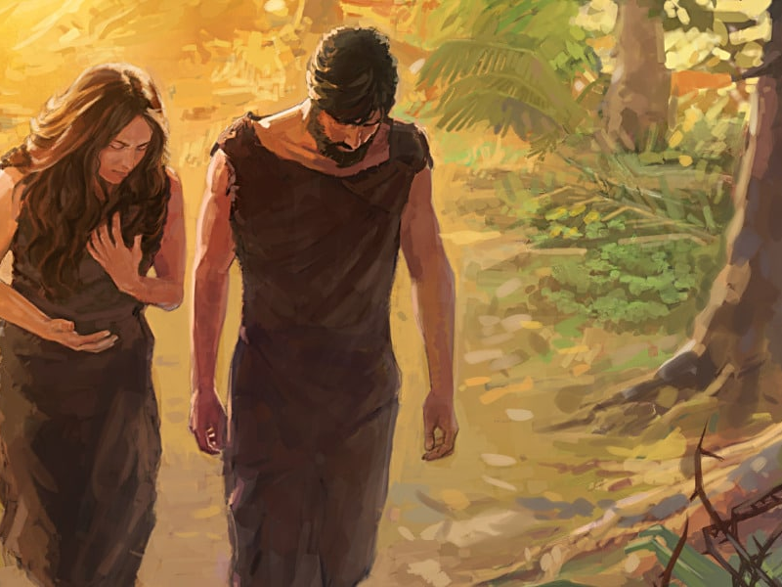
Before the Flood
27 So God created man in His own image; in the image of God He created him; male and female He created them. (Genesis 1:27)
15 And I will put enmity between you and the woman, and between your seed and her Seed; He shall bruise your head, and you shall bruise His heel. (Genesis 3:15)
10 to the intent that now the manifold wisdom of God might be made known by the church to the principalities and powers in the heavenly places, 11 according to the eternal purpose which He accomplished in Christ Jesus our Lord (Ephesians 3:10-11)

Slide 4
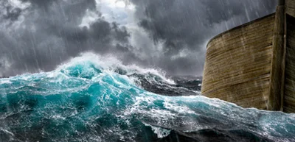
The Flood
6 And the Lord was sorry that He had made man on the earth, and He was grieved in His heart. 7 So the Lord said, “I will destroy man whom I have created from the face of the earth, both man and beast, creeping thing and birds of the air, for I am sorry that I have made them.” 8 But Noah found grace in the eyes of the Lord. (Genesis 6:6-8)

Slide 5
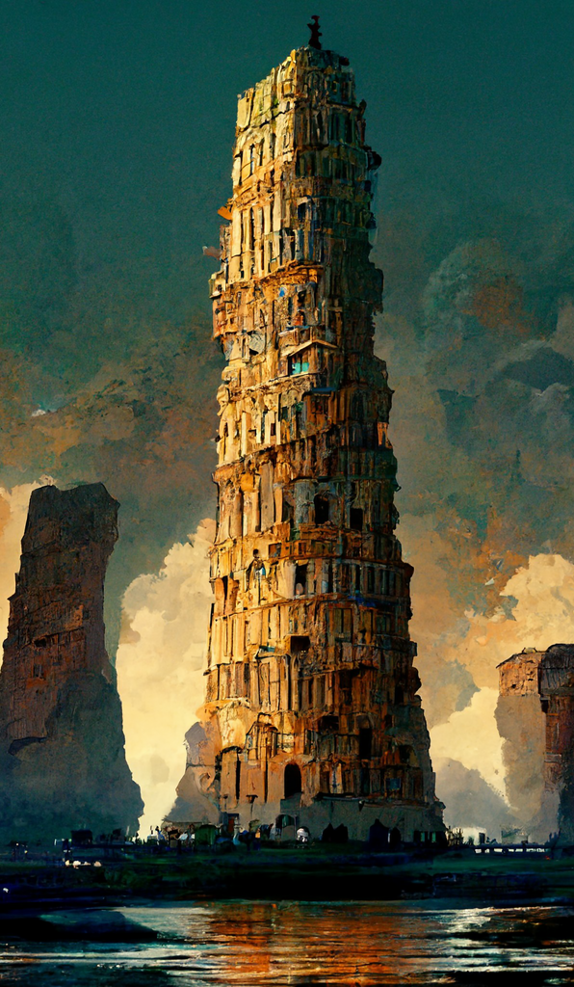
The Scattering of the People
5 But the Lord came down to see the city and the tower which the sons of men had built. 6 And the Lord said, “Indeed the people are one and they all have one language, and this is what they begin to do; now nothing that they propose to do will be withheld from them. 7 Come, let Us go down and there confuse their language, that they may not understand one another’s speech.” 8 So the Lord scattered them abroad from there over the face of all the earth, and they ceased building the city. (Genesis 11:5-8)

Slide 6
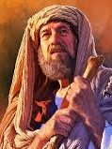
The Patriarchs
1 Now the Lord had said to Abram: “Get out of your country, from your family and from your father’s house, to a land that I will show you. 2 I will make you a great nation; I will bless you and make your name great; And you shall be a blessing. 3 I will bless those who bless you, and I will curse him who curses you; And in you all the families of the earth shall be blessed.”
7 Then the Lord appeared to Abram and said, “To your descendants I will give this land.” And there he built an altar to the Lord, who had appeared to him. (Genesis 12:1-3, 7)

Slide 7
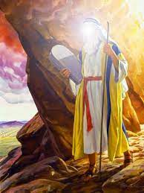
The Exodus
3 And Moses went up to God, and the Lord called to him from the mountain, saying, “Thus you shall say to the house of Jacob, and tell the children of Israel: 4 ‘You have seen what I did to the Egyptians, and how I bore you on eagles’ wings and brought you to Myself. 5 Now therefore, if you will indeed obey My voice and keep My covenant, then you shall be a special treasure to Me above all people; for all the earth is Mine. 6 And you shall be to Me a kingdom of priests and a holy nation.’ These are the words which you shall speak to the children of Israel.” 7 So Moses came and called for the elders of the people, and laid before them all these words which the Lord commanded him. 8 Then all the people answered together and said, “All that the Lord has spoken we will do.” So Moses brought back the words of the people to the Lord. (Exodus 19:3-8)

Slide 8
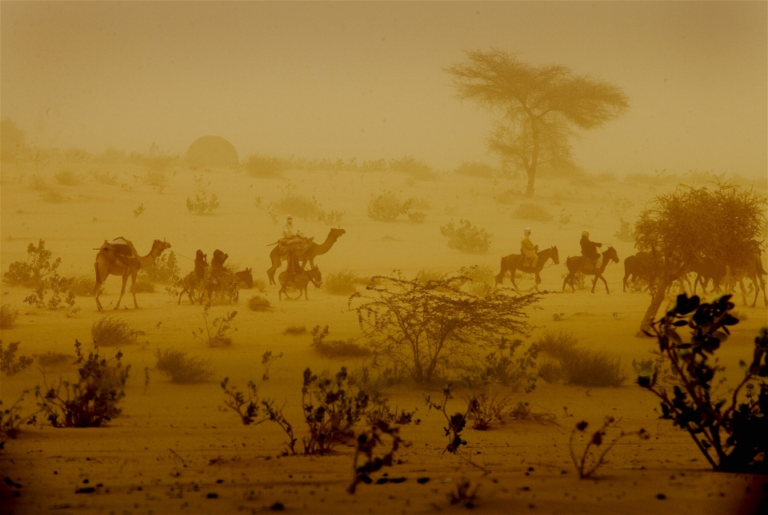
Wandering in the Wilderness
30 Except for Caleb the son of Jephunneh and Joshua the son of Nun, you shall by no means enter the land which I swore I would make you dwell in. 31 But your little ones, whom you said would be victims, I will bring in, and they shall know the land which you have despised. 32 But as for you, your carcasses shall fall in this wilderness. 33 And your sons shall be shepherds in the wilderness forty years, and bear the brunt of your infidelity, until your carcasses are consumed in the wilderness. 34 According to the number of the days in which you spied out the land, forty days, for each day you shall bear your guilt one year, namely forty years, and you shall know My rejection. 35 I the Lord have spoken this. I will surely do so to all this evil congregation who are gathered together against Me. In this wilderness they shall be consumed, and there they shall die.’ ” (Numbers 14:30-35)

Slide 9
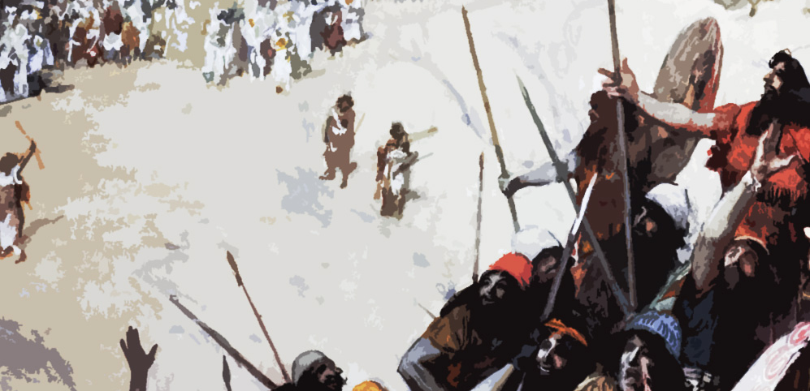
Invasion and Conquest of the Land
43 So the Lord gave to Israel all the land of which He had sworn to give to their fathers, and they took possession of it and dwelt in it. 44 The Lord gave them rest all around, according to all that He had sworn to their fathers. And not a man of all their enemies stood against them; the Lord delivered all their enemies into their hand. 45 Not a word failed of any good thing which the Lord had spoken to the house of Israel. All came to pass. (Joshua 21:43-45)

Slide 10
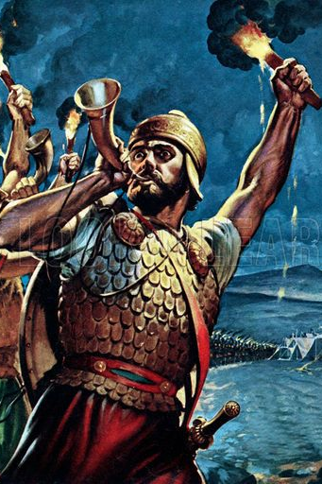
The Judges
1 Then the Angel of the Lord came up from Gilgal to Bochim, and said: “I led you up from Egypt and brought you to the land of which I swore to your fathers; and I said, ‘I will never break My covenant with you. 2 And you shall make no covenant with the inhabitants of this land; you shall tear down their altars.’ But you have not obeyed My voice. Why have you done this? 3 Therefore I also said, ‘I will not drive them out before you; but they shall be thorns in your side, and their gods shall be a snare to you.’ ” (Judges 2:1-3)

Slide 11
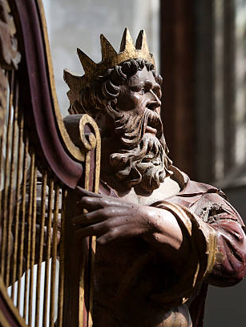
The United Kingdom
12 “When your days are fulfilled and you rest with your fathers, I will set up your seed after you, who will come from your body, and I will establish his kingdom. 13 He shall build a house for My name, and I will establish the throne of his kingdom forever. 14 I will be his Father, and he shall be My son. If he commits iniquity, I will chasten him with the rod of men and with the blows of the sons of men. 15 But My mercy shall not depart from him, as I took it from Saul, whom I removed from before you. 16 And your house and your kingdom shall be established forever before you. Your throne shall be established forever.” ’ ” (2 Samuel 7:12-16)

Slide 12
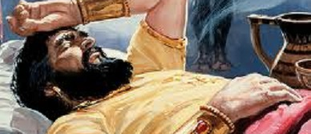
The Divided Kingdom
9 So the Lord became angry with Solomon, because his heart had turned from the Lord God of Israel, who had appeared to him twice, 10 and had commanded him concerning this thing, that he should not go after other gods; but he did not keep what the Lord had commanded. 11 Therefore the Lord said to Solomon, “Because you have done this, and have not kept My covenant and My statutes, which I have commanded you, I will surely tear the kingdom away from you and give it to your servant. 12 Nevertheless I will not do it in your days, for the sake of your father David; I will tear it out of the hand of your son. 13 However I will not tear away the whole kingdom; I will give one tribe to your son for the sake of My servant David, and for the sake of Jerusalem which I have chosen.” (1 Kings 11:9-13)

Slide 13
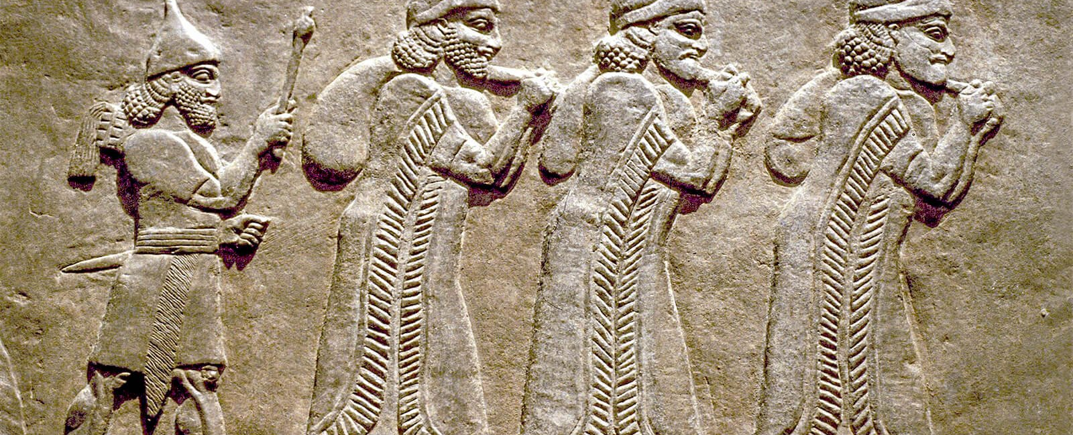
Judah
Alone
19 Also Judah did not keep the commandments of the Lord their God, but walked in the statutes of Israel which they made. 20 And the Lord rejected all the descendants of Israel, afflicted them, and delivered them into the hand of plunderers, until He had cast them from His sight. 21 For He tore Israel from the house of David, and they made Jeroboam the son of Nebat king. Then Jeroboam drove Israel from following the Lord, and made them commit a great sin. 22 For the children of Israel walked in all the sins of Jeroboam which he did; they did not depart from them, 23 until the Lord removed Israel out of His sight, as He had said by all His servants the prophets. So Israel was carried away from their own land to Assyria, as it is to this day. (2 Kings 17:19-23)

Slide 14
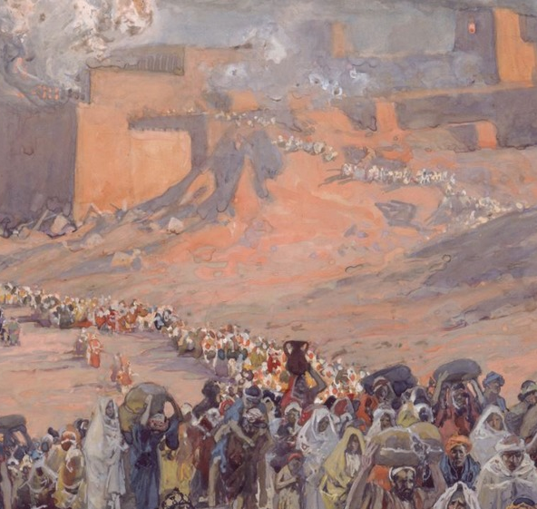
The Captivity
12 Now in the fifth month, on the tenth day of the month (which was the nineteenth year of King Nebuchadnezzar king of Babylon), Nebuzaradan, the captain of the guard, who served the king of Babylon, came to Jerusalem. 13 He burned the house of the Lord and the king’s house; all the houses of Jerusalem, that is, all the houses of the great, he burned with fire. 14 And all the army of the Chaldeans who were with the captain of the guard broke down all the walls of Jerusalem all around. 15 Then Nebuzaradan the captain of the guard carried away captive some of the poor people, the rest of the people who remained in the city, the defectors who had deserted to the king of Babylon, and the rest of the craftsmen. 16 But Nebuzaradan the captain of the guard left some of the poor of the land as vinedressers and farmers.
(Jeremiah 52:12-16)

Slide 15
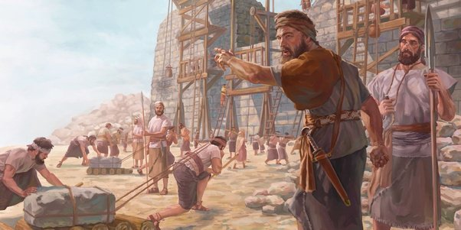
Return from Captivity
1 Now in the first year of Cyrus king of Persia, that the word of the Lord by the mouth of Jeremiah might be fulfilled, the Lord stirred up the spirit of Cyrus king of Persia, so that he made a proclamation throughout all his kingdom, and also put it in writing, saying, 2Thus says Cyrus king of Persia: All the kingdoms of the earth the Lord God of heaven has given me. And He has commanded me to build Him a house at Jerusalem which is in Judah. 3 Who is among you of all His people? May his God be with him, and let him go up to Jerusalem which is in Judah, and build the house of the Lord God of Israel (He is God), which is in Jerusalem. 4 And whoever is left in any place where he dwells, let the men of his place help him with silver and gold, with goods and livestock, besides the freewill offerings for the house of God which is in Jerusalem. (Ezra 1:1-4)

Slide 16
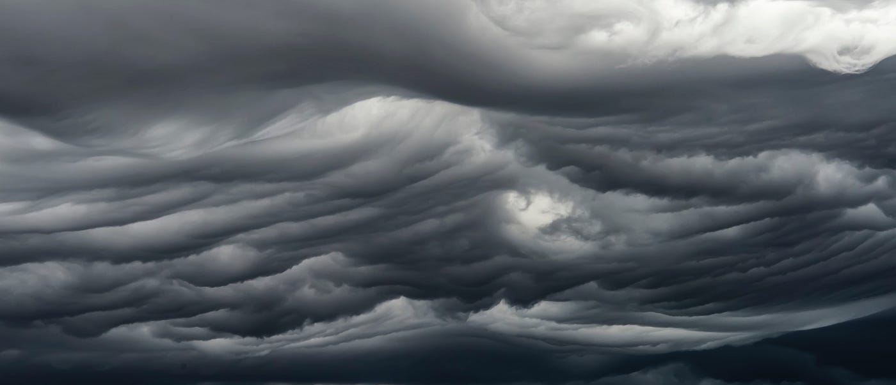
The Years of Silence
11 “Behold, the days are coming,” says the Lord God, “That I will send a famine on the land, not a famine of bread, nor a thirst for water, but of hearing the words of the Lord.” (Amos 8:11)

Slide 17
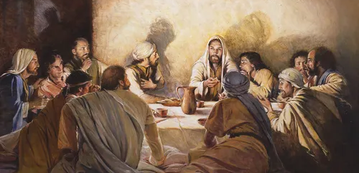
The Life of Christ
26 And as they were eating, Jesus took bread, blessed and broke it, and gave it to the disciples and said, “Take, eat; this is My body.” 27 Then He took the cup, and gave thanks, and gave it to them, saying, “Drink from it, all of you. 28 For this is My blood of the new covenant, which is shed for many for the remission of sins. 29 But I say to you, I will not drink of this fruit of the vine from now on until that day when I drink it new with you in My Father’s kingdom.” (Matthew 26:26-29)

Slide 18
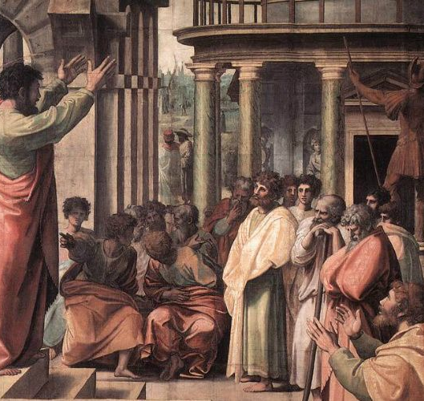
The Early Church
36 “Therefore let all the house of Israel know assuredly that God has made this Jesus, whom you crucified, both Lord and Christ.” 37 Now when they heard this, they were cut to the heart, and said to Peter and the rest of the apostles, “Men and brethren, what shall we do?” 38 Then Peter said to them, “Repent, and let every one of you be baptized in the name of Jesus Christ for the remission of sins; and you shall receive the gift of the Holy Spirit. 39 For the promise is to you and to your children, and to all who are afar off, as many as the Lord our God will call.” (Acts 2:36-38)

Slide 19
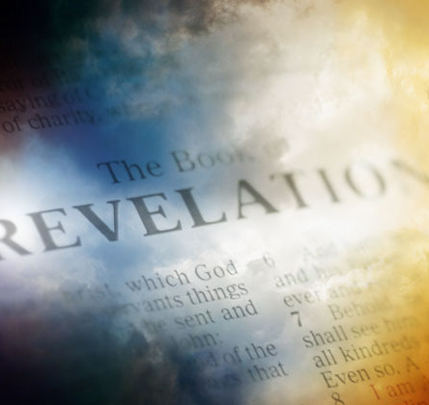
Letters to the Christians
12 “And behold, I am coming quickly, and My reward is with Me, to give to every one according to his work. 13 I am the Alpha and the Omega, the Beginning and the End, the First and the Last.” 14 Blessed are those who do His commandments, that they may have the right to the tree of life, and may enter through the gates into the city. 15 But outside are dogs and sorcerers and sexually immoral and murderers and idolaters, and whoever loves and practices a lie. 16 “I, Jesus, have sent My angel to testify to you these things in the churches. I am the Root and the Offspring of David, the Bright and Morning Star.” 17 And the Spirit and the bride say, “Come!” And let him who hears say, “Come!” And let him who thirsts come. Whoever desires, let him take the water of life freely. (Revelation 22:12-17)

Slide 20
Review of the Bible Story
From Genesis to Revelation

