Slide 1

The Need for Consistency
~ Matthew 5:37

Slide 2
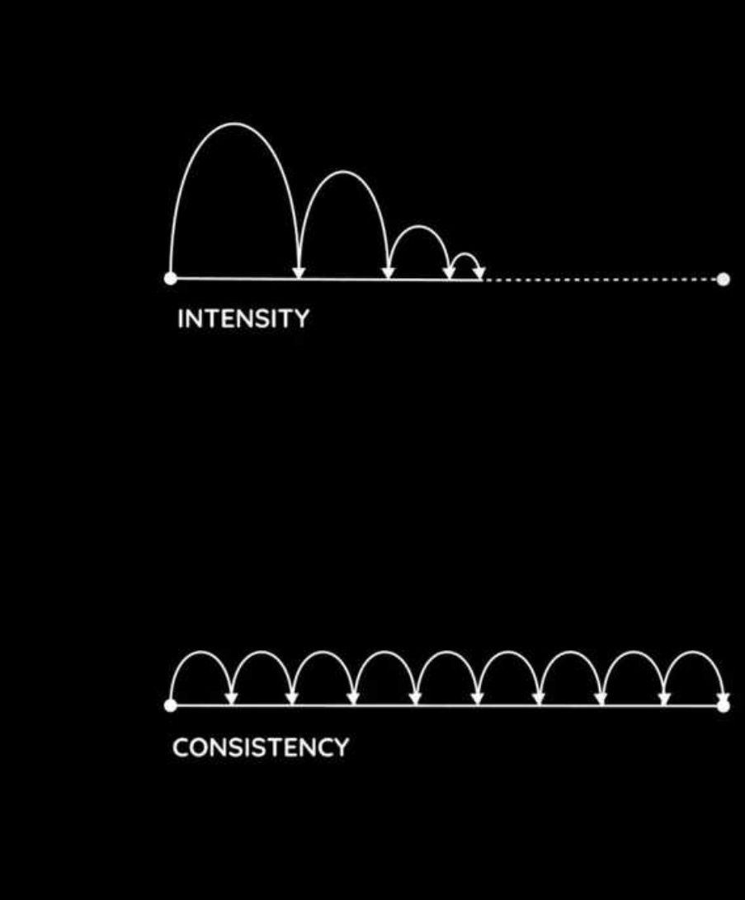
The Need for Consistency
Scripture presents faith not merely as what we confess, but as how we live over time (Jas. 2:14-26).
God is not honored by isolated moments of intensity, but by steady, faithful obedience.

Slide 3
The Need for Consistency

Slide 4
The Need for Consistency
Consistency reveals the genuineness of our faith.
  Jas .1:21-27; Lk. 7:43-45; 1 Jn. 2:3–6; Tit. 1:16; Matt. 7:24–27

Slide 5
The Need for Consistency
Consistency reveals the genuineness of our faith.
Inconsistency undermines our influence and relationships.
    Matt. 5:37; Lk. 16:10; Prov. 25:19; Gal. 2:11-14

Slide 6
The Need for Consistency
Consistency reveals the genuineness of our faith.
Inconsistency undermines our influence and relationships.
Consistency is formed through perseverance, not emotion.
  Lk. 9:62; Heb. 12:11; Gal. 6:9; 1 Cor. 15:58; Lk. 18:1–8

Slide 7
The Need for Consistency
~ Matthew 5:37

