Slide 1

The Need for Contentment
~ Philippians 4:11

Slide 2
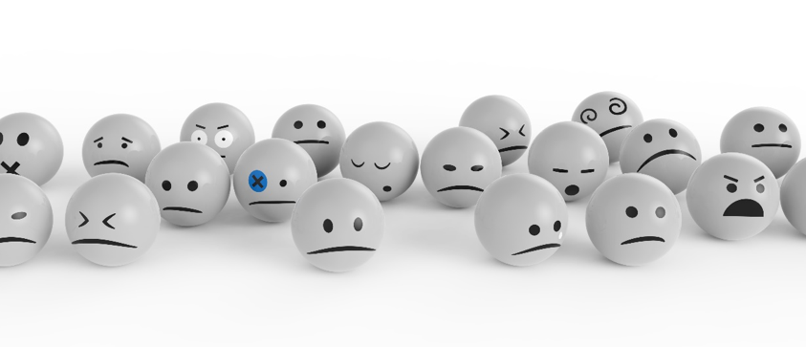
The Need for Contentment
Discontent may develop quietly through constant comparisons to others and fostering the sense that things work, if only something were different.
Scripture treats discontent as a spiritual danger, while contentment is disciplined trust in God’s wisdom provision.

Slide 3

The Need for Contentment

Slide 4
The Need for Contentment
Discontent: When desire detaches from trust in God
  Exod. 16:2–8; Num. 11:4–6; Heb. 13:5; Psa. 106:8–15

Slide 5
The Need for Contentment
Discontent: When desire detaches from trust in God
Discontent: Distorts judgment & leads to poor choices
  1 Sam. 15:10–23; 1 Tim. 6:6–10; Prov. 27:20; Eccl. 4:4, 6

Slide 6
The Need for Contentment
Discontent: When desire detaches from trust in God
Discontent: Distorts judgment & leads to poor choices
Contentment: Learned through steady trust
  Phil. 4:11–13; Hab. 3:17–19; Lk. 12:15; 1 Tim. 6:17–18

Slide 7
The Need for Contentment
Discontent may develop quietly through constant comparisons to others and fostering the sense that things work, if only something were different.
Scripture treats discontent as a spiritual danger, while contentment is disciplined trust in God’s wisdom provision.

Slide 8
The Need for Contentment
~ Philippians 4:11

