Slide 1

Knowledge & Application
~ Matt. 7:7-11; 2 Pet. 1:4-11

Slide 2
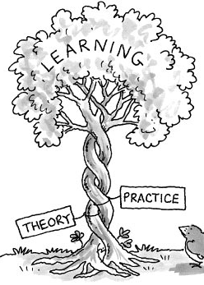
Knowledge & Application
Asa turned to the physicians & did not seek help from God (2 Chron. 16:12).
Israel in the days of Jehoash & Jeroboam 2.
Prayer as a means of seeking the favor of God.
We know who is unfaithful or not a Christian but refuse to do anything.
Have I had enough faith to be baptized, but not enough to pray regularly?
Have I enough faith to try hard in being right, but not enough faith to tell others about the gospel?

Slide 3
Knowledge & Application
“A man hears the Gospel and is saved accordingly but does not feel compelled to tell anyone else about this good news. The same man is at the Home Depot and they are having a 90% off sale on all their tools. How many folks do you suppose this man will tell about that good news… But what is better, a great deal on some tools or eternal salvation offered to all who will accept? Again, the difference in attitude lies in the appreciation of the information.” (Stephen Russell, Words of Life, Volume 42, Issue 3, p. 3).

Slide 4
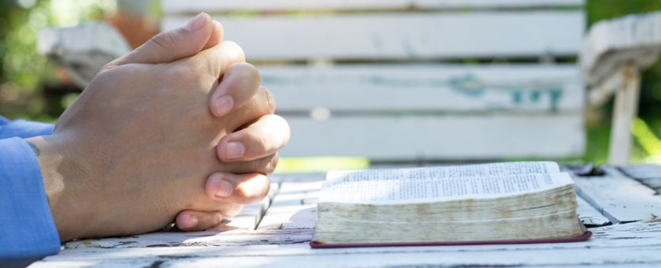
Problems With Prayer & Faith
When we pray, the answer is almost never immediate.
Sometimes the answer is no, or not the one we wanted (Jer. 7:16; 11:14; 14:11; 15:1).
God knows what is best (Matt. 7:7-11).
For me to pray for a miracle is vain (1 Cor. 13:8-13).
Do we think that if we pray for something ordinary, the person will get well, but if it is a fatal disease, they won’t?
God may alter things in answer, things that we may never know about!
We do not have answers to all our questions (Isa. 55:8-11).
  A function of faith, not understanding (Isa. 40:28).

Slide 5

Increasing Our Faith
Expose yourselves to things that build faith (wholesome influences, friends, etc.).
Do not expose yourself needlessly to those things that will destroy faith (1 Cor. 10:11-12; Eph. 5:11).
Provide time & opportunity for Bible meditation.
Pray even when you don’t feel like it.
True character is becoming “partakers of the divine nature” (2 Pet. 1:4).
  A balanced process (2 Pet. 1:5-11).

