Slide 1

Brother & Sister Crotchety

Slide 2
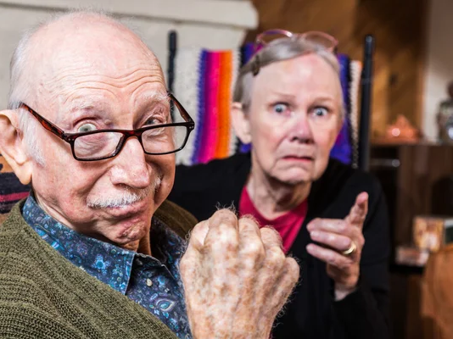

Slide 3
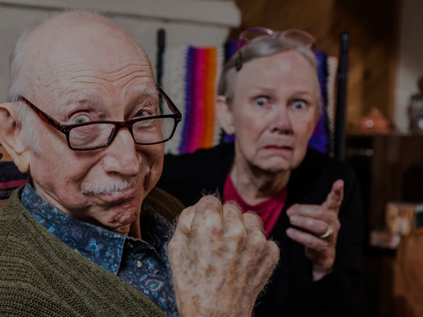

Slide 4
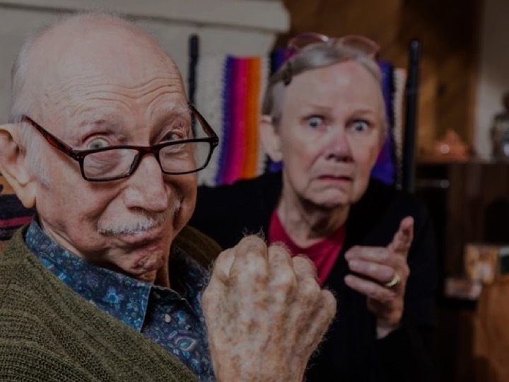
Crotchety:
Definition: Subject to whims, crankiness, or ill temper <a crotchety old man>.
Examples: None of the students dared to talk back to the crotchety old teacher. I get crotchety after a long day at work.
Synonyms: Crabby, cranky, cross, irritable, fiery, grouchy, grumpy, petulant, prickly, quick-tempered, short-tempered, snarky, snippy, testy.
Merriam-Webster Dictionary

Slide 5
Characteristics of Brother & Sister Crotchety
Arrogant
Inactive
Opinionated
Stubborn
Uncooperative

Slide 6

Concern For
Brother & Sister Crotchety
Pride goes before a fall (Prov. 16:18-19; 13:10; 3 Jn. 9-10)
Contentiousness may be a sign of selfishness (Phil. 2:1-4)
Contentiousness, in of itself, is sinful (Gal. 5:19-20. 22; Cf. Rom. 14:1-3)

Slide 7

Dealing With
Brother & Sister Crotchety
We must always love (Matt. 5:43-48; 1 Pet. 3:8-12)
We may need to ignore (Tit. 3:9-11; 1 Pet. 3:13-17)
We must have the proper mindset (Lk. 15)

Slide 8
How to Avoid Becoming
Brother & Sister Crotchety
We must be honest with ourselves
Practice selflessness & yielding
Follow proper examples (Isa. 50:5-6; 1 Cor. 10:31-33; 11:1)
There is no room for bitterness & strife (Jn. 13:35; 2 Cor. 13:5)

Slide 9
Brother & Sister Crotchety

