Slide 1
From Struggling to Prevailing
Genesis 32:22-32

Slide 2
From Struggling to Prevailing
Genesis 32 records one of the most mysterious, yet transformative, encounters in all of Scripture.
This is not merely a strange story—it is Scripture, and therefore, profitable for teaching (2 Tim. 3:16-17).
Let us consider some biblical truths that appear in this account of Jacob’s move, “From Struggling to Prevailing.”

Slide 3
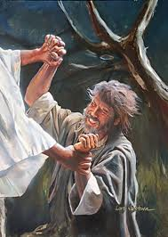
From Struggling to Prevailing

Slide 4
From Struggling to Prevailing
God often meets men when we are finally alone and helpless.
  Gen. 32:22-32; Matt. 26:38–39;Heb. 5:5–8; Jas. 4:8–10

Slide 5
From Struggling to Prevailing
God often meets men when we are finally alone and helpless.
God wrestles to transform character, not to simply fix our circumstances.
  2 Cor. 12:1–10; Rom. 5:3–5; Heb. 12:11; Phil. 3:8-10; 1 Pet. 5:10

Slide 6
From Struggling to Prevailing
God often meets men when we are finally alone and helpless.
God wrestles to transform character, not to simply fix our circumstances.
God transforms before releasing us unto blessing(s).
  Jn. 1:42; 21:15–19; 2 Cor. 5:17; Rom. 8:12–17; Gal. 2:20

Slide 7
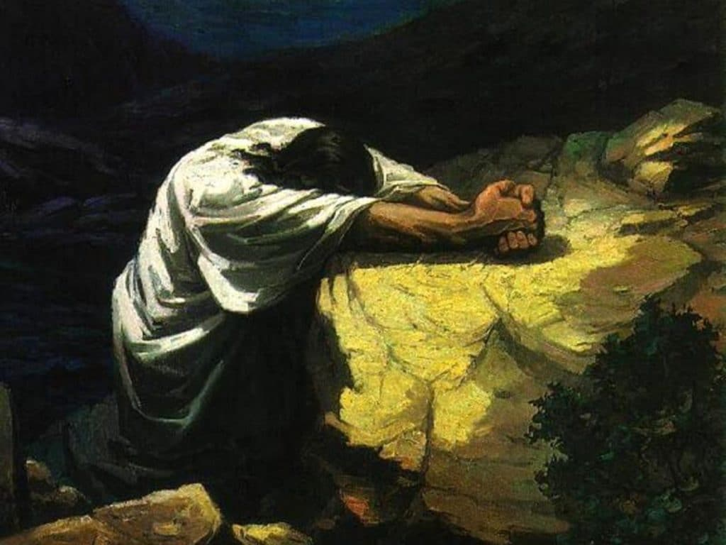
From Struggling to Prevailing
The NT reveals a similar pattern in Jesus Christ:
  Jesus was wounded yet brought blessing (Gen. 3:15; Heb. 2:14-15).
  Jesus was humbled, yet exalted (Phil. 2:5-11).
  Jesus wrestled in obedience so we could walk in the grace He affords (Heb. 5:7-9).
Like Jacob, we may leave our encounters with God marked—but those marks testify that we have “seen” God and live.

