Slide 1
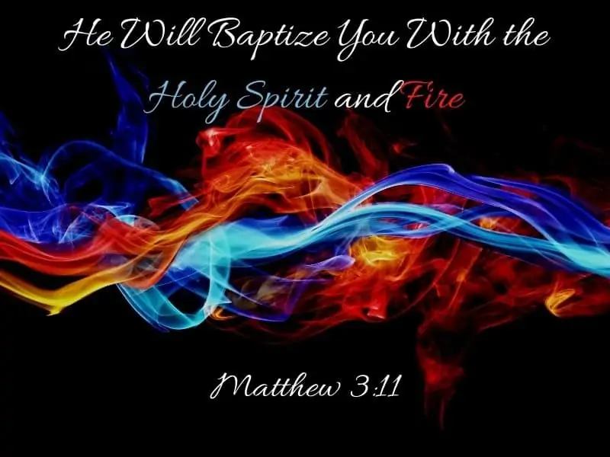

Slide 2


Slide 3
7 But when he saw many of the Pharisees and Sadducees coming to his baptism, he said to them, “Brood of vipers! Who warned you to flee from the wrath to come? 8 Therefore bear fruits worthy of repentance, 9 and do not think to say to yourselves, ‘We have Abraham as our father.’ For I say to you that God is able to raise up children to Abraham from these stones. 10 And even now the ax is laid to the root of the trees. Therefore every tree which does not bear good fruit is cut down and thrown into the fire. 11 I indeed baptize you with water unto repentance, but He who is coming after me is mightier than I, whose sandals I am not worthy to carry. He will baptize you with the Holy Spirit and fire. 12 His winnowing fan is in His hand, and He will thoroughly clean out His threshing floor, and gather His wheat into the barn; but He will burn up the chaff with unquenchable fire.”
~ Matthew 3:7-12

Slide 4
7 But when he saw many of the Pharisees and Sadducees coming to his baptism, he said to them, “Brood of vipers! Who warned you to flee from the wrath to come? 8 Therefore bear fruits worthy of repentance, 9 and do not think to say to yourselves, ‘We have Abraham as our father.’ For I say to you that God is able to raise up children to Abraham from these stones. 10 And even now the ax is laid to the root of the trees. Therefore every tree which does not bear good fruit is cut down and thrown into the fire. 11 I indeed baptize you with water unto repentance, but He who is coming after me is mightier than I, whose sandals I am not worthy to carry. He will baptize you with the Holy Spirit and fire. 12 His winnowing fan is in His hand, and He will thoroughly clean out His threshing floor, and gather His wheat into the barn; but He will burn up the chaff with unquenchable fire.”
~ Matthew 3:7-12

Slide 5


Slide 6
15 For behold, the Lord will come with fire and with His chariots, like a whirlwind, to render His anger with fury, and His rebuke with flames of fire. 16 For by fire and by His sword the Lord will judge all flesh; And the slain of the Lord shall be many.
~ Isaiah 66:15-16

Slide 7
15 For behold, the Lord will come with fire and with His chariots, like a whirlwind, to render His anger with fury, and His rebuke with flames of fire. 16 For by fire and by His sword the Lord will judge all flesh; And the slain of the Lord shall be many.
~ Isaiah 66:15-16

Slide 8
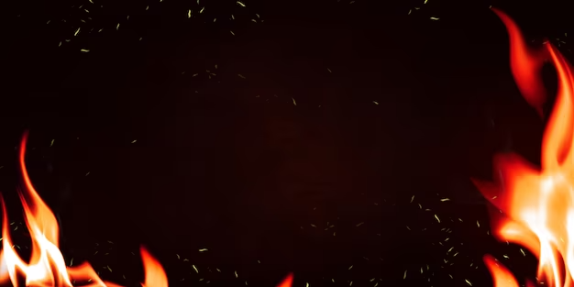

Slide 9
20 As men gather silver, bronze, iron, lead, and tin into the midst of a furnace, to blow fire on it, to melt it; so I will gather you in My anger and in My fury, and I will leave you there and melt you. 21 Yes, I will gather you and blow on you with the fire of My wrath, and you shall be melted in its midst. 22 As silver is melted in the midst of a furnace, so shall you be melted in its midst; then you shall know that I, the Lord, have poured out My fury on you.’ ”
~ Ezekiel 22:20-22

Slide 10
20 As men gather silver, bronze, iron, lead, and tin into the midst of a furnace, to blow fire on it, to melt it; so I will gather you in My anger and in My fury, and I will leave you there and melt you. 21 Yes, I will gather you and blow on you with the fire of My wrath, and you shall be melted in its midst. 22 As silver is melted in the midst of a furnace, so shall you be melted in its midst; then you shall know that I, the Lord, have poured out My fury on you.’ ”
~ Ezekiel 22:20-22

Slide 12
7 But when he saw many of the Pharisees and Sadducees coming to his baptism, he said to them, “Brood of vipers! Who warned you to flee from the wrath to come? 8 Therefore bear fruits worthy of repentance, 9 and do not think to say to yourselves, ‘We have Abraham as our father.’ For I say to you that God is able to raise up children to Abraham from these stones. 10 And even now the ax is laid to the root of the trees. Therefore every tree which does not bear good fruit is cut down and thrown into the fire. 11 I indeed baptize you with water unto repentance, but He who is coming after me is mightier than I, whose sandals I am not worthy to carry. He will baptize you with the Holy Spirit and fire. 12 His winnowing fan is in His hand, and He will thoroughly clean out His threshing floor, and gather His wheat into the barn; but He will burn up the chaff with unquenchable fire.”
~ Matthew 3:7-12

Slide 13
7 But when he saw many of the Pharisees and Sadducees coming to his baptism, he said to them, “Brood of vipers! Who warned you to flee from the wrath to come? 8 Therefore bear fruits worthy of repentance, 9 and do not think to say to yourselves, ‘We have Abraham as our father.’ For I say to you that God is able to raise up children to Abraham from these stones. 10 And even now the ax is laid to the root of the trees. Therefore every tree which does not bear good fruit is cut down and thrown into the fire. 11 I indeed baptize you with water unto repentance, but He who is coming after me is mightier than I, whose sandals I am not worthy to carry. He will baptize you with the Holy Spirit and fire. 12 His winnowing fan is in His hand, and He will thoroughly clean out His threshing floor, and gather His wheat into the barn; but He will burn up the chaff with unquenchable fire.”
~ Matthew 3:7-12

Slide 14


Slide 15
1 “For behold, the day is coming, burning like an oven, and all the proud, yes, all who do wickedly will be stubble. And the day which is coming shall burn them up,” says the Lord of hosts, “That will leave them neither root nor branch. 2 But to you who fear My name the Sun of Righteousness shall arise with healing in His wings; And you shall go out and grow fat like stall-fed calves. 3 You shall trample the wicked, for they shall be ashes under the soles of your feet on the day that I do this,” Says the Lord of hosts.
~ Malachi 4:1-3

Slide 16
1 “For behold, the day is coming, burning like an oven, and all the proud, yes, all who do wickedly will be stubble. And the day which is coming shall burn them up,” says the Lord of hosts, “That will leave them neither root nor branch. 2 But to you who fear My name the Sun of Righteousness shall arise with healing in His wings; And you shall go out and grow fat like stall-fed calves. 3 You shall trample the wicked, for they shall be ashes under the soles of your feet on the day that I do this,” Says the Lord of hosts.
~ Malachi 4:1-3

Slide 17


Slide 18

28 “And it shall come to pass afterward that I will pour out My Spirit on all flesh; Your sons and your daughters shall prophesy, your old men shall dream dreams, your young men shall see visions. 29 And also on My menservants and on My maidservants I will pour out My Spirit in those days. 30“And I will show wonders in the heavens and in the earth: Blood and fire and pillars of smoke. 31The sun shall be turned into darkness, and the moon into blood, before the coming of the great and awesome day of the Lord. 32 And it shall come to pass that whoever calls on the name of the Lord shall be saved. For in Mount Zion and in Jerusalem there shall be deliverance, as the Lord has said, among the remnant whom the Lord calls. 3:1 “For behold, in those days and at that time, when I bring back the captives of Judah and Jerusalem,
~ Joel 2:28-3:1

Slide 19
28 “And it shall come to pass afterward that I will pour out My Spirit on all flesh; Your sons and your daughters shall prophesy, your old men shall dream dreams, your young men shall see visions. 29 And also on My menservants and on My maidservants I will pour out My Spirit in those days. 30“And I will show wonders in the heavens and in the earth: Blood and fire and pillars of smoke. 31The sun shall be turned into darkness, and the moon into blood, before the coming of the great and awesome day of the Lord. 32 And it shall come to pass that whoever calls on the name of the Lord shall be saved. For in Mount Zion and in Jerusalem there shall be deliverance, as the Lord has said, among the remnant whom the Lord calls. 3:1 “For behold, in those days and at that time, when I bring back the captives of Judah and Jerusalem,
~ Joel 2:28-3:1

Slide 21
7 But when he saw many of the Pharisees and Sadducees coming to his baptism, he said to them, “Brood of vipers! Who warned you to flee from the wrath to come? 8 Therefore bear fruits worthy of repentance, 9 and do not think to say to yourselves, ‘We have Abraham as our father.’ For I say to you that God is able to raise up children to Abraham from these stones. 10 And even now the ax is laid to the root of the trees. Therefore every tree which does not bear good fruit is cut down and thrown into the fire. 11 I indeed baptize you with water unto repentance, but He who is coming after me is mightier than I, whose sandals I am not worthy to carry. He will baptize you with the Holy Spirit and fire. 12 His winnowing fan is in His hand, and He will thoroughly clean out His threshing floor, and gather His wheat into the barn; but He will burn up the chaff with unquenchable fire.”
~ Matthew 3:7-12

Slide 22
7 But when he saw many of the Pharisees and Sadducees coming to his baptism, he said to them, “Brood of vipers! Who warned you to flee from the wrath to come? 8 Therefore bear fruits worthy of repentance, 9 and do not think to say to yourselves, ‘We have Abraham as our father.’ For I say to you that God is able to raise up children to Abraham from these stones. 10 And even now the ax is laid to the root of the trees. Therefore every tree which does not bear good fruit is cut down and thrown into the fire. 11 I indeed baptize you with water unto repentance, but He who is coming after me is mightier than I, whose sandals I am not worthy to carry. He will baptize you with the Holy Spirit and fire. 12 His winnowing fan is in His hand, and He will thoroughly clean out His threshing floor, and gather His wheat into the barn; but He will burn up the chaff with unquenchable fire.”
~ Matthew 3:7-12

Slide 23
He Will Baptize You…
With the Messiah will be two events:
  The baptism of the Holy Spirit (arrival of the kingdom of God, restoration of God’s covenant with Israel, and blessing).
  Judgment.
Repent, because the restoration of the kingdom is near!

