Slide 1
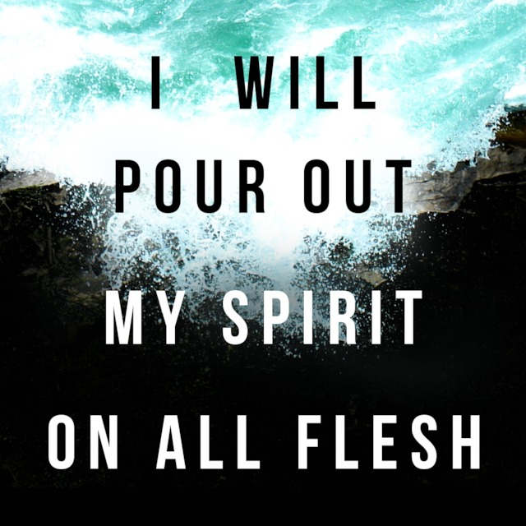

Slide 2
The Holy Spirit in The OT:
A foundational lesson:
  Not an easy topic.
  Different from the norm.
Questions:
  What is the Holy Spirit’s function?
  How does that apply to me?
Things done wrong:
  Beginning in Acts 2 & assuming the audience knew nothing of the Holy Spirit.
  Assuming that whatever we learn in Acts 2, is what/when audience began to learn the OT.

Slide 3


Slide 4
16 So the Lord said to Moses: “Gather to Me seventy men of the elders of Israel, whom you know to be the elders of the people and officers over them; bring them to the tabernacle of meeting, that they may stand there with you. 17 Then I will come down and talk with you there. I will take of the Spirit that is upon you and will put the same upon them; and they shall bear the burden of the people with you, that you may not bear it yourself alone.
24 So Moses went out and told the people the words of the Lord, and he gathered the seventy men of the elders of the people and placed them around the tabernacle. 25 Then the Lord came down in the cloud, and spoke to him, and took of the Spirit that was upon him, and placed the same upon the seventy elders; and it happened, when the Spirit rested upon them, that they prophesied, although they never did so again. 26 But two men had remained in the camp: the name of one was Eldad, and the name of the other Medad. And the Spirit rested upon them. Now they were among those listed, but who had not gone out to the tabernacle; yet they prophesied in the camp.
~ Numbers 11:16-17, 24-26

Slide 5
16 So the Lord said to Moses: “Gather to Me seventy men of the elders of Israel, whom you know to be the elders of the people and officers over them; bring them to the tabernacle of meeting, that they may stand there with you. 17 Then I will come down and talk with you there. I will take of the Spirit that is upon you and will put the same upon them; and they shall bear the burden of the people with you, that you may not bear it yourself alone.
24 So Moses went out and told the people the words of the Lord, and he gathered the seventy men of the elders of the people and placed them around the tabernacle. 25 Then the Lord came down in the cloud, and spoke to him, and took of the Spirit that was upon him, and placed the same upon the seventy elders; and it happened, when the Spirit rested upon them, that they prophesied, although they never did so again. 26 But two men had remained in the camp: the name of one was Eldad, and the name of the other Medad. And the Spirit rested upon them. Now they were among those listed, but who had not gone out to the tabernacle; yet they prophesied in the camp.
~ Numbers 11:16-17, 24-26

Slide 6
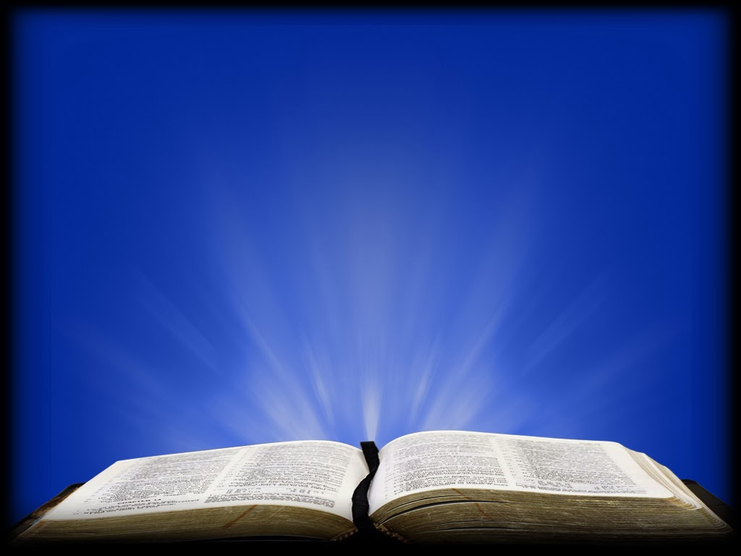

Slide 7
14 Because the palaces will be forsaken, the bustling city will be deserted. The forts and towers will become lairs forever, a joy of wild donkeys, a pasture of flocks— 15 Until the Spirit is poured upon us from on high, and the wilderness becomes a fruitful field, and the fruitful field is counted as a forest. 16 Then justice will dwell in the wilderness, and righteousness remain in the fruitful field. 17 The work of righteousness will be peace, and the effect of righteousness, quietness and assurance forever. 18 My people will dwell in a peaceful habitation, in secure dwellings, and in quiet resting places…
~ Isaiah 32:14-18

Slide 8
14 Because the palaces will be forsaken, the bustling city will be deserted. The forts and towers will become lairs forever, a joy of wild donkeys, a pasture of flocks— 15 Until the Spirit is poured upon us from on high, and the wilderness becomes a fruitful field, and the fruitful field is counted as a forest. 16 Then justice will dwell in the wilderness, and righteousness remain in the fruitful field. 17 The work of righteousness will be peace, and the effect of righteousness, quietness and assurance forever. 18 My people will dwell in a peaceful habitation, in secure dwellings, and in quiet resting places…
~ Isaiah 32:14-18

Slide 9


Slide 10
3 For I will pour water on him who is thirsty, and floods on the dry ground; I will pour My Spirit on your descendants, and My blessing on your offspring; 4 They will spring up among the grass like willows by the watercourses.’ 5 One will say, ‘I am the Lord’s’; Another will call himself by the name of Jacob; Another will write with his hand, ‘The Lord’s,’ and name himself by the name of Israel.
~ Isaiah 44:3-5

Slide 11
3 For I will pour water on him who is thirsty, and floods on the dry ground; I will pour My Spirit on your descendants, and My blessing on your offspring; 4 They will spring up among the grass like willows by the watercourses.’ 5 One will say, ‘I am the Lord’s’; Another will call himself by the name of Jacob; Another will write with his hand, ‘The Lord’s,’ and name himself by the name of Israel.
~ Isaiah 44:3-5

Slide 12
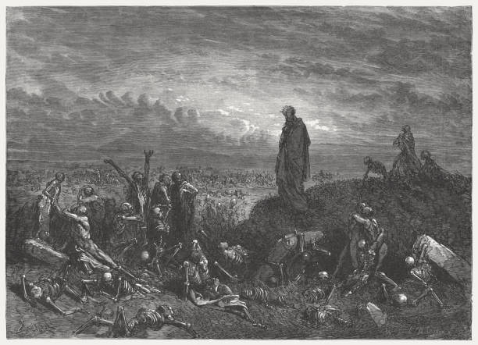

Slide 13
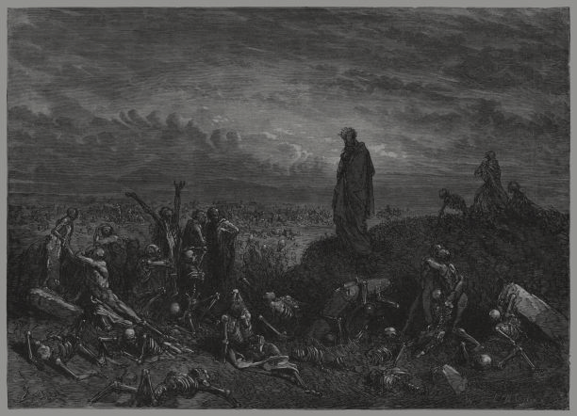
13 Then you shall know that I am the Lord, when I have opened your graves, O My people, and brought you up from your graves. 14 I will put My Spirit in you, and you shall live, and I will place you in your own land. Then you shall know that I, the Lord, have spoken it and performed it,” says the Lord.’ ”
~ Ezekiel 37:13-14

Slide 14
13 Then you shall know that I am the Lord, when I have opened your graves, O My people, and brought you up from your graves. 14 I will put My Spirit in you, and you shall live, and I will place you in your own land. Then you shall know that I, the Lord, have spoken it and performed it,” says the Lord.’ ”
~ Ezekiel 37:13-14

Slide 15


Slide 16
28 then they shall know that I am the Lord their God, who sent them into captivity among the nations, but also brought them back to their land, and left none of them captive any longer. 29 And I will not hide My face from them anymore; for I shall have poured out My Spirit on the house of Israel,’ says the Lord God.”
~ Ezekiel 39:28-29

Slide 17
28 then they shall know that I am the Lord their God, who sent them into captivity among the nations, but also brought them back to their land, and left none of them captive any longer. 29 And I will not hide My face from them anymore; for I shall have poured out My Spirit on the house of Israel,’ says the Lord God.”
~ Ezekiel 39:28-29

Slide 18
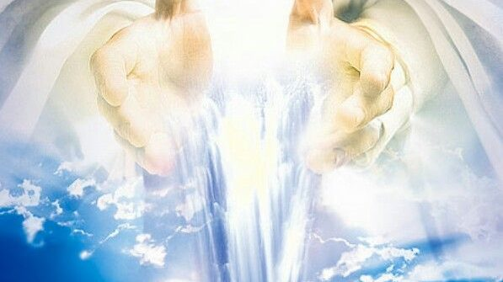

Slide 19
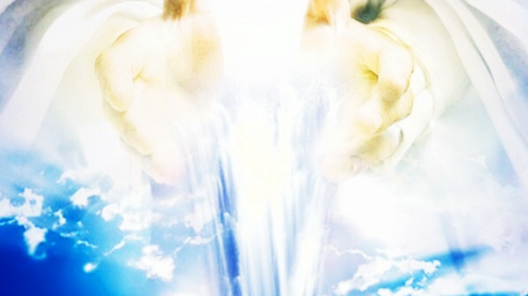
28 “And it shall come to pass afterward that I will pour out My Spirit on all flesh; Your sons and your daughters shall prophesy, your old men shall dream dreams, your young men shall see visions. 29 And also on My menservants and on My maidservants I will pour out My Spirit in those days. 30“And I will show wonders in the heavens and in the earth: Blood and fire and pillars of smoke. 31The sun shall be turned into darkness, and the moon into blood, before the coming of the great and awesome day of the Lord. 32 And it shall come to pass that whoever calls on the name of the Lord shall be saved. For in Mount Zion and in Jerusalem there shall be deliverance, as the Lord has said, among the remnant whom the Lord calls. 3:1 “For behold, in those days and at that time, when I bring back the captives of Judah and Jerusalem,
~ Joel 2:28-3:1

Slide 20
28 “And it shall come to pass afterward that I will pour out My Spirit on all flesh; Your sons and your daughters shall prophesy, your old men shall dream dreams, your young men shall see visions. 29 And also on My menservants and on My maidservants I will pour out My Spirit in those days. 30“And I will show wonders in the heavens and in the earth: Blood and fire and pillars of smoke. 31The sun shall be turned into darkness, and the moon into blood, before the coming of the great and awesome day of the Lord. 32 And it shall come to pass that whoever calls on the name of the Lord shall be saved. For in Mount Zion and in Jerusalem there shall be deliverance, as the Lord has said, among the remnant whom the Lord calls. 3:1 “For behold, in those days and at that time, when I bring back the captives of Judah and Jerusalem,
~ Joel 2:28-3:1

Slide 22
The Holy Spirit in The OT
Three points to take from the Scriptures:
  Restoration of the Kingdom.
  Restoration of God’s Blessings.
  Restoration of Covenant Relationship.

