Slide 1
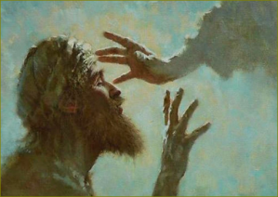
Jesus Heals a Blind Man at Bethsaida
Mark 8:22–26

Slide 2
Jesus Heals a Blind Man at Bethsaida

Slide 3
Jesus Heals a Blind Man at Bethsaida
More than one man’s condition.
  Mk. 8:22; Cf. Matt. 11:21; Mk 8:14–21; Exod. 4:21; Jn. 5:39–40

Slide 4
Jesus Heals a Blind Man at Bethsaida
More than one man’s condition.
Jesus removes the man from the village.
  Mk. 8:23a; Cf. Matt. 11:21; Gen. 12; Exod. 3; Gal. 1:17-18

Slide 5
Jesus Heals a Blind Man at Bethsaida
More than one man’s condition.
Jesus removes the man from the village.
The man gains sight without full clarity.
  Mk. 8:23b-24, v. 14-21, 27-33; 1 Sam. 16; Jn. 3:3-5; Acts 18:24-26

Slide 6
Jesus Heals a Blind Man at Bethsaida
More than one man’s condition.
Jesus removes the man from the village.
The man gains sight without full clarity.
Jesus touches again – healing complete.
  Mk. 8:25; Phil. 1:6

Slide 7
Jesus Heals a Blind Man at Bethsaida
More than one man’s condition.
Jesus removes the man from the village.
The man gains sight without full clarity.
Jesus touches again – healing complete.
Clear vision changes how we live
  Mk. 8:26; Cf. Mk. 5:19-20; Acts 9:20-22; Phil. 3:1-16

Slide 8
Jesus Heals a Blind Man at Bethsaida
Mark 8:22–26

