Slide 1
The Gospel According to Matthew
~ Chapter 1

Slide 2
The Gospel
According to Matthew
Years of Preparation (Matt. 1:1-3:12).
Beginning of Jesus’ Ministry (Matt. 3:13-4:11).
The Great Galilean Ministry (Matt. 4:12-14:12).
Periods of Retirement (Matt. 14:13-18:35).
Close of Jesus’ Ministry (Matt. 19:1-20:34).
The Last Week (Matt. 21:1-27:66).
The Resurrection and Exaltation (Matt. 28:1-20).

Slide 3
Introduction to Matthew's Genealogy
Matthew begins with Jesus’ genealogy (Matt. 1:1–17)
Structured generations:
  Abraham to David
  David to Babylonian exile
  Exile to Christ
Emphasis: Jesus as legal heir of David

Slide 4
Some Seed Promises in Scripture
Genesis 3:15 – Seed of woman
Genesis 12:3; 22:18 – Seed of Abraham
2 Samuel 7:12-16 – Seed of David, throne established forever
Galatians 4:4-7 – Paul connects seed to Christ

Slide 5
Inclusion of Imperfect and Foreign Women
Women in Matthew's genealogy:
  Tamar, Rahab, Ruth, Bathsheba
Highlights God's grace and universality of salvation
Jesus = Savior for all nations

Slide 6
The Betrothal of Mary & Joseph
Mary = betrothed; Joseph = called “husband” (Matt. 1:18-20)
Joseph's righteousness and obedience emphasized
Link to Deut. 22:23-24 – betrothal was covenantal
God values covenant, not just consummation (Mal. 2:14-16)

Slide 7
Virgin Birth & Divine Sonship
Conceived by the Holy Spirit (Matt. 1:18, 20)
Fulfillment of Isa. 7:14 – Immanuel (“God with us”)
Psalm 2; 2 Sam. 7:14 – “You are My Son”
Resurrection confirms Sonship (Acts 13:33; Rom. 1:4)

Slide 8
The Name “Jesus”
“Jesus” = Greek form of Joshua, meaning “Yahweh saves”
Joshua son of Nun: conqueror
Joshua in Ezra: high priest
Jesus = both Warrior King & High Priest

Slide 9
Fulfillment of Prophecy and Universal Savior
Jesus = Seed of woman, Abraham, and David
Fulfills messianic prophecies
Matthew emphasizes Jesus as King and Messiah for all

Slide 10
Responding to Skepticism
Apparent contradictions often stem from:
  Ignorance (lack of knowledge)
  Dishonesty (willful rejection)
Faith is reasonable—rooted in fulfilled prophecy and moral truth (Psalm 14:1)

Slide 11
The Book of Hebrews Confirms Matthew’s Claims
Heb. 1:1-4 – Jesus greater than angels
Heb. 1:5-6 – Quotes Psalm 2:7 & 2 Sam. 7:14
Heb. 1:8 – Psalm 45:6-7 – Jesus is divine King
Heb. 1:10-12 – Jesus = Creator (Psalm 102)
Parallels: Matt. 1:23 – “God with us”; Micah 5:2 – “from everlasting”

Slide 12
Summary
Jesus = Son of God (divine) & Son of Man (human)
Born of woman (Mary), conceived by Spirit, declared Son by resurrection
Fulfills role as King, Savior, High Priest, and God Incarnate

Slide 13
Final Thoughts & Application
Matthew affirms Jesus:
  As fulfillment of prophecies
  As seed of Abraham, David, and woman
  As Savior from sin (Matt. 1:21)
Hebrews confirms: Jesus is King, Creator, and Redeemer
Faith is not blind—it’s based on prophetic fulfillment and divine revelation

Slide 14
The Gospel According to Matthew
~ Chapter 2

Slide 15
The Gospel
According to Matthew
Years of Preparation (Matt. 1:1-3:12).
Beginning of Jesus’ Ministry (Matt. 3:13-4:11).
The Great Galilean Ministry (Matt. 4:12-14:12).
Periods of Retirement (Matt. 14:13-18:35).
Close of Jesus’ Ministry (Matt. 19:1-20:34).
The Last Week (Matt. 21:1-27:66).
The Resurrection and Exaltation (Matt. 28:1-20).

Slide 16
Context and Purpose of Matthew
Audience: Written by a Jew (Matthew) to fellow Jews
Focus: Jesus as fulfillment of Old Testament prophecies
Key Themes:
  Jesus, Son of Mary, begotten of God
  Descendant of Abraham and David
  Fulfillment of prophecy (e.g., virgin birth)

Slide 17
Key Events in Matthew 2
Birth of a King
Reactions to the Birth:
  Herod: Hostile and threatened
  Wise Men: Reverent and seeking
Flight to Egypt and Return to Nazareth

Slide 18
Bethlehem and Herod
Bethlehem: ~6 miles south of Jerusalem; birthplace of David
Herod the Great:
  Infamous for jealousy and cruelty
  Ordered massacre of infants (vv. 16-18)
  Feared loss of power

Slide 19
The Wise Men (Magi)
From the East: Possibly Babylon or Persia
Seeking a King: Guided by a miraculous star
Worship: Came with intent to honor the Christ

Slide 20
Contrasting Responses to Jesus
Herod: Pretended to worship; planned harm
Chief Priests & Scribes: Knowledgeable but indifferent (?)
Wise Men: Traveled far to worship Him
Gifts (v.11):
  Gold – Royalty?
  Frankincense – Priestly?
  Myrrh – Sacrificial death (burial)?

Slide 21
The Flight to Egypt (vv. 13–15)
Joseph warned in a dream
Jesus’ escape: Fulfills Hosea 11:1 – "Out of Egypt I called My son"
Spiritual parallel: Sin → Refuge → Providence (like Joseph in Genesis)

Slide 22
The Massacre of the Innocents
Herod’s paranoia led to violence
  Tragedy involving infants
Jeremiah 31:15 parallel: Rachel weeping for her children

Slide 23
Return to Nazareth (vv. 19–23)
Settled in Nazareth to fulfill prophecy
“He shall be called a Nazarene”
  Isaiah 53 connection?: Humble origins, man of sorrows
  Nazareth's Reputation: “Can anything good come from Nazareth?” (Jn. 1:46)

Slide 24
Themes and Applications
Jesus Fulfilled Prophecy from Birth
Responses to Jesus Vary:
  Hostility
  Indifference
  Worship
Call to Action: Seek Him, honor Him, worship Him!

Slide 25
The Gospel According to Matthew
~ Chapter 3

Slide 26
The Gospel
According to Matthew
Years of Preparation (Matt. 1:1-3:12).
Beginning of Jesus’ Ministry (Matt. 3:13-4:11).
The Great Galilean Ministry (Matt. 4:12-14:12).
Periods of Retirement (Matt. 14:13-18:35).
Close of Jesus’ Ministry (Matt. 19:1-20:34).
The Last Week (Matt. 21:1-27:66).
The Resurrection and Exaltation (Matt. 28:1-20).

Slide 27
Jesus’ Early Life
Jesus' family returned to Nazareth (Matt. 2).
At age 12, He was found in the temple (Luke 2:41–50): “about His Father’s business.”
Grew in wisdom and stature (Luke 2:52).
Learned carpentry (Matt. 13:55; Mark 6:3).
Jesus fully entered human experience to redeem humanity.

Slide 28
Introduction to Matthew 3
Jews were anticipating the Messiah, a powerful king (Mal. 3:1–2; Isa. 49:6–8).
John the Baptist fulfills prophecy (Mal. 4:4–6; Luke 1:17).
Jesus' arrival was part of God’s sovereign plan (Matt. 11:13–15; 17:9–13).

Slide 29
John the Baptist’s Mission
Luke 1:4–5: “Great in the sight of the Lord,” filled with the Holy Spirit from the womb.
No miracles, yet Spirit-filled (John 10:41).
Purpose: Turn hearts to God (Luke 1:16–17; Isa. 40:3; Matt. 3:3).
All 4 Gospels affirm John's role as forerunner of Jesus.

Slide 30
A Kingdom at Hand (Matt. 3:1–12)
After 400 years of silence, God speaks again—through John’s message of repentance.
Prophets foretold a spiritual Kingdom (Isa. 9:1–7; Dan. 2:44; Dan. 7:13–14).
Many Jews expected a physical reign, not a spiritual transformation.

Slide 31
Repentance and Preparation
John preached repentance because the Kingdom was near (Matt. 3:2).
True repentance: A changed heart and actions (Matt. 21:28–32; Acts 26:20).
Jews relying on heritage from Abraham were warned—God can raise children from stones (Matt. 3:9).
The Kingdom is spiritual, for those who truly turn to God.

Slide 32
John’s Appearance & Role
John's attire: Camel’s hair, leather belt—practical and prophetic (Matt. 3:4; 2 Kings 1:8).
Diet: Locusts and honey (Lev. 11:22).
Preached in the wilderness, yet people came (John 3:23).

Slide 33
Baptism and Confession
People confessed sins (Matt. 3:6); today we confess faith in Jesus (Rom. 10:9).
Pre-Cross: Looking forward to Christ; Post-Cross: We look back in faith.
Baptism now: repentance and spiritual renewal.

Slide 34
Baptism of Jesus (Matt. 3:13–17)
Jesus baptized to fulfill all righteousness (v.15).
An example for us to follow.
Godhead present:
  Jesus baptized
  Spirit descending like a dove
  Father’s voice from heaven (Matt. 3:16–17; John 1:29–34).
Beginning of Jesus’ public ministry (Luke 3:21–23a).

Slide 35
Key Takeaways
Jesus’ life fulfilled prophecy from birth to ministry.
John’s role: Prepare hearts for the spiritual Kingdom of God.
God’s plan: A Kingdom not of this world but eternal and righteous.
Repentance, baptism, and transformed lives are still core to entering that Kingdom.

Slide 36
The Gospel According to Matthew
~ Chapter 4

Slide 37
The Gospel
According to Matthew
Years of Preparation (Matt. 1:1-3:12).
Beginning of Jesus’ Ministry (Matt. 3:13-4:11).
The Great Galilean Ministry (Matt. 4:12-14:12).
Periods of Retirement (Matt. 14:13-18:35).
Close of Jesus’ Ministry (Matt. 19:1-20:34).
The Last Week (Matt. 21:1-27:66).
The Resurrection and Exaltation (Matt. 28:1-20).

Slide 38
Overview of Early Chapters
Matthew begins with:
  Birth of Jesus (Chapter 1)
  Settling in Nazareth (Chapter 2)
  John the Baptist’s introduction (Chapter 3)
Jesus baptized and led into wilderness
Launch of the Great Galilean Ministry (Matt. 4:12)

Slide 39
The Kingdom in Matthew
Emphasis on Kingdom:
  Nature of the Kingdom
  Nature of the King
  Nature of the subjects
Jews expected a physical kingdom
Matthew presents Jesus’ divine authority
Tension between humanity and divinity

Slide 40
Jesus’ Temptation in the Wilderness
Scripture used to resist temptation
Reality of spiritual warfare
Hebrews 2:14–18; 4:14–16 – Jesus understood temptation
Could Jesus have sinned? Temptation implies possibility

Slide 41
Temptation as Testing
Greek: "temptation" = to test or prove
James 1:2–18 – Life’s trials test faith
Jesus fasted before temptation – commitment to mission

Slide 42
The First Temptation – Stones to Bread
Satan: “If You are the Son of God…”
Jesus refuses to misuse divine power
Spiritual hunger > physical hunger
Foreshadowing (?): Will Jesus use bread to win followers (Matt. 14:13-21; John 6:1-71)?

Slide 43
The Second Temptation – Sensationalism
Satan quotes Scripture (Psalm 91) out of context
Temptation: Jump off the temple
Jesus: Do not test God (Matt. 4:7)
Modern parallel (?): Flashy tactics in religion (e.g., televangelism)

Slide 44
The Third Temptation – Shortcut to Power
Satan offers all kingdoms of the world
Jesus rejects worldly glory and compromise
“Away with you, Satan!” – integrity over shortcuts
1 Tim. 1:4; 2 Tim. 2:23 – Focus on what really matters

Slide 45
Key Lessons from the Temptation
Temptations appeal to:
  Physical desires
  Ego/pride
  Power
1 John 2:15–17 – Similar temptations today
Jesus' mission: truth over compromise

Slide 46
Transition to Great Galilean Ministry
Matt. 4:12–17 – Jesus moves to Capernaum
Fulfilled prophecy (Isaiah 9:1–2)
Northern region (first attacked, first to see the Light)
Ministry launched near Gentiles

Slide 47
Message of the Kingdom
Jesus preaches same message as John: “The kingdom is near”
Matthew uses “Kingdom of Heaven” (vs. “Kingdom of God”)
Reflects God's leadership from Heaven

Slide 48
Calling the First Disciples
Galilee: region full of fishermen
“I will make you become fishers of men” (Mark 1:17)
Discipleship involves training and preparation
Evangelism requires tact and wisdom

Slide 49
Immediate Response
Disciples left immediately (Matt. 4:20, 22)
Not their 1st encounter with Jesus (cf. Mk, Lk, Jn)
Luke 9:62 – Don’t look back
Spiritual urgency and commitment emphasized

Slide 50
Jesus in the Synagogues
Synagogues: developed during exile
Worship included: reading, praying, singing, teaching
Jesus taught and preached (instruction + exhortation)
Pattern for church today

Slide 51
Miracles and Outreach
Jesus’ fame spreads (Matt. 4:24–25)
Ministered outside synagogues – in the countryside
Healed many, including those demon-possessed
Miracles confirmed divine authority

Slide 52
Context of Demonic Possession
Demons rarely mentioned before Matthew
Not common throughout all Scripture
Concentration of miracles during specific periods
Purpose: reveal Jesus’ authority over evil

Slide 53
Jesus' Growing Influence
Crowds from:
  Galilee
  Decapolis
  Syria
  Judea
  Beyond the Jordan
Jesus’ ministry transcended Jewish boundaries
Sets the stage for the Sermon on the Mount

Slide 54
Summary and Reflection
Jesus’ ministry begins with:
  Baptism and temptation
  Calling disciples
  Preaching and healing
Spiritual truth, not sensationalism or power, defines His mission
A model for ministry: depth, commitment, and truth

Slide 55
The Gospel According to Matthew
~ Chapters 5-7

Slide 56
The Gospel
According to Matthew
Years of Preparation (Matt. 1:1-3:12).
Beginning of Jesus’ Ministry (Matt. 3:13-4:11).
The Great Galilean Ministry (Matt. 4:12-14:12).
Periods of Retirement (Matt. 14:13-18:35).
Close of Jesus’ Ministry (Matt. 19:1-20:34).
The Last Week (Matt. 21:1-27:66).
The Resurrection and Exaltation (Matt. 28:1-20).

Slide 57
Introduction
Examining the Sermon on the Mount (Matt. 5–7)
Goes beyond Old Law—reveals Kingdom principles
Jesus brings an inbreaking of God’s Kingdom
Ch. 5: Moral character of Kingdom citizens
Ch. 6: Trust in God
Ch. 7: Judging principles

Slide 58
The Beatitudes – Overview
Foundational blessings for Kingdom citizens
Stand in contrast to worldly values
Spiritual condition emphasized over material success

Slide 59
Verses 3–6
V3: Poor in spirit → Kingdom of Heaven
V4: Mourn over sin → Comforted
V5: Meek → Inherit the earth
  Romans despised meekness—Christ exalts it
V6: Hunger for righteousness → Filled

Slide 60
Verses 7–9
V7: Merciful → Will receive mercy
V8: Pure in heart → Will see God (cf. James 4:8)
V9: Peacemakers → Children of God
  Evangelistic responsibility tied to peace

Slide 61
Verses 10–12
Persecuted for righteousness → Rejoice!
Suffering links to heavenly reward (cf. Rev. 19:7)
Kingdom character opposes worldly values

Slide 62
Salt and Light (Verses 13–16)
Salt: Preserves, prevents, flavors (cf. Job 6:6, Gen. 18)
Light: Guides, warms, reveals
Influence of Christians in a dark world

Slide 63
Jesus & The Law (Verses 17–20)
Jesus fulfills, not abolishes, the Law
“Jot and tittle” → enduring nature of moral truth
V19: Warning to false teachers
V20: True righteousness > Pharisaical hypocrisy

Slide 64
Inner Transformation (Verses 21–26)
Anger and contempt are condemned
Move from outward acts to inward attitudes
Reconciliation prioritized (cf. Matt. 18:15)

Slide 65
Lust and the Heart (Verses 27–30)
Adultery begins in the heart
Spiritual discipline over sensual temptation
Drastic steps advised to avoid sin (cf. Gal. 5:24; Col. 3:5)

Slide 66
Divorce & Oaths (Verses 31–37)
Divorce connected to covenant unfaithfulness
Let your "yes" be yes—honesty as a virtue
Not about civil oaths, but personal integrity (cf. Gal. 1:20)

Slide 67
Going the Second Mile (Verses 38–42)
V38: Let go of personal vengeance
V39–41: Generosity in spirit and action
V42: Generosity with wisdom—not encouraging idleness

Slide 68
Love Your Enemies (Verses 43–45)
No OT teaching to hate enemies
Love surpasses worldly standards
Grace transforms our morality

Slide 69
Kingdom Citizenship
Godly disposition (1 John 4:7)
Contrast with other kingdoms
The call to be light in the world—an incredible blessing!

Slide 70
The Gospel According to Matthew
~ Chapters 5-7

Slide 71
The Gospel
According to Matthew
Years of Preparation (Matt. 1:1-3:12).
Beginning of Jesus’ Ministry (Matt. 3:13-4:11).
The Great Galilean Ministry (Matt. 4:12-14:12).
Periods of Retirement (Matt. 14:13-18:35).
Close of Jesus’ Ministry (Matt. 19:1-20:34).
The Last Week (Matt. 21:1-27:66).
The Resurrection and Exaltation (Matt. 28:1-20).

Slide 72
The Living Word
The Bible remains continually fresh and revealing.
The Sermon on the Mount offers new insights into true righteousness.
Themes: Kingdom of God, Kingdom of Heaven, Heart-motivated obedience.

Slide 73
Seen vs. Done (Matthew 6:1–18)
Are good deeds done for men’s praise or God's approval?
Focus: “Father” appears 12x vs. “God” 3x.
God sees in secret—He must remain our central focus.

Slide 74
The Heart of Giving (vv. 1–4)
Giving is about attitude, not applause.
No literal trumpet—Jesus addresses heart motives.
True giving: joyfully fulfilling God's will, not seeking praise.

Slide 75
Reward and Recognition
Public recognition = full reward.
God’s approval > man’s praise.
Be content with divine reward, not earthly applause.

Slide 76
Authentic Prayer (vv. 5–8)
Don’t pray for show.
Avoid vain repetitions—like Acts 19:28 in Ephesus.
Trust God hears brief, sincere prayers.

Slide 77
The Power of Simple Prayer
Examples:
  Peter: “Lord, save me!” (Matt. 14:30)
  Tax collector: “Be merciful to me, a sinner” (Lk. 18:13)
Prayer’s value lies in sincerity, not length.

Slide 78
The Manner of Prayer (vv. 9–13)
Focus on God's will, not ours.
Praying “Thy kingdom come” = inviting God’s rule into our lives.
Daily dependence and spiritual awareness are key.

Slide 79
Mercy and Motivation (v. 12)
Forgive others, seek mercy.
Prayer reflects our character and relationship with others.
The goal: to be pleasing to God in all.

Slide 80
Proper Fasting (vv. 16–18)
Fasting for God, not recognition.
Not about ritual but relationship.
God sees in secret and rewards accordingly.

Slide 81
Where Is Your Treasure? (vv. 19–21)
Treasures reflect your heart.
Earthly wealth fades—heavenly reward endures.
Wealth isn’t sin; misplaced trust is.

Slide 82
Focus Determines Vision (vv. 22–23)
A healthy eye = a clear, godly perspective.
Divided focus = spiritual darkness.
Set your sight on heaven, not the world.

Slide 83
You Can’t Serve Two Masters (v. 24)
Mammon = wealth and materialism.
God and the world pull in opposite directions.
One ultimate loyalty—choose God.

Slide 84
Life Is More Than Worry (vv. 25–27)
Don’t fixate on food, drink, clothing.
Worry distracts from faith.
Philippians 4:6-7 – peace replaces anxiety.

Slide 85
Trust and Contentment (vv. 28–33)
God provides.
Prioritize His kingdom, and “all these things” will be added.
Philippians 4:11 – learn contentment.

Slide 86
Live for Today (v. 34)
Most worries are about tomorrow.
Focus on faithfulness today.
Trust in your heavenly Father’s care.

Slide 87
Key Questions for Reflection
Do I seek God’s glory or man’s approval?
Is my life truly focused on heaven?
Am I preaching and living like Jesus—pointing others to God?

Slide 88
Final Thoughts
The Kingdom of Heaven calls for genuine righteousness.
Let’s re-focus our hearts, prayers, fasting, giving, and living.
Our Father in Heaven is our reward, our provider, our focus.

Slide 89
The Gospel According to Matthew
~ Chapters 5-7

Slide 90
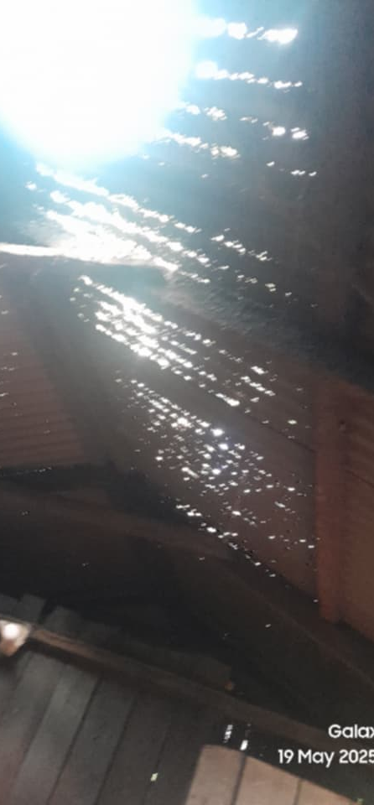
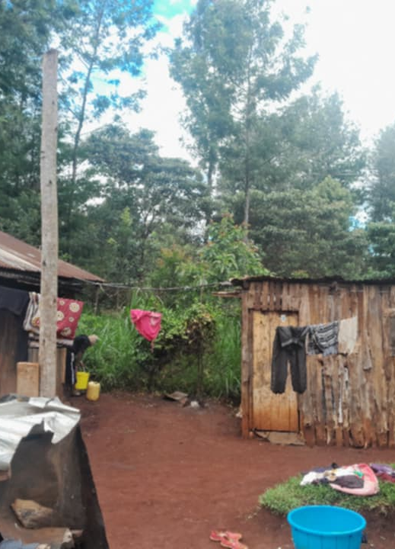
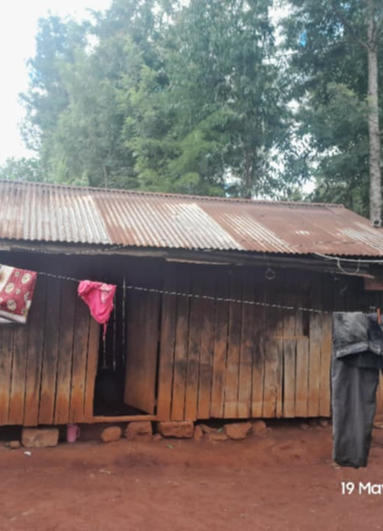
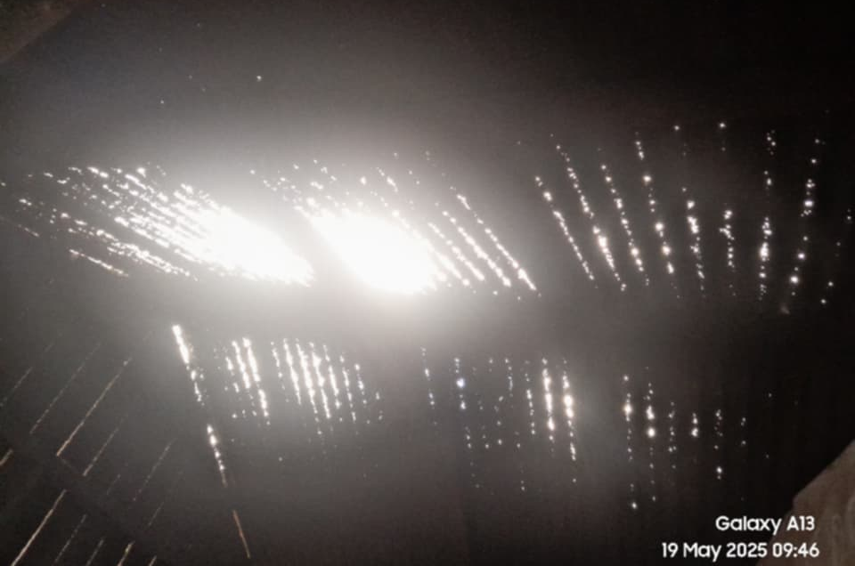

Slide 91
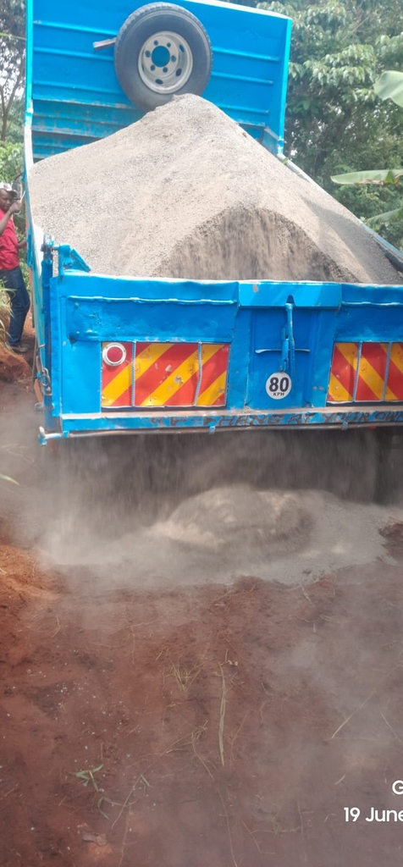
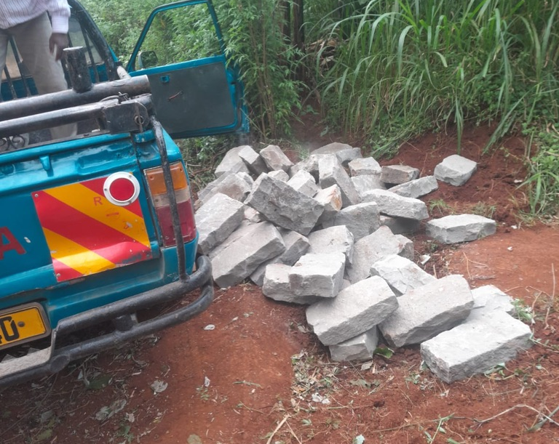
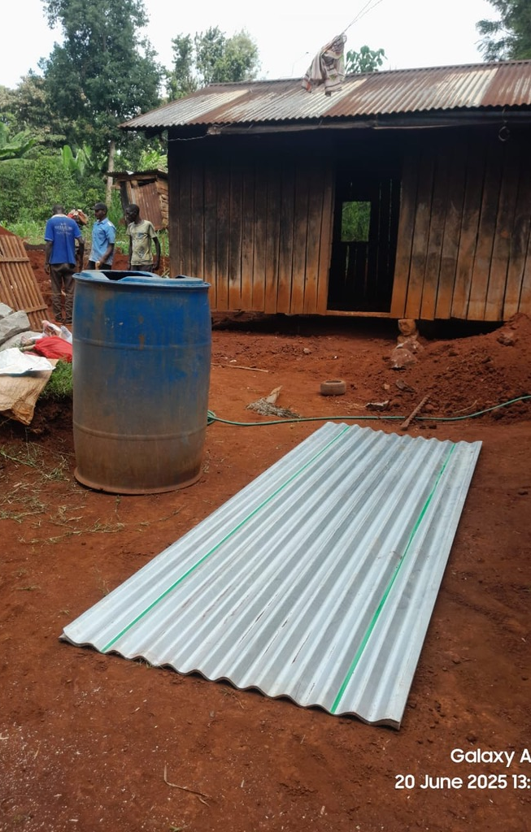
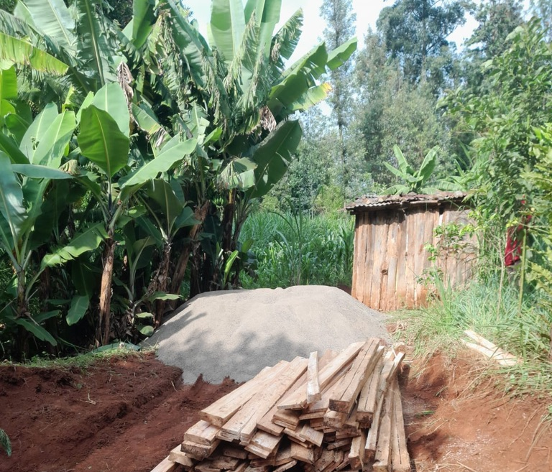

Slide 92
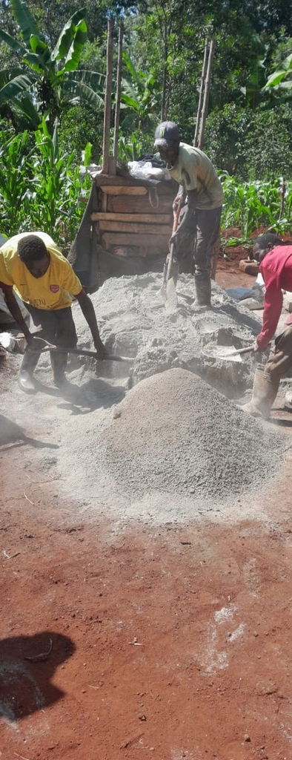
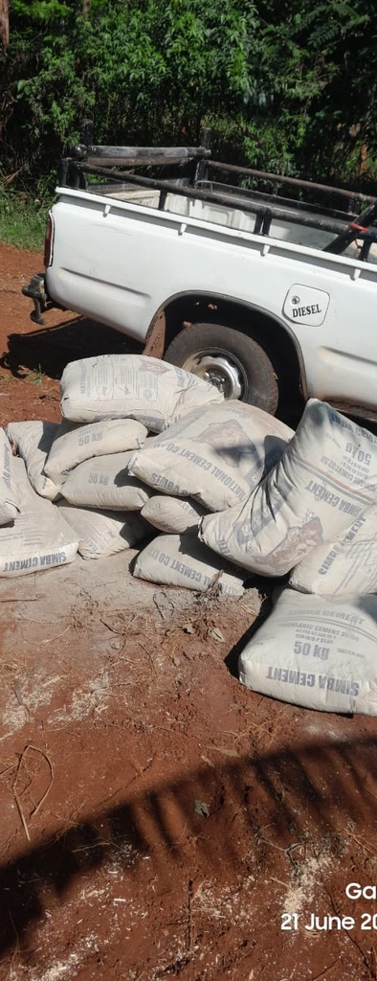
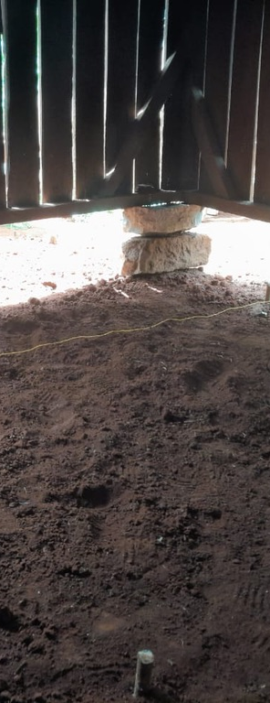

Slide 93
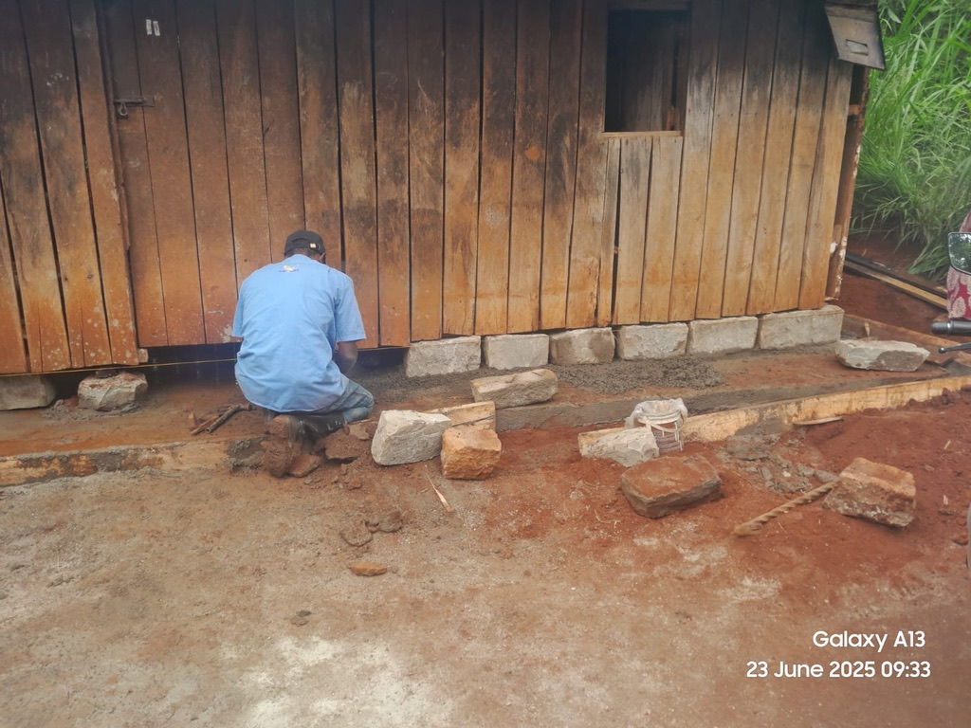
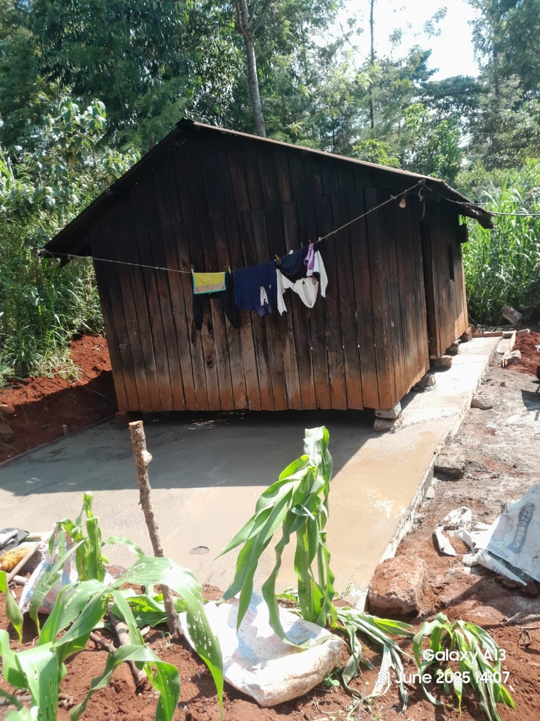
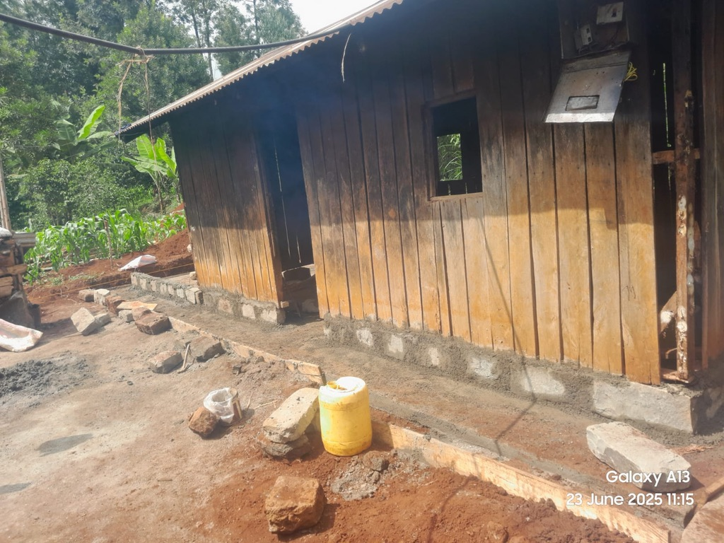

Slide 94
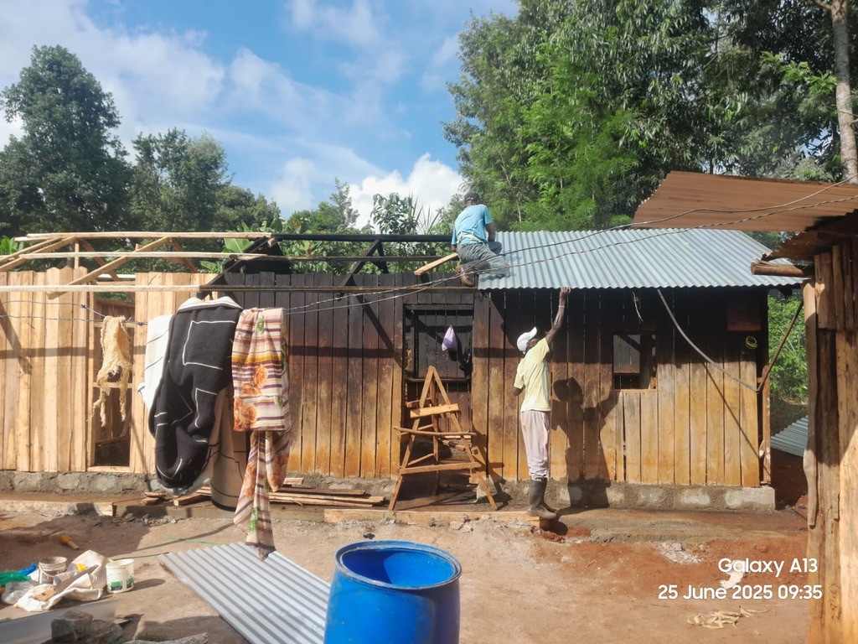

Slide 95
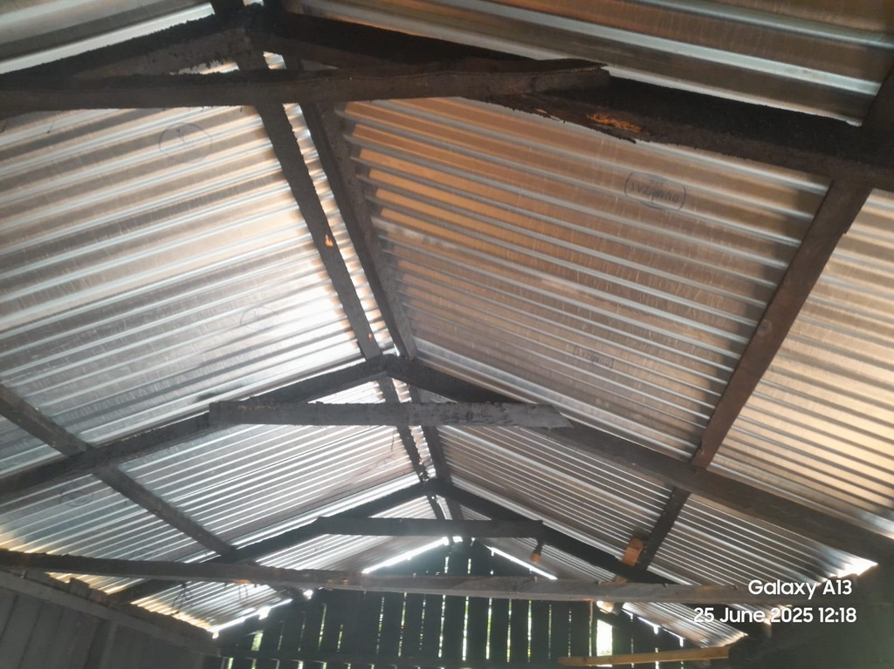

Slide 96
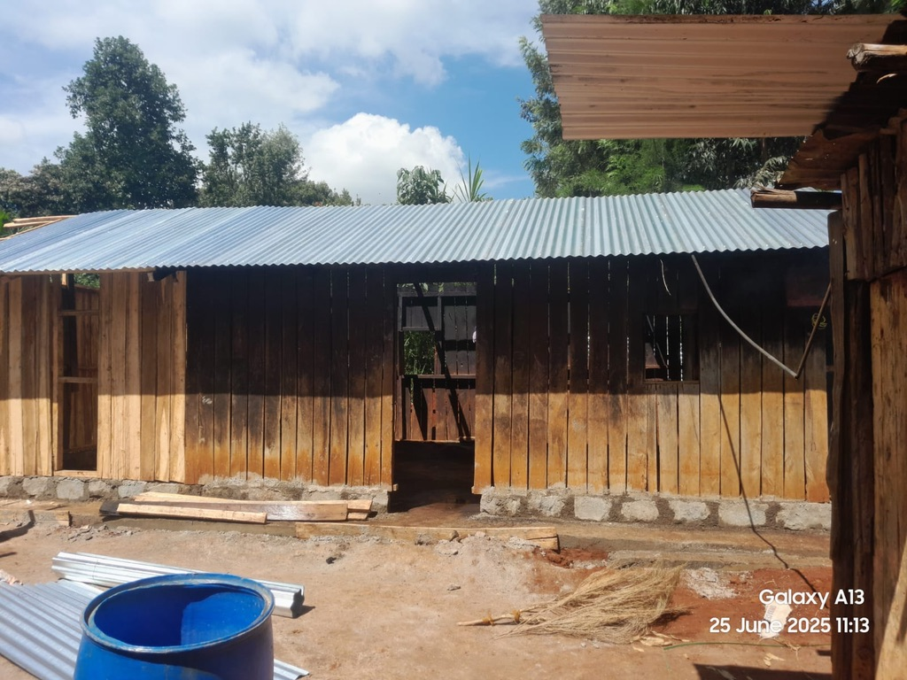

Slide 97
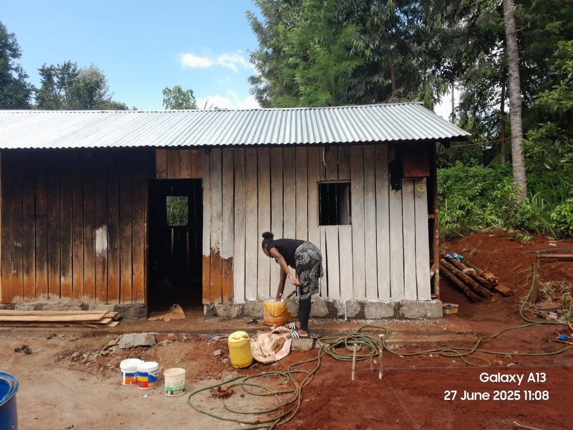

Slide 98
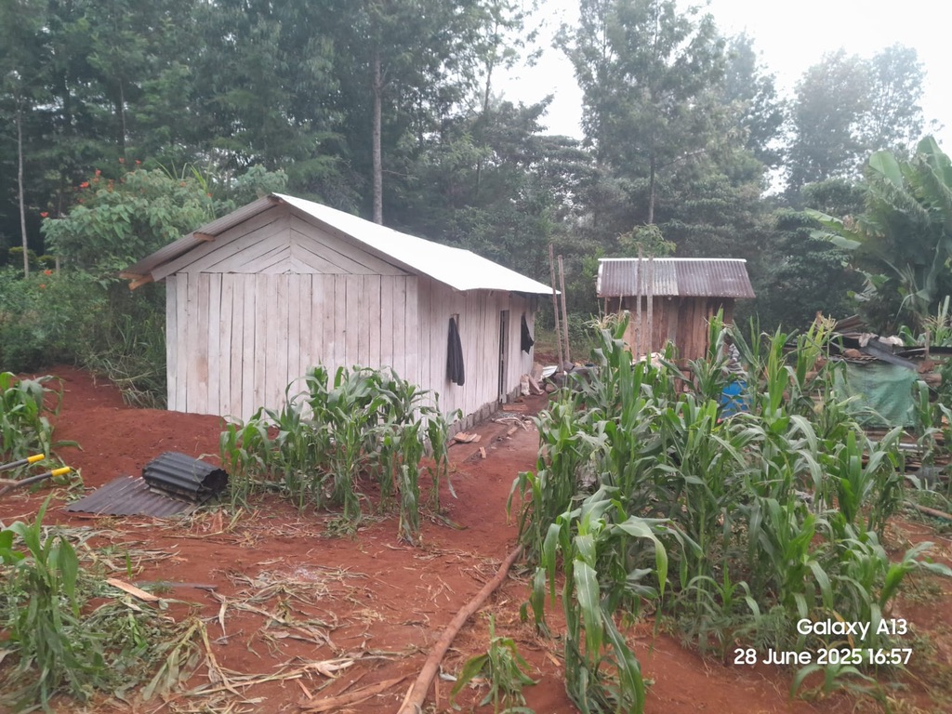
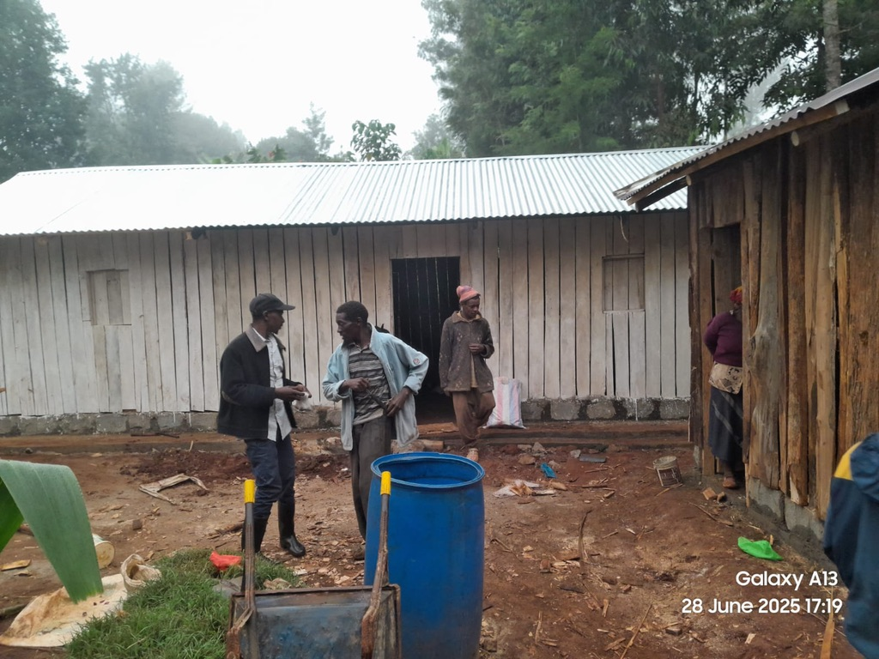

Slide 99
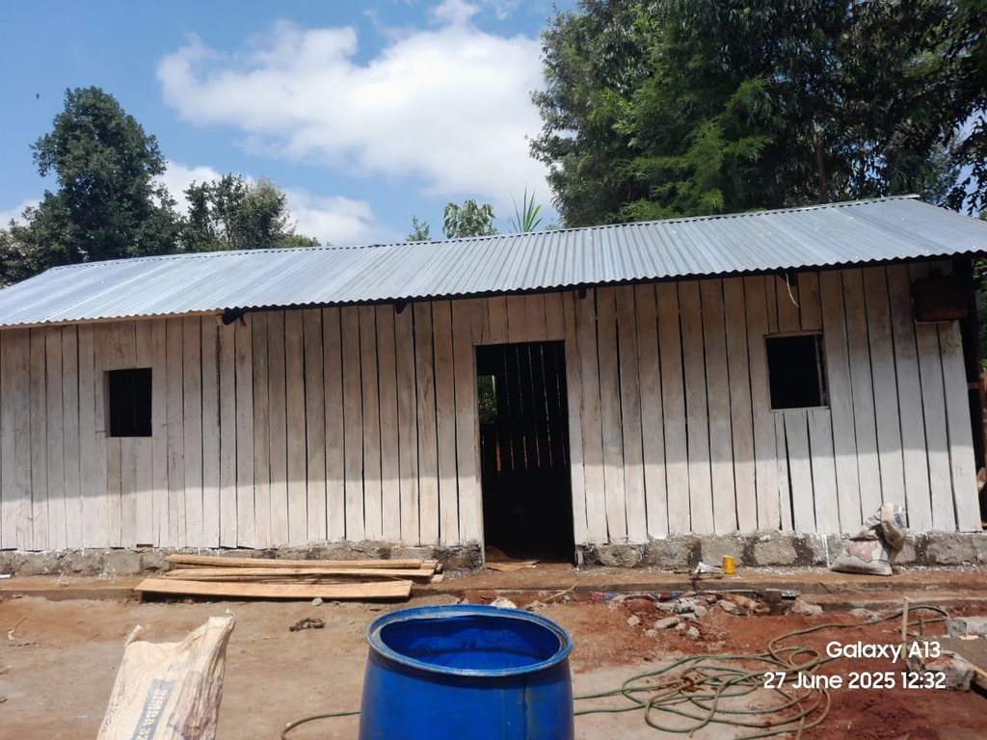

Slide 100
The Gospel
According to Matthew
Years of Preparation (Matt. 1:1-3:12).
Beginning of Jesus’ Ministry (Matt. 3:13-4:11).
The Great Galilean Ministry (Matt. 4:12-14:12).
Periods of Retirement (Matt. 14:13-18:35).
Close of Jesus’ Ministry (Matt. 19:1-20:34).
The Last Week (Matt. 21:1-27:66).
The Resurrection and Exaltation (Matt. 28:1-20).

Slide 101
Introduction
The Sermon on the Mount: unparalleled in power and depth
It continues to teach and transform lives
Three core chapters:
  Chapter 5 – Character of the Kingdom
  Chapter 6 – Righteousness, Treasure, Trust
  Chapter 7 – Living Principles

Slide 102
Chapter 5 – Character of Kingdom Citizens
Beatitudes: Who are the blessed?
Our identity reflects our spiritual character
Salt and light: influence through godly living

Slide 103
Chapter 6 – Righteousness and Trust
True righteousness is internal, not for show
Treasure: where is your heart?
Trust in the Father: Do not worry, seek the Kingdom

Slide 104
Chapter 7 – Principles for Living
Discernment and judgment
Proper prayer
The Golden Rule
Two paths: broad vs. narrow
True vs. false teachers
Foundation of life choices

Slide 105
Judging Others (Matt. 7:1–5)
Do not be a fault-finder
Self-reflection before criticizing others
Judge righteously – not hypocritically (John 7:24)

Slide 106
Judging by Fruit (Matt. 7:15–20)
Evaluate by actions, not appearances
False teachers are known by their fruit
Link to: Gal. 5:22–23 (Fruit of the Spirit)

Slide 107
Distinguishing the Holy (Matt. 7:6)
Share truth with all, but walk away from contempt
Use wisdom and discernment (Phil. 1:9–11)
Preach with peace, not force

Slide 108
Encouragement to Pray (Matt. 7:7–11)
Keep asking, seeking, knocking
Trust God's wisdom in answering
God gives what is good (Eccl. 6:12)

Slide 109
The Golden Rule (Matt. 7:12)
Not just "do no harm" — actively do good
Reflects God’s proactive love
Foundational Kingdom ethic

Slide 110
Two Paths (Matt. 7:13–14)
Broad way = easy, but leads to destruction
Narrow way = disciplined, leads to life
Ongoing commitment, not a one-time choice

Slide 111
Discernment of Teachers (Matt. 7:15–20)
Test every spirit (1 John 4:1)
Hold to what is good (1 Thess. 5:21)
Are they teaching God’s Word or man’s opinion?

Slide 112
Doers vs. Speakers (Matt. 7:21–23)
Saying “Lord, Lord” isn’t enough
True disciples do the will of the Father
Obedience matters

Slide 113
Building on the Rock (Matt. 7:24–27)
Wise builder = hears and obeys
Foolish builder = hears but ignores
Foundation tested in life’s storms

Slide 114
Final Reflections
Judgment, prayer, action, and discernment are all Kingdom values
Align life with Christ’s teachings
Scripture is the authority (John 7:16; Eph. 3:3–5)
Let’s live what we preach

Slide 115
Challenge and Commitment
What path are you choosing?
What is your foundation built upon?
Choose to serve God (Josh. 24:14; Deut. 30:19–20)
“Therefore everyone who hears these words of mine and puts them into practice is like a wise man who built his house on the rock.”
– Matthew 7:24

Slide 116
The Gospel According to Matthew
~ Chapter 8

Slide 117
The Gospel
According to Matthew
Years of Preparation (Matt. 1:1-3:12).
Beginning of Jesus’ Ministry (Matt. 3:13-4:11).
The Great Galilean Ministry (Matt. 4:12-14:12).
Periods of Retirement (Matt. 14:13-18:35).
Close of Jesus’ Ministry (Matt. 19:1-20:34).
The Last Week (Matt. 21:1-27:66).
The Resurrection and Exaltation (Matt. 28:1-20).

Slide 118
Walking in Light, Dispelling Darkness
Counting blessings can dispel darkness (1 Jn. 1:7)
Reflection on Scripture strengthens faith
Matthew 8 shows Jesus in action: miracles with purpose

Slide 119
Matthew 5–7 Recap
Chapter 5 – Correcting perverted law
Chapter 6 – Trust in God's providence
Chapter 7 – Principles of the Kingdom
Chapter 8 – Demonstrations of Jesus’ divine power

Slide 120
Why Miracles?
Confirm divine authority (Acts 2:22)
Miracle = supernatural act
Wonder = evokes awe
Sign = points to deeper spiritual truth

Slide 121
Overview of Matthew 8 Miracles
Healing a leper, paralytic, and Peter’s mother-in-law
Calming the storm
Casting out demons
Each miracle reveals a deeper principle

Slide 122
The Leper (Matt. 8:1–4)
Leprosy: compare sin
Sin begins small and grows
Jesus’ touch = complete cleansing
Guilt isolates, but Jesus restores

Slide 123
The Centurion’s Faith (Matt. 8:5–13)
A Roman shows remarkable faith
"Just say the word" – no physical contact needed
Jesus praises his faith
Distance is no obstacle to Jesus’ power

Slide 124
Peter’s Mother-in-Law (Matt. 8:14–15)
Healed by Jesus’ touch
Immediately began to serve
Healing brings strength to act
A model for spiritual service

Slide 125
Word Spreads Naturally (Matt. 8:16–17)
Jesus didn't self-promote
People came because of His works
Do good in the name of the Lord — God gets the glory (Matt. 6:4)

Slide 126
Following Jesus Isn’t Easy (Matt. 8:18–22)
Jesus tested motives of followers
He requires sacrifice and commitment
He responds to our true needs, not just our wants

Slide 127
Calming the Storm (Matt. 8:23–27)
Jesus shows power over nature
Faith in storms of life
“Stay in the boat with the Lord — you will not perish”
Trust the one who created the sea

Slide 128
Demons and the Swine (Matt. 8:28–34)
Jesus commands unclean spirits
Demons request to enter swine — swine rush into the sea
People reject Jesus — why? Fear or financial loss?
Some resist Jesus when He disrupts profit

Slide 129
Miracles with Meaning
Over disease – He restores what sin damages
Over nature – He calms chaos
Over spirits – He conquers evil
Jesus is the Lord of all creation

Slide 130
Modern Relevance
Not all claim miraculous powers — our trust is in Jesus’ divinity, not modern miracles
He still heals spiritually, gives peace, and strengthens faith
He saves us, restores us, and enables us to serve

Slide 131
Final Thoughts
Jesus isn’t just a teacher—He is the Son of God
He confirms His Word through His works
Will we trust and follow Him?
Let us bow in faith and put our trust in the One who has overcome the world!
“…He Himself took our infirmities and bore our sicknesses.”
– Matthew 8:17

Slide 132
The Gospel According to Matthew
~ Chapter 9

Slide 133
The Gospel
According to Matthew
Years of Preparation (Matt. 1:1-3:12).
Beginning of Jesus’ Ministry (Matt. 3:13-4:11).
The Great Galilean Ministry (Matt. 4:12-14:12).
Periods of Retirement (Matt. 14:13-18:35).
Close of Jesus’ Ministry (Matt. 19:1-20:34).
The Last Week (Matt. 21:1-27:66).
The Resurrection and Exaltation (Matt. 28:1-20).

Slide 134
Context & Structure of Matthew
John the Baptist prepares the way (Matt 3)
Jesus’ arrival and baptism (Matt 3-4)
Sermon on the Mount (Ch. 5–7) – Kingdom principles
Chapters 8–9: 10 Miracles demonstrating Jesus’ authority
  Ch. 8: Power over disease, nature, spiritual realm
  Ch. 9: Power over..?

Slide 135
The Healing of the Paralytic (Matt 9:1–8)
Jesus forgives sins – proving divinity
Reference: Mark 2:7 – “Who can forgive sins but God alone?”
Friends’ faith made healing possible
Spiritual Lesson: We can bring others to Jesus by our faith and effort
Jesus proves authority: “Arise, take up your bed, and go home”
Immediate, visible miracle – contrasting modern "miracles"

Slide 136
Reactions to the Miracle
The crowd marveled and glorified God (Matt 9:8)
Compare reactions to today’s claims of miracles
Key Insight: True miracles bring glory to God, not man

Slide 137
Jesus Calls Sinners, Not the Righteous (Matt 9:9–13)
Call of Matthew the tax collector
Jesus dines with sinners – challenges religious elitism
“I did not come to call the righteous, but sinners to repentance”
Cross-references:
  Ecclesiastes 7:20, Romans 3:23, Luke 5:27–32

Slide 138
A New Covenant, A New Order (Matt 9:14–17)
Question about fasting – John’s disciples vs. Jesus’
Jesus: “The bridegroom is here…”
Parables of cloth & wineskins:
  The old system (Law) in comparison to the new (Covenant)?
Key Insight: Jesus introduces a new covenant, the old order will pass away

Slide 139
The Healing on the Way (Matt 9:18–26)
Jairus’ daughter (Mark: “at the point of death”)
Jesus is not hurried, calm in urgency
Healing of the woman with the issue of blood
  Faith: “If I may touch His garment…”
Jesus: the Great Physician
Spiritual Parallel: Getting close to Jesus = spiritual healing

Slide 140
Jesus Raises the Dead
“The girl is not dead, but sleeping”
Jesus takes her hand – she arises
Power over death – confirmed in 3 recorded resurrections:
  Jairus’ daughter
  Widow’s son (Luke 7)
  Lazarus (John 11)
Death is not final for Jesus – He is life

Slide 141
The Blind See (Matt 9:27–31)
Two blind men: “Son of David, have mercy on us!”
Jesus: “Do you believe?” – Faith tested
Eyes opened – according to their faith
Spiritual lessons:
  Ephesians 1:18 – “Eyes of your heart enlightened”
  Jesus gives spiritual sight to behold the beauty of salvation

Slide 142
The Mute Speaks (Matt 9:32–34)
Demon-possessed, mute man is healed
Once healed, the man speaks
Spiritual lesson:
  Jesus not only opens eyes but liberates tongues
  We must first be healed spiritually before we can proclaim Him

Slide 143
Opposition from the Pharisees
Pharisees: “He casts out demons by the ruler of demons”
Tragic refusal to acknowledge God’s work
Application: Don’t let religious pride blind you to God’s power and goodness

Slide 144
Compassion and the Harvest (Matt 9:35–38)
Jesus: teaching, healing, and preaching the gospel of the Kingdom
Compassion for the crowds: “Like sheep without a shepherd”
“The harvest is plentiful, but the laborers are few”
Pray for more laborers in the Kingdom!

Slide 145
Summary – The King’s Power in Matthew 9
Jesus has authority over:
  Sin – He forgives
  Death – He raises the dead
  Disease – He heals
  Blindness & Muteness – He gives sight and voice
  Demons – He casts them out
Every miracle confirms His divinity and kingship
He is ushering in a new Kingdom with transformed hearts

Slide 146
Personal Reflections
Am I helping bring others to Jesus like the friends of the paralytic?
Do I trust Jesus with urgency and patience like Jairus?
Have I reached out to touch the hem of His garment in faith?
Are my spiritual eyes open?
Am I using my voice to glorify Him?
Will I be a laborer in the harvest?

Slide 147
Let the King Reign in You
Jesus, the compassionate King, calls us into His Kingdom
He offers forgiveness, healing, spiritual sight, and purpose
Let Him be your King. Let Him open your eyes and loosen your tongue
The harvest is ready – Will you follow Him?

Slide 148
The Gospel According to Matthew
~ Chapter 10

Slide 149
The Gospel
According to Matthew
Years of Preparation (Matt. 1:1-3:12).
Beginning of Jesus’ Ministry (Matt. 3:13-4:11).
The Great Galilean Ministry (Matt. 4:12-14:12).
Periods of Retirement (Matt. 14:13-18:35).
Close of Jesus’ Ministry (Matt. 19:1-20:34).
The Last Week (Matt. 21:1-27:66).
The Resurrection and Exaltation (Matt. 28:1-20).

Slide 150
Quick Recap — Chapters 1–9
Ch. 1: Genealogy & Virgin Birth
Ch. 2: Birth, Egypt, Nazareth
Ch. 3: John the Baptist, Baptism of Jesus
Ch. 4: Temptation, Preaching Begins
Chs. 5–7: Sermon on the Mount
Ch. 8: Five Miracles
Ch. 9: Five More Miracles & Growing Opposition

Slide 151
The Harvest & the Laborers (Matt. 9:35–38)
Jesus says the harvest is plentiful, but the laborers are few
He urges prayer for laborers—and they themselves are the answer
Application: Sometimes we are the answer to our own prayers

Slide 152
Preparing the Soil
Not all harvests are ready—some areas need cultivation
John & Jesus prepared the way before the apostles reaped
Application: Work the soil before expecting fruit
  E.g., modern mission fields like China

Slide 153
Calling the Twelve (Matt. 10:1–4)
Jesus empowers His twelve disciples
Their miracles prove they have been with Jesus
Each man is unique, yet called for a purpose

Slide 154
Lessons from the Apostles
Peter: Bold but flawed → became strong
James & John: “Sons of Thunder” – Zeal misapplied
Simon the Zealot & Matthew the Tax Collector: Once enemies, now brothers
Judas Iscariot: Chosen but unfaithful
Thomas: Honest doubt, seeking truth

Slide 155
Sent to the House of Israel (Matt. 10:5–7)
Why not Gentiles yet?
Jews were more prepared
Message: “The Kingdom of Heaven is at hand”

Slide 156
Miracles with a Purpose (Matt. 10:8)
Three Purposes:
  Confirm the Word
  Attract people
  Show the goodness of the Kingdom
Application: Miracles showed that love and grace are central to the gospel

Slide 157
Trusting God's Provision (Matt. 10:9–10)
No money or extra supplies
Lesson: Faith in God's daily provision
Luke 22: Jesus later tells them to prepare—timing matters

Slide 158
Receiving or Rejecting the Message (Matt. 10:11–15)
Stay where you are welcomed
If rejected, shake the dust off
Judgment will be more severe than for Sodom

Slide 159
Be Wise and Harmless (Matt. 10:16)
Wise as serpents: Discernment, caution
Harmless as doves: Peaceful, pure motives
Application: Don’t mistake wisdom for cowardice

Slide 160
Persecution & Faithfulness (Matt. 10:17–23)
Opposition will come—even from family
Endurance = Salvation (Matt. 10:22, Rev. 2:10)
Remain faithful unto death—not just until death

Slide 161
Not Above the Master (Matt. 10:24–25)
If Jesus was insulted, so will we
Called “Beelzebub” – god of filth
Don’t be discouraged by ridicule or rejection

Slide 162
Fear God, Not Man (Matt. 10:26–28)
Man can kill the body, not the soul
God sees and will judge all things
Application: Preach boldly, trust God's justice

Slide 163
God Cares Deeply (Matt. 10:29–31)
Not even a sparrow falls without God knowing
You are of more value than many sparrows
Isa. 40:26 – God names stars, and He knows your name

Slide 164
Confess Christ Boldly (Matt. 10:32–33)
Confession is a lifelong commitment
Romans 10:9–10 – Believe and confess
Even in death, we stand with Christ

Slide 165
Jesus Brings a Sword (Matt. 10:34–36)
Not peace—but division over truth
Gospel may divide families
Application: Be ready to choose truth over tradition

Slide 166
Count the Cost (Matt. 10:37–39)
Love for Christ must exceed all
Cf. Luke 14: Count the cost of discipleship
Taking up your cross = real sacrifice

Slide 167
Representing Christ (Matt. 10:40–41)
Receiving the apostles = receiving Christ
Rejecting apostolic teaching = rejecting Jesus
Be careful not to "red-letter" only the words of Christ

Slide 168
Even a Cup of Cold Water (Matt. 10:42)
No act of service is too small
You won’t lose your reward
God sees your faithfulness, even when others don’t

Slide 169
Final Thoughts – Lessons from Chapter 10
Jesus sends diverse people on a shared mission
He warns of challenges, but gives reassurance
Be wise, faithful, and committed
Do not grow weary—persevere and stay faithful

Slide 170
The Gospel According to Matthew
~ Chapter 11

Slide 171
The Gospel
According to Matthew
Years of Preparation (Matt. 1:1-3:12).
Beginning of Jesus’ Ministry (Matt. 3:13-4:11).
The Great Galilean Ministry (Matt. 4:12-14:12).
Periods of Retirement (Matt. 14:13-18:35).
Close of Jesus’ Ministry (Matt. 19:1-20:34).
The Last Week (Matt. 21:1-27:66).
The Resurrection and Exaltation (Matt. 28:1-20).

Slide 172
Introduction
So far in Matthew: Jesus’ ministry among the Jews regarding the Kingdom of Heaven
This chapter focuses on:
  Jesus’ relationship with John the Baptist
  His rebuke of three cities
  His prayer to the Father & gracious invitation
Previous lesson: The Limited Commission (Matt. 10)

Slide 173
John’s Question (Matt. 11:1–3)
John, in prison, hears of Jesus’ works
Sends disciples: “Are You the Coming One, or should we look for another?”
John’s prior bold preaching & witness:
  Kingdom at hand (Matt. 3:2)
  Lamb of God (Jn. 1:29, 34, 36)
  Herald of the Messiah (Mal. 3:1)

Slide 174
Jesus’ Reply (Matt. 11:4–6)
“Tell John what you see and hear” – miracles & Kingdom works
Possible reasons for John’s question:
  Reassurance for himself or disciples
  Confusion about timing or method of ministry
Key Point: Jesus’ mission validated by works, not political power

Slide 175
Jesus Honors John (Matt. 11:7–11)
Not a reed shaken by the wind – steadfast!
Not a man in soft garments – not a politician
“A prophet… and more than a prophet” (Mal. 3:1)
Greatest born of women… yet least in the Kingdom is greater
We are part of a royal priesthood (1 Pet. 2:9)

Slide 176
The Kingdom & Violence (Matt. 11:12)
“Kingdom suffers violence” – people attempting to seize it by force
Examples:
  John 6:15 – making Jesus king by force
  Peter in Gethsemane (Jn. 18:11)
Key Point: Christ’s Kingdom is not political

Slide 177
John as Elijah (Matt. 11:13–15)
Law & Prophets prophesied until John
John = Elijah in spirit & power (Mal. 4:5; Lk. 1:17)
Boldness like Elijah (1 Ki. 18; 2 Ki. 1)
Kingdom subjects enjoy greater blessings

Slide 178
The Critical Generation (Matt. 11:16–19)
Like children unwilling to be pleased
Criticized both John (too austere) & Jesus (too social)
Lesson: Some will always find fault instead of accepting truth
“Wisdom is justified by her children” – fruit reveals true wisdom (Jas. 3:13–18)

Slide 179
Rebuke of the Cities (Matt. 11:20–24)
Chorazin & Bethsaida: saw mighty works, but did not repent
Capernaum: exalted, yet will be brought low
More tolerable for Tyre, Sidon, & Sodom in judgment
Opportunity brings responsibility (Jn. 20:30–31)

Slide 180
U.S. Application
America: richly blessed with gospel access
Danger: treating blessings lightly
We are accountable for our opportunities

Slide 181
Jesus’ Prayer (Matt. 11:25–27)
Hidden from the proud, revealed to the humble
Knowing the Son & Father depends on Jesus’ revelation
Pride = barrier to true knowledge of God (Jas. 4:10; 1 Pet. 5:6)

Slide 182
The Lord’s Invitation (Matt. 11:28–30)
“Come to Me… I will give you rest”
Yoke: easy • Burden: light
Rest for the soul found only in Christ
All are invited—none turned away

Slide 183
Key Takeaways
Opportunity begets responsibility
Grave danger in indifference to the Gospel
In the Kingdom, least is greater than John—don’t undervalue your standing in Christ

Slide 184
The Gospel According to Matthew
~ Chapter 12

Slide 185
The Gospel
According to Matthew
Years of Preparation (Matt. 1:1-3:12).
Beginning of Jesus’ Ministry (Matt. 3:13-4:11).
The Great Galilean Ministry (Matt. 4:12-14:12).
Periods of Retirement (Matt. 14:13-18:35).
Close of Jesus’ Ministry (Matt. 19:1-20:34).
The Last Week (Matt. 21:1-27:66).
The Resurrection and Exaltation (Matt. 28:1-20).

Slide 186
INTRODUCTION
Jesus in Conflict with the Pharisees (Matthew 12)
Opposition to truth is inevitable
Pharisees bound by tradition, not truth
Lessons for today’s disciples

Slide 187
Opposition to Truth
Matthew 9 and 12: Pharisees oppose Jesus
Preachers of truth will face resistance
Traditions often valued above God’s Word
Danger of misjudging based on human traditions

Slide 188
Conflict over the Sabbath (12:1–8)
Disciples pluck grain → Pharisees accuse of breaking the Sabbath
Jesus responds with three arguments:
  David & holy bread (1 Sam. 21) – human need > ceremonial law
  Priests in temple – their service transcends Sabbath restrictions
  Jesus > Temple – “Son of Man is Lord of the Sabbath”

Slide 189
Healing on the Sabbath (12:9–14)
Man with withered hand → Pharisees test Jesus
Jesus: “Of how much more value is a man than a sheep?”
It is lawful to do good on the Sabbath (Matt. 12:12; James 4:17)
Pharisees plot to destroy Him

Slide 190
Lessons on Authority
Traditions ≠ God’s law
Mark 2:27–28: Sabbath made for man
Only Jesus can interpret the Law fully
Warning: avoid binding where God has not bound

Slide 191
Jesus’ Example of Wisdom (12:15–21)
Jesus withdraws from conflict, yet continues healing
Fulfillment of Isaiah’s prophecy
Gentle servant: “A bruised reed He will not break”
Jesus came to save, not destroy (Luke 9:56)

Slide 192
Accusation of Casting Out Demons by Satan (12:22–30)
Jesus heals demon-possessed, blind, and mute man
Pharisees: “He casts out demons by Beelzebub”
Jesus:
  A divided kingdom cannot stand
  If by God’s Spirit → Kingdom of God has come
  Stronger than Satan → binding the strong man
Choice required: with Christ or against Him

Slide 193
Blasphemy Against the Spirit (12:31–32)
Persistent rejection of the Spirit’s witness → no forgiveness
Danger of hardening heart until unable to repent
Application: accept God’s Word while time remains

Slide 194
Good and Evil Fruit (12:33–37)
Pharisees’ words reveal their hearts
Warning: careless words will be judged
James 3: the tongue is powerful and dangerous
We must speak truth with a good heart

Slide 195
The Sign of Jonah (12:38–42)
Pharisees demand a sign → Jesus points to Jonah
Jonah = 3 days in the fish → Jesus = 3 days in the earth
Resurrection = ultimate sign of divinity
Nineveh repented, Queen of Sheba sought wisdom → greater than Jonah & Solomon is here

Slide 196
Warning about Empty Houses (12:43–45)
Unclean spirit returns with more demons → worse condition
Spiritual lesson: opportunities wasted → decline
Growth and commitment necessary after conversion

Slide 197
True Family of Jesus (12:46–50)
Jesus’ family seeks Him → He points to disciples
True kinship = doing the will of God
Spiritual family > physical family
Challenge: who are we closest to—world or brethren?

Slide 198
Conclusion
Jesus often in conflict with Pharisees
Demonstrated power over Satan, healing, and resurrection
Key takeaways:
  Avoid elevating tradition above God’s Word
  Prioritize mercy, truth, and spiritual kinship
  Respond to the evidence of Christ’s power with faith

Slide 199
The Gospel According to Matthew
~ Chapter 13

Slide 200
The Gospel
According to Matthew
Years of Preparation (Matt. 1:1-3:12).
Beginning of Jesus’ Ministry (Matt. 3:13-4:11).
The Great Galilean Ministry (Matt. 4:12-14:12).
Periods of Retirement (Matt. 14:13-18:35).
Close of Jesus’ Ministry (Matt. 19:1-20:34).
The Last Week (Matt. 21:1-27:66).
The Resurrection and Exaltation (Matt. 28:1-20).

Slide 201
Introduction
The Kingdom of Heaven is a central theme in Matthew.
Prophesied in the Old Testament.
John the Baptist: “Repent, for the Kingdom of Heaven is at hand” (Matt. 3:2).
Jesus echoes the same message in His ministry (Matt. 4:17).

Slide 202
Sermon on the Mount (Matt. 5–7)
Beatitudes: blessings tied to Kingdom citizenship (5:3, 5:10).
Greatness in the Kingdom based on obedience (5:19).
Righteousness must exceed that of Pharisees (5:20).
Not all who say “Lord, Lord” will enter (7:21).

Slide 203
Kingdom Expands (Matt. 8 & 11)
Many will join from east and west (8:11).
John the Baptist: great, yet least in the Kingdom is greater (11:11).
The Kingdom faces opposition but continues forward (11:12).

Slide 204
Chapter 13 Overview
Kingdom mentioned 8 times.
Seven parables: Sower, Tares, Mustard Seed, Leaven, Treasure, Pearl, Dragnet.
Parables reveal truth to seekers, conceal from rejecters.

Slide 205
Parable of the Sower (13:1–23)
Four types of soil (hearts):
  Pathway: word snatched away.
  Rocky: no root, faith withers.
  Thorny: cares & riches choke faith.
  Good soil: hears, understands, bears fruit.
Reminder: not all will respond, but some will produce fruit.

Slide 206
Parable of the Tares (13:24–30, 36–43)
Good seed = sons of the Kingdom.
Tares = sons of the wicked one.
Harvest = end of the age.
Lesson: God will separate righteous from wicked in the final judgment.

Slide 207
Parable of the Mustard Seed (13:31–32)
Smallest seed → greatest plant.
Kingdom starts small but grows great.
Symbolizes growth, inclusiveness, and faith’s potential.

Slide 208
Parable of the Leaven (13:33)
Small influence permeates the whole.
Kingdom spreads quietly but powerfully.
Christians = salt and light (Matt. 5:13–16).

Slide 209
Parable of the Hidden Treasure (13:44)
Man sells all to gain hidden treasure.
Illustrates Kingdom’s surpassing value.
Worth more than worldly riches or traditions.

Slide 210
Parable of the Pearl (13:45–46)
Merchant seeks fine pearls, sells all for one pearl of great price.
Seeker finds what is worth everything.
Both treasure & pearl = Kingdom’s incomparable worth.

Slide 211
Parable of the Dragnet (13:47–50)
Net gathers of all all kind.
Angels separate wicked from righteous at the end.
Reminder: being in the “net” ≠ guaranteed salvation—must bear fruit.

Slide 212
Final Lessons (13:51–52)
Old & new treasures = applying past & present understanding.
Growth is both blessing and responsibility.
Accountability: use what God has given, not bury it.

Slide 213
Key Takeaways
Kingdom citizens:
  Sow the Word faithfully.
  Expect different responses.
  Grow in faith, even from small beginnings.
  Influence the world quietly but powerfully.
  Treasure the Kingdom above all else.
  Live prepared for final judgment.

Slide 214
Closing Challenge
The Kingdom is priceless—worth every sacrifice.
Faithfulness, influence, and fruit-bearing define citizens.
“He who has ears to hear, let him hear” (Matt. 13:43).

Slide 216
The Gospel According to Matthew
~ Chapter 13 (Cont.)
~ Chapter 14

Slide 217
The Gospel
According to Matthew
Years of Preparation (Matt. 1:1-3:12).
Beginning of Jesus’ Ministry (Matt. 3:13-4:11).
The Great Galilean Ministry (Matt. 4:12-14:12).
Periods of Retirement (Matt. 14:13-18:35).
Close of Jesus’ Ministry (Matt. 19:1-20:34).
The Last Week (Matt. 21:1-27:66).
The Resurrection and Exaltation (Matt. 28:1-20).

Slide 218
Jesus Returns to His Hometown (Matt. 13:53–58)
Jesus finishes His parables and returns home
Teaches in the synagogue → people astonished
Questioned: “Is this not the carpenter’s son? … Are not His brothers and sisters with us?”
Instead of faith → offense at Him

Slide 219
Rejection of a Prophet
Jesus responds: “A prophet is not without honor except in his own country and in his own house” (v. 57)
He performed few mighty works → because of unbelief
Lesson: A hardened heart can block God’s blessings

Slide 220
Parallels with the Prophets
Prophets rejected by their own people:
  Jeremiah 11:21
  Amos 7:12–13
Foreshadows Jesus’ ultimate rejection by Israel
Points toward His crucifixion

Slide 221
Warnings for Us Today
Familiarity can breed contempt
Danger: Becoming too used to Jesus, Scripture, or church
Guard against apathy → Rediscover awe in the Lord
Don’t dismiss truth or people God uses because they don’t meet our expectations

Slide 222
Application
Even when rejected, Jesus continued His mission
We, too, must remain steadfast in following God
Faithfulness matters—even when misunderstood or dismissed by those closest to us

Slide 223
Matthew 14
Stark contrast: Herod’s wickedness vs. Jesus’ righteousness
Key events:
  Death of John the Baptist
  Feeding the 5,000
  Jesus walks on water
  Healing at Gennesaret

Slide 224
Herod’s Troubled Conscience (vv. 1–2)
Herod hears reports about Jesus
Believes: “This is John the Baptist risen from the dead”
Conscience guilty → superstition versus faith

Slide 225
John’s Rebuke & Imprisonment (vv. 3–5)
John rebuked Herod for marrying his brother’s wife
Herodias = driving force behind John’s imprisonment
Herod feared the people → reluctant to kill John

Slide 226
The Death of John (vv. 6–12)
Herod’s birthday feast → daughter of Herodias danced
Herod’s rash oath → request for John’s head
John executed → disciples buried him & told Jesus
Lesson: Truth-tellers may suffer, but remain faithful

Slide 227
The Character of Herod & Herodias
Herod Antipas: cunning, weak, politically ambitious
Herodias: manipulative, power-hungry, vengeful
Union condemned by Law (Lev. 18:16; 20:21)
Sin’s consequences: downfall & destruction (Hos. 8:7; Gal. 6:7–8)

Slide 228
Contrast: Wickedness vs. Righteousness
Herod & Herodias: lust, pride, manipulation
John the Baptist: bold truth-telling, righteousness
Jesus: compassion, healing, provision, faithfulness

Slide 229
Feeding the 5,000 (vv. 13–21)
Jesus sought solitude → multitudes followed
Compassion: healed the sick & taught them
Disciples: “Send them away” → Jesus: “You give them food”
A boy’s loaves & fish (Jn.) → multiplied to feed thousands
Lesson: Bring what you have → God multiplies

Slide 230
Lessons from the Miracle
Small offerings + faith → abundant results (Eph. 3:20–21)
Apostles grew in faith through service
Generosity principle: Lk. 6:38 → blessings overflow
Twelve baskets left = God’s provision never runs dry

Slide 231
Jesus Walks on Water (vv. 22–33)
Disciples struggle in the storm → “contrary winds”
Jesus walks on the sea → disciples afraid
Peter steps out in faith → begins to sink when distracted
Jesus rescues him → together walk back on water
Lesson: With Jesus in the boat, storms grow calm

Slide 232
Arrival at Gennesaret (vv. 34–36)
Jesus and disciples cross over the sea
People immediately recognize Him
Word spreads quickly throughout the region

Slide 233
The People’s Response
Multitudes bring their sick to Jesus
They beg just to touch the hem of His garment
Great faith displayed in their actions

Slide 234
The Result
“As many as touched Him were made perfectly well”
Complete healing → no exceptions
No one was disappointed

Slide 235
Key Takeaway
Jesus meets every true need
His power is unlimited
Those who come to Him in faith always find hope and healing

Slide 236
Key Applications
Faith like John: Stand for truth, even at a cost
Compassion like Jesus: Meet needs with action, not just feeling
Faith like Peter: Step out in trust—even if we falter, Jesus saves
Keep eyes fixed on Christ → storms fade, hope remains
Jesus never disappoints (vv. 34–36)

Slide 237
The Gospel According to Matthew
~ Chapter 15

Slide 238
The Gospel
According to Matthew
Years of Preparation (Matt. 1:1-3:12).
Beginning of Jesus’ Ministry (Matt. 3:13-4:11).
The Great Galilean Ministry (Matt. 4:12-14:12).
Periods of Retirement (Matt. 14:13-18:35).
Close of Jesus’ Ministry (Matt. 19:1-20:34).
The Last Week (Matt. 21:1-27:66).
The Resurrection and Exaltation (Matt. 28:1-20).

Slide 239
Overview
Jesus prepares His Kingdom
Confrontation with Pharisees (traditions vs. God’s word)
The faith of the Syrophoenician woman
Miracles among Gentiles
Feeding of the 4,000

Slide 240
Pharisees Challenge Jesus (vv. 1–3)
Pharisees question disciples’ handwashing
Jesus counters: Why transgress God’s commands for tradition?
Human tradition vs. God’s Word

Slide 241
Tradition vs. Commandment (vv. 4–7)
Example: Honoring parents vs. Corban (Mark 7:11)
Pharisees nullify God’s law by tradition
Application: Responsibility to care for parents
Contrast: cultures where the elderly are honored

Slide 242
Dangers of Tradition
Traditions are not inherently wrong
Problem arises when tradition contradicts Scripture
Examples:
  Mechanical instruments in worship (tradition vs. command)
  Roman Catholic forms added later
Key: Worship must align with God’s Word

Slide 243
True Defilement (vv. 10–20)
Not what goes in, but what comes out defiles
Pharisees: blind leaders of the blind
From the heart come evil thoughts, murders, adulteries, etc.
Proverbs 4:23 – Guard your heart diligently

Slide 244
The Heart over Ritual
Jesus rejects ceremonial cleansing as a measure of purity
True defilement = heart condition
Col. 2:16–23 – false wisdom & empty tradition
Application: Focus on inner transformation, not outward show

Slide 245
Faith of the Canaanite Woman (vv. 21–28)
Woman of Canaan calls Jesus Son of David
Contrast: Pharisees rejected Him
Her persistence: Love, faith, perseverance
Jesus: Great is your faith! Daughter healed

Slide 246
Lessons from Her Faith
Persistent prayer (Luke 18:1–8)
God’s responses: Yes, No, Not Yet, Maybe
Faith pushes past silence and obstacles
Application: Do we persist in prayer?

Slide 247
Healing Multitudes (vv. 29–31)
Jesus heals lame, blind, mute, maimed
Multitudes glorify “the God of Israel”
Gentile emphasis: Kingdom is for all

Slide 248
Feeding the 4,000 (vv. 32–39)
Compassion for the hungry crowd
Seven loaves + few fish → abundance
Distinct from feeding the 5,000
Seven large baskets left over (Acts 9:25 type basket)

Slide 249
Spiritual Significance
Jesus provides both physical and spiritual bread
Theme of provision:
  Feeding 5,000
  Feeding 4,000
  Lord’s Supper (Matt. 26)
Abundance remains—Jesus satisfies fully

Slide 250
Ministry Application
Every member’s role (Eph. 4:11–16)
Not just preachers/teachers—all supply growth
Build the Church on God’s foundation (Matt. 7:24–27)
True ministry = body working together

Slide 251
Key Lessons from Matthew 15
Human traditions cannot replace God’s Word
Faith tested reveals persistence and love
Jesus provides abundantly for all—Jews & Gentiles
Guard your heart above all else
Every believer has a role in God’s Kingdom

Slide 252
Closing Thought
Jesus is the Bread of Life who satisfies all needs
Will we hold to traditions or to God’s Word?
Will our faith persist like the Canaanite woman’s?
Will we contribute to the body of Christ?

Slide 253
The Gospel According to Matthew
~ Chapter 16

Slide 254
The Gospel
According to Matthew
Years of Preparation (Matt. 1:1-3:12).
Beginning of Jesus’ Ministry (Matt. 3:13-4:11).
The Great Galilean Ministry (Matt. 4:12-14:12).
Periods of Retirement (Matt. 14:13-18:35).
Close of Jesus’ Ministry (Matt. 19:1-20:34).
The Last Week (Matt. 21:1-27:66).
The Resurrection and Exaltation (Matt. 28:1-20).

Slide 255
Chapter 16 Overview
Jesus confronted Pharisees & scribes about traditions
Now faces Pharisees + Sadducees together (unusual alliance)
Key themes:
  Warning against “leaven”
  Promise to build His church
  Prediction of death & resurrection

Slide 256
Pharisees & Sadducees
Normally opposed each other
United in opposition to Jesus
Pharisees: strict law, believed in angels & resurrection
Sadducees: materialistic, political, denied resurrection
Both demand a sign from heaven

Slide 257
“Signs of the Times” (vv. 1–4)
Jesus rebukes them: “You can read the sky but not the times”
Signs included:
  John’s preaching
  Jesus’ teaching & miracles
  Fulfilled prophecy
Only sign: prophet Jonah → 3 days in the earth (resurrection)

Slide 258
Spiritual Adultery
“Wicked & adulterous generation” = spiritual unfaithfulness
Adultery = turning from God to falsehoods
Jonah’s sign = foreshadow of Jesus’ death & resurrection

Slide 259
The Leaven Warning (vv. 5–12)
Disciples worried about bread
Jesus reminds them:
  Fed 5,000 (12 baskets left)
  Fed 4,000 (7 baskets left)
Leaven = false doctrine of Pharisees & Sadducees
Today: beware of ritualism & materialism

Slide 260
Leaven: Two Uses
Positive (Matt. 13): Kingdom’s influence spreads
Negative (Matt. 16): Corrupting influence of false teaching
Key lesson: guard hearts & minds against error

Slide 261
Caesarea Philippi
Pagan city, center for worship of Pan
“Gates of Hades” nearby
Built on massive rock/cliff
Jesus uses setting to reveal church foundation

Slide 262
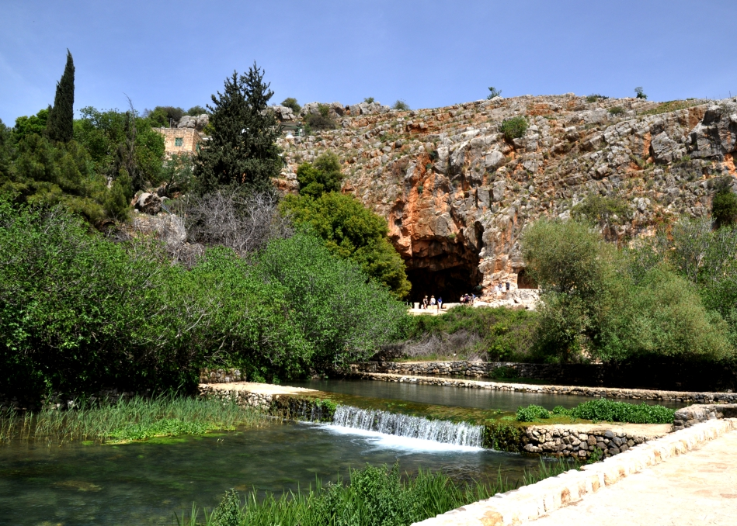

Slide 263
“Who Do You Say I Am?” (vv. 13–17)
Public opinion: John, Elijah, Jeremiah, or prophet
Peter’s confession: “You are the Christ, the Son of the Living God”
Revelation through evidence & Spirit’s work
Still the central question today

Slide 265
The Rock & The Church (v. 18)
Wordplay: Petros (Peter) vs. Petra (rock ledge)
Church built on truth of Jesus as Christ
OT prophecy: cornerstone (Ps. 118:22; Isa. 28:16)
NT fulfillment: Christ = cornerstone (Acts 4, 1 Peter 2)

Slide 267
Keys of the Kingdom (v. 19)
Authority given (cf. 18:1, 18)
“Binding & loosing” = reflecting heaven’s authority
Not human decision → God’s will revealed

Slide 268
Jesus Predicts His Death (vv. 21–23)
Must suffer, die, and rise on the third day
Peter objects → Jesus rebukes him: “Get behind Me, Satan!”
Lesson: think with God’s perspective, not man’s

Slide 269
Taking Up the Cross (vv. 24–26)
Requirements of discipleship:
  Deny self
  Take up cross
  Follow Jesus
True life found by losing it for Christ
What profit is the whole world if you lose your soul?

Slide 270
Coming of the Son of Man (vv. 27–28)
Jesus will return in glory & judgment
Some standing there would live to see it
Likely reference: judgment on Jerusalem (AD 70)
Fulfilled within that generation

Slide 271
Chapter Summary
Pharisees & Sadducees demand sign → given Jonah’s sign
Warning: beware of their leaven (false teaching)
Peter’s confession: Jesus is the Christ
Promise: Christ will build His church on this truth
Jesus predicts death & resurrection
Call to disciples: take up your cross
Promise of judgment & ultimate accountability

Slide 273
The Gospel According to Matthew
Chapter 17: From the mountain of glory to the valley of unbelief

Slide 274
Overview of Matthew 17
Transfiguration (vv. 1–13)
Healing of the boy with a demon (vv. 14–21)
Second prediction of Jesus’ death (vv. 22–23)
The temple tax (vv. 24–27)
Key themes: Faith • Transformation • Submission • Glory beyond the cross

Slide 275
Importance of Preaching Jesus
We must spend intimate time with the Lord through the Gospels
People need to see and know Jesus
The Gospels reveal the heart of our faith—His words, works, and ways

Slide 276
The Transfiguration (vv. 1–2)
Jesus takes Peter, James, and John up the mountain
His face shines like the sun; clothes white as light
Occurs six days after Peter’s confession (Matt 16:21–28)
A foretaste of resurrection glory

Slide 277
Peter, James, and John
Inner circle seen 3 times:
  Jairus’ daughter (Mark 5:21–43)
  Transfiguration (Matt 17:1–13)
  Gethsemane (Matt 26:36–46)
Possible reasons(?): leadership development, unique callings
  Peter – first preacher (Acts 2, 10)
  James – first apostolic martyr (Acts 12:1–4)
  John – longest living, close to Jesus

Slide 278
The Meaning of “Transfigured”
Greek metamorphoō – transformed, changed in form
Same word in Romans 12:2 — “Be transformed by renewing your mind.”
Transformation comes through time with God

Slide 279
Transformation through Prayer
Luke 9:28–29 — “As He prayed, His appearance was altered.”
True change comes from prayer and communion
2 Cor 3:18 — “Beholding the glory of the Lord, we are transformed.”
Transformation is both inward (now) and future (glory to come)

Slide 280
Purpose of the Transfiguration
To strengthen disciples’ faith before His suffering
To reveal the glory beyond the cross (cf. Phil. 3:20–21)
To remind us that glory follows obedience and suffering

Slide 281
Moses and Elijah Appear (v. 3)
Represent(?) the Law (Moses) and Prophets (Elijah)
Both encountered God on mountains
One died (Moses), one did not (Elijah)
Symbolic of the living & the dead united in Christ (1 Thess. 4:13–18)?

Slide 282
Peter’s Response and God’s Voice
Peter: “Let’s build three tabernacles.”
God’s voice from the cloud:
  “This is My beloved Son… Hear Him.”
Shift from Law and Prophets → to Christ’s authority
Glory cloud = God’s presence (Ex 40; 1 Kgs 8)

Slide 283
“They Saw No One but Jesus”
After the voice, only Jesus remains (v. 8)
The glory fades, but Christ endures
The cross still lies ahead — glory comes after suffering

Slide 284
Peter’s Later Reflection (2 Peter 1:16–18)
Peter recalls being an eyewitness of His majesty
Confirms the truth of the gospel
The Transfiguration validated Jesus’ divine sonship

Slide 285
Descent into the Valley (vv. 14–21)
From the mountain of glory → valley of unbelief
Boy with a demon brought to the disciples
They could not heal him
Jesus rebukes their lack of faith

Slide 286
Faith and the Mustard Seed
“If you have faith as a mustard seed…”
Not size of faith, but the presence of true faith
Prayer and fasting needed (v. 21)
Faith unlocks divine potential (Eph. 3:20)

Slide 287
Second Prediction of His Death (vv. 22–23)
Jesus foretells betrayal, death, and resurrection
Disciples grieve — they do not yet understand
Faith must endure through sorrow and uncertainty

Slide 288
The Temple Tax (vv. 24–27)
Collectors question Peter about Jesus’ tax
Jesus: “Sons are free, but pay so as not to offend.”
Miraculous coin in the fish’s mouth
Lesson: humble submission and avoiding unnecessary offense

Slide 289
Relinquishing Rights
Jesus models yielding personal rights for others’ sake
Paul echoes this principle (1 Cor 8–10; Rom 14)
True discipleship sometimes means giving up privileges
Freedom used in love, not entitlement

Slide 290
Lessons from Matthew 17
True transformation comes from time with Christ
Faith overcomes unbelief
Glory lies beyond the cross
Humility and restraint display true strength
Listen to Jesus—the Son in whom the Father is pleased

Slide 291
Application
Spend “intimate” time in the Gospels—see Jesus clearly
Faith is tested in the valleys
Prayer renews and transforms
Use freedom responsibly; seek peace, not offense

Slide 292
Closing Reflection
Every disciple will experience both mountain and valley moments
Transformation comes through time in Lord’s presence
Let our faith move mountains, our humility reflect Christ,
and our lives point others to Jesus.

Slide 294
The Gospel According to Matthew
~ Chapter 18

Slide 295
The Gospel
According to Matthew
Years of Preparation (Matt. 1:1-3:12).
Beginning of Jesus’ Ministry (Matt. 3:13-4:11).
The Great Galilean Ministry (Matt. 4:12-14:12).
Periods of Retirement (Matt. 14:13-18:35).
Close of Jesus’ Ministry (Matt. 19:1-20:34).
The Last Week (Matt. 21:1-27:66).
The Resurrection and Exaltation (Matt. 28:1-20).

Slide 296
Matthew 18: Kingdom Principles for God’s People
Jesus nearing end of His ministry
Foundational teachings for Kingdom life
Corrects disciples’ misunderstandings
Teaches humility, concern, discipline, forgiveness
Four major Kingdom principles

Slide 297
Becoming Like Little Children
Greatness begins with conversion and humility
Children: trusting, dependent, directable, without pride
Receiving a disciple = receiving Christ

Slide 298
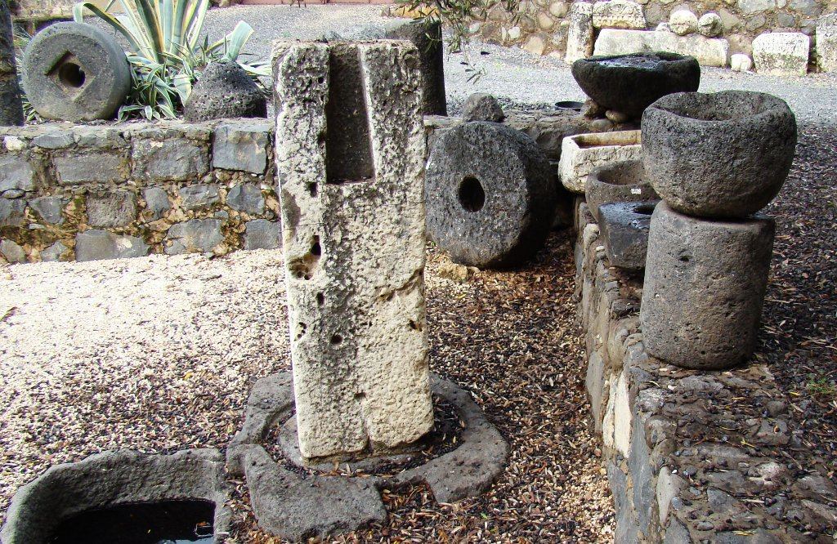
Serious Warning
Causing “little ones” to stumble = severe offense
Millstone imagery shows gravity of leading others astray

Slide 299
Personal Vigilance & God’s Care
Remove anything that causes sin (“cut it off”)
Do not despise any believer
God seeks the wandering one (Lost Sheep)
We must care for one another

Slide 300
Steps of Biblical Restoration
Go privately
Bring witnesses if needed
Tell the church if unrepentant
If refusal continues → treat as heathen/publican

Slide 301
Authority & Presence
Apostles given authority to “bind and loose”
Where two or three act in His name, He is present

Slide 302
Limitless Forgiveness
Peter asks: “Up to seven times?”
Jesus: “Seventy times seven.”
Forgiveness must be sincere and ongoing

Slide 303
Parable of the Unforgiving Servant
Huge forgiven debt (our sin before God)
Servant refuses to forgive a minor debt
God expects us to show the same mercy we receive

Slide 304
Conclusion
Humility — greatness through lowliness
Concern for Others — never cause stumbling
Restoration — handle offenses God’s way
Forgiveness — from the heart, without limit
These govern life in the Kingdom of Heaven

Slide 306
The Gospel According to Matthew
~ Chapter 19

Slide 307
The Gospel
According to Matthew
Years of Preparation (Matt. 1:1-3:12).
Beginning of Jesus’ Ministry (Matt. 3:13-4:11).
The Great Galilean Ministry (Matt. 4:12-14:12).
Periods of Retirement (Matt. 14:13-18:35).
Close of Jesus’ Ministry (Matt. 19:1-20:34).
The Last Week (Matt. 21:1-27:66).
The Resurrection and Exaltation (Matt. 28:1-20).

Slide 308
The Gospel
According to Matthew
Years of Preparation (Matt. 1:1-3:12).
Beginning of Jesus’ Ministry (Matt. 3:13-4:11).
The Great Galilean Ministry (Matt. 4:12-14:12).
Periods of Retirement (Matt. 14:13-18:35).
Close of Jesus’ Ministry (Matt. 19:1-20:34).
The Last Week (Matt. 21:1-27:66).
The Resurrection and Exaltation (Matt. 28:1-20).

Slide 309
Setting the Scene
Jesus leaves Galilee, heading east of the Jordan.
Crowds follow, and He heals them (v.1–2).
Pharisees test Him with a question about divorce (v.3).

Slide 310
The Pharisees’ Question
“Is it lawful for a man to divorce his wife for just any reason?”
A loaded question meant to test Jesus.
They sought to pit Him against Moses’ Law or rabbinic tradition.

Slide 311
Jesus’ Response: Back to Creation
Matthew 19:4–6
“Have you not read… He who made them male and female…”
Jesus cites Genesis 1:27 and Genesis 2:24.
Marriage is God’s design: one man, one woman, one flesh, for life.

Slide 312
The Divine Pattern
Unity in marriage mirrors unity between Christ and God.
The law of marriage predates Moses — it’s a creation ordinance.
God joins; man must not separate.

Slide 313
The Question About Moses
“Why then did Moses command to give a certificate of divorce?” (v.7)
Moses did not command divorce — he permitted it.
Reference: Deuteronomy 24:1–4

Slide 314
Deuteronomy’s Context
Divorce allowed only due to the hardness of hearts.
Law protected women from being mistreated or “passed around.”
Adultery under Mosaic Law was punishable by death, not divorce.

Slide 315
Jesus’ Clarification
Matthew 19:8–9
“From the beginning it was not so… And I say unto you”
Divorce permitted only for sexual immorality.
Remarriage after wrongful divorce = adultery.

Slide 316
Scope of the Teaching
Spoken to Jews under covenant law.
Yet the principle goes back to Genesis — for all humanity.
Marriage laws apply to all marriages, not just believers.

Slide 317
Parallel Passage: Mark 10
Mark adds: women also can divorce (Roman context).
Shows Jesus’ teaching applies to both Jews and Gentiles.

Slide 318
The Disciples’ Reaction
“If such is the case… it is better not to marry.” (v.10)
Jesus affirms marriage as honorable (Hebrews 13:4).
Celibacy not forbidden but reserved for specific callings (v.11–12).
Some choose singleness for the Kingdom’s sake.

Slide 319
Jesus and the Children (v.13–15)
Mothers bring children; disciples rebuke them.
Jesus: “Let the little children come to Me.”
The Kingdom belongs to those with childlike humility and trust.

Slide 320
The Rich Young Ruler (v.16–22)
Question: “What good thing shall I do to have eternal life?”
Jesus lists commandments; the man claims to have kept them.
Jesus: “Sell what you have… give to the poor… follow Me.”
He went away sorrowful — riches held his heart.

Slide 321
Wealth and the Kingdom
Matthew 19:23–26
“It is hard for a rich man to enter the Kingdom of Heaven.”
“With God all things are possible.”
Wealth isn’t sin, but trusting wealth hinders faith.
Salvation depends on God’s power.

Slide 322
Examples of the Wealthy Faithful
Abraham
David
Nicodemus
Joseph of Arimathea
→ Wealth can serve God when surrendered to His will.

Slide 323
The Apostles’ Reward (v.27–30)
Peter: “We have left all and followed You — what shall we have?”
Jesus: “In the regeneration… you will sit on twelve thrones.”
Judgment = discerning response to the gospel.
Reward = eternal life for all who sacrifice for His name.

Slide 324
The Hundredfold Promise
Those who leave family or possessions for Christ gain a hundredfold.
Fellowship among believers brings real blessings — even now.
Yet, with blessing comes persecution and need for endurance.

Slide 325
The Kingdom Paradox
“Many who are first will be last, and the last first.” (v.30)
God values humility over status.
Faithful, unseen servants in small places will be rewarded greatly.

Slide 326
Key Lessons from Matthew 19
God’s design for marriage is permanent.
Divorce is permitted only for immorality — not commanded.
Childlike faith defines Kingdom citizens.
Wealth cannot buy salvation — surrender is essential.
Sacrifice for Christ brings eternal reward.

Slide 327
Closing Reflection
What holds us back from fully following Jesus?
Are we clinging to something like the rich young ruler?
Jesus still calls: “Come, follow Me.”

Slide 328
The Gospel According to Matthew
~ Chapter 20

Slide 329
The Gospel
According to Matthew
Years of Preparation (Matt. 1:1-3:12).
Beginning of Jesus’ Ministry (Matt. 3:13-4:11).
The Great Galilean Ministry (Matt. 4:12-14:12).
Periods of Retirement (Matt. 14:13-18:35).
Close of Jesus’ Ministry (Matt. 19:1-20:34).
The Last Week (Matt. 21:1-27:66).
The Resurrection and Exaltation (Matt. 28:1-20).

Slide 330
Context from Matthew 19
Peter: “We have left everything… what shall we have?”
Jesus promises:
  Twelve thrones for the apostles
  Hundredfold reward
  Eternal life
Key statement: “Many who are first will be last, and the last first.” (19:30)

Slide 331
Parable of the Workers (20:1–7)
Set during harvest season—urgent labor needed
Landowner repeatedly hires workers throughout the day
Groups hired: early morning, 3rd, 6th, 9th, 11th hours
Agreement: A denarius (the equitable wage)

Slide 332
Payment & Reaction (20:8–15)
Last hired paid first
All receive one denarius
Early workers complain
Landowner:
  “Did you not agree with me?”
  “Is your eye evil because I am good?”

Slide 333
Meaning of the Parable
No seniority system in the Kingdom
Reward = eternal life, equal for all
Jews/apostles struggled with “first place” mentality
Reinforced by: Matthew 19:29; 19:30

Slide 334
Degrees of Reward/Punishment?
Some cite: Matt. 16:27; Lk. 12:47–48
Not necessarily literal tiers of heaven/hell
Greater knowledge rejected → deeper regret
Illustration: Appreciations/Regrets

Slide 335
Misuse of the Parable
Not about “deathbed confessions”
11th-hour workers came at first opportunity
Key lesson:
  Don’t delay obedience
  But anyone who obeys—even late—receives the same reward

Slide 336
Jesus’ Third Prediction (20:17–19)
Betrayed
Condemned
Delivered to Gentiles
Mocked, scourged
Crucified
Risen the third day
Disciples fearful and confused (Mark 10, Luke 18)

Slide 337
Understanding His Suffering
Emotional: abandonment, denial
Injustice
Mocking/shame
Extreme physical pain (scourging & cross)
Suffering → glory
Encouragement: we often struggle to understand Scripture too

Slide 338
Ambition of James & John (20:20–23)
Mother requests places of honor
Jesus:
  “You do not know what you ask.”
  “Cup” and “baptism” = suffering
James: martyred (Acts 12)
John: exile, lifelong suffering
Greatness is God’s decision, not ours

Slide 339
True Greatness (20:24–28)
Disciples angry at James & John
Jesus gives Kingdom leadership model:
  World: authority dominates
  Kingdom: authority serves
“Whoever desires to be great must be your servant”
“Whoever desires to be first must be your slave”
Jesus: “Not to be served, but to serve, and give His life as a ransom.”

Slide 340
Who Is the Ransom Paid To?
Not devil vs. God
Humanity owed debt → death
Jesus pays the ransom → God grants grace
Key application: Ask, “How can I serve?”

Slide 341
Healing Two Blind Men (20:29–34)
Two men cry out: “Have mercy on us, Son of David!”
Crowds try to silence them
They cry louder—refusing to miss their opportunity
Jesus asks: “What do you want me to do for you?”
They request sight—not money or status
Jesus heals them
They follow Him

Slide 342
Lessons from the Healing
Don’t miss the moment—opportunities don’t repeat
Persistence in seeking Jesus
Jesus responds with compassion
Proper response to blessings: follow Him

Slide 343
Summary
Heaven is our reward
Seniority doesn’t grant status
True ambition = serving
Jesus is the ultimate standard of greatness
Serve wherever you can
  We can’t heal physical blindness
  But we can help people see Jesus more clearly

Slide 344
The Gospel According to Matthew
~ Chapter 21

Slide 345
The Gospel
According to Matthew
Years of Preparation (Matt. 1:1-3:12).
Beginning of Jesus’ Ministry (Matt. 3:13-4:11).
The Great Galilean Ministry (Matt. 4:12-14:12).
Periods of Retirement (Matt. 14:13-18:35).
Close of Jesus’ Ministry (Matt. 19:1-20:34).
The Last Week (Matt. 21:1-27:66).
The Resurrection and Exaltation (Matt. 28:1-20).

Slide 346
The Gospel
According to Matthew
Years of Preparation (Matt. 1:1-3:12).
Beginning of Jesus’ Ministry (Matt. 3:13-4:11).
The Great Galilean Ministry (Matt. 4:12-14:12).
Periods of Retirement (Matt. 14:13-18:35).
Close of Jesus’ Ministry (Matt. 19:1-20:34).
The Last Week (Matt. 21:1-27:66).
The Resurrection and Exaltation (Matt. 28:1-20).

Slide 347
Setting & Significance
Final week before the crucifixion
Passover in Jerusalem (estimated 1–2.5 million people)
City filled with expectation and tension

Slide 348
The Triumphal Entry (21:1–11)
Jesus arranges the donkey and colt
Fulfills Zechariah 9:9
Crowd cries: “Hosanna to the Son of David”
Public declaration of Jesus as King

Slide 349
Nature of Christ’s Kingdom
Enters on a donkey, not a war horse
Kingdom of peace, not violence
Salvation from sin, not Rome

Slide 350
Misunderstood Praise
“Hosanna” = “Save now” (Ps. 118:26)
Crowd desired political deliverance
Jesus offered spiritual salvation

Slide 351
Cleansing the Temple (21:12–17)
Temple turned into a marketplace
“House of prayer… den of robbers”
Merchants driven out
Blind and lame healed
Children praise Him

Slide 352
The Fig Tree (21:18–22)
Leaves without fruit
Symbol of empty religion
Judgment on outward appearance
Faith must produce fruit

Slide 353
Authority Challenged (21:23–27)
Leaders question Jesus’ authority
Jesus points to John the Baptist
Leaders refuse to answer honestly
Reveals spiritual blindness

Slide 354
Parable of the Two Sons (21:28–32)
One says “no” but obeys
One says “yes” but disobeys
Repentance shown by action
Sinners enter the Kingdom before hypocrites

Slide 355
Parable of the Wicked Vinedressers (21:33–41)
Vineyard = God’s people
Servants = prophets
Son = Christ
Rejection leads to judgment

Slide 356
The Rejected Stone (21:42–44)
Psalm 118 fulfilled in Jesus
Rejected stone becomes cornerstone
Kingdom given to a fruit-bearing people
Fulfilled judgment (AD 70)

Slide 357
Major Lessons
Jesus is the promised King
God rejects empty religion
True faith produces fruit
Tradition must not blind truth

Slide 358
The Gospel According to Matthew
~ Chapter 22

Slide 359
The Gospel
According to Matthew
Years of Preparation (Matt. 1:1-3:12).
Beginning of Jesus’ Ministry (Matt. 3:13-4:11).
The Great Galilean Ministry (Matt. 4:12-14:12).
Periods of Retirement (Matt. 14:13-18:35).
Close of Jesus’ Ministry (Matt. 19:1-20:34).
The Last Week (Matt. 21:1-27:66).
The Resurrection and Exaltation (Matt. 28:1-20).

Slide 360
Setting & Context
Jesus now teaching in Jerusalem during Passover
Massive crowds present
Jesus openly reveals:
  His kingship
  The nature of His Kingdom

Slide 361
Parables of Judgment (Matt. 21)
Two Sons – Obedience matters more than words
Wicked Vinedressers – Leaders reject God’s Son
Judgment and rejection foretold

Slide 362
Parable of the Wedding Feast (22:1–10)
King = God
Son = Jesus
Invitation to the Kingdom
Original guests refuse
Invitation extended to all

Slide 363
Judgment & Grace
Rejection leads to destruction
City burned (fulfilled later in Jerusalem)
Highways and byways filled
Gentiles included in God’s call

Slide 364
The Wedding Garment (22:11–14)
Guest enters unprepared
No excuse offered
Cast into outer darkness
Lesson: Invitation requires preparation

Slide 365
Many Called, Few Chosen
Gospel call is broad
True acceptance requires righteousness
Even within the church:
  Faithful and unfaithful exist

Slide 366
Paying Taxes to Caesar (22:15–22)
Pharisees + Herodians attempt a trap
Jesus exposes hypocrisy
“Render to Caesar… and to God…”
Earthly and spiritual duties affirmed

Slide 367
Resurrection Questioned
(22:23–33)
Sadducees deny resurrection
Jesus rebukes:
  Ignorance of Scripture
  Ignorance of God’s power
God is the God of the living

Slide 368
The Greatest Commandments (22:34–40)
Love God with all your being
Love your neighbor as yourself
Entire law hangs on love

Slide 369
Whose Son Is the Christ?
(22:41–46)
Messiah is David’s Son
Yet David calls Him Lord
Jesus is both God and man
Leaders silenced by Scripture

Slide 370
Conclusion
Jesus reveals:
  True righteousness
  Resurrection hope
  Authority over all
Rejection of Christ brings judgment
Genuine faith requires preparation and love

Slide 371
The Gospel According to Matthew
~ Chapter 23:1-12
Jesus, the Pharisees, and True Righteousness

Slide 372
The Gospel
According to Matthew
Years of Preparation (Matt. 1:1-3:12).
Beginning of Jesus’ Ministry (Matt. 3:13-4:11).
The Great Galilean Ministry (Matt. 4:12-14:12).
Periods of Retirement (Matt. 14:13-18:35).
Close of Jesus’ Ministry (Matt. 19:1-20:34).
The Last Week (Matt. 21:1-27:66).
The Resurrection and Exaltation (Matt. 28:1-20).

Slide 373
Setting the Stage
Jesus’ final public teaching (Matt. 23)
Spoken to the multitudes and disciples
Direct confrontation with scribes and Pharisees
Purpose: expose hypocrisy and call people back to God

Slide 374
Why Background Matters
Conflict didn’t appear overnight
Rooted in history, culture, and religious development
Understanding the Pharisees clarifies Jesus’ strong words

Slide 375
The Years of Silence
Period between OT and NT
Rise of Greek influence (Hellenism)
Jewish faith challenged by pagan culture
Seeds of later religious division

Slide 376
Alexander the Great
Conquered Persian Empire (334 BC)
Spread Greek culture and religion
Passed through Palestine and Egypt
Founded Alexandria (major Jewish center)

Slide 377
After Alexander’s Death
Empire divided among generals
Seleucids (north) vs. Ptolemies (south)
Judea caught in the middle
Constant political and cultural pressure

Slide 378
Antiochus Epiphanes & Revolt
Tried to erase Jewish religion (175–168 BC)
Imposed Greek worship
Sparked the Maccabean Revolt
Heightened zeal for preserving the Law

Slide 379
Rise of the Pharisees
Emerged from the Hasidim (pious ones)
Name means “separated ones”
Opposed Greek culture and idolatry
Sought to protect the Law of Moses

Slide 380
Written Law & Oral Law
Torah = Written Law (Genesis–Deuteronomy)
Mishnah = Oral Law (traditions, interpretations)
Oral law gradually treated as equal to Scripture
Focus shifted from spirit → strict rule-keeping

Slide 381
Influence of the Pharisees
Small group (approx. 6,000–7,000)
Huge moral and religious influence
Even King Herod feared them
Controlled public opinion and religious practice

Slide 382
Law, Grace, and Salvation
Salvation not earned by works (Eph. 2:8–9)
Law reveals sin but cannot save (Rom. 3:20)
Faith produces obedience (James 2)
Balance: faith and works must go together

Slide 383
Not All Pharisees Were the Same
Nicodemus – seeker of truth (John 3)
Defended Jesus (John 7)
Honored Him in burial (John 19)
Joseph of Arimathea – righteous, courageous disciple

Slide 384
Pharisees & Jesus
Some showed interest in Jesus (Luke 7; Luke 13)
Opposition grew when traditions were challenged
Truth accepted—until it confronts personal practice

Slide 385
Jesus’ Core Criticism
“They say, and do not do” (Matt. 23:3)
Taught truth but failed to live it
Burdened others with rules
Focused on appearance, not obedience
Hypocrisy undermined God’s Law

Slide 386
External Religion
Heavy burdens placed on others (v. 4)
Acts done to be seen by men (v. 5)
Phylacteries and tassels for show
Loved titles, seats of honor, recognition

Slide 387
Titles & Humility
“All are brethren” (v. 8)
No spiritual elevation through titles
Greatness = servanthood
“Whoever humbles himself will be exalted” (v. 12)

Slide 388
Why Jesus Spoke so Stern
Not hatred, but love for God’s Law
Desired repentance, not humiliation
Condemned pride, not people
Called leaders back to mercy, justice, and faith

Slide 389
Key Takeaways (Matt. 23:1–12)
Tradition can distort truth
Hypocrisy destroys spiritual credibility
God values mercy over performance
Titles do not define greatness
Grace must never be replaced by self-righteousness

Slide 390
For Reflection
Am I living what I teach?
Is my faith sincere or performative?
Do I value humility over recognition?
Jesus still calls us back to the heart of God’s Law

Slide 391
The Gospel According to Matthew
~ Chapter 23:13-39
Jesus’ Final Public Pronouncement

Slide 392
The Gospel
According to Matthew
Years of Preparation (Matt. 1:1-3:12).
Beginning of Jesus’ Ministry (Matt. 3:13-4:11).
The Great Galilean Ministry (Matt. 4:12-14:12).
Periods of Retirement (Matt. 14:13-18:35).
Close of Jesus’ Ministry (Matt. 19:1-20:34).
The Last Week (Matt. 21:1-27:66).
The Resurrection and Exaltation (Matt. 28:1-20).

Slide 393
Setting the Context
Matthew 23 is Jesus’ last public sermon
Matthew 24–25: spoken privately to disciples
This discourse publicly condemns Israel’s religious leaders
A turning point before the His suffering

Slide 394
From Beatitudes to Woes
Jesus began public teaching: Matthew 5 (Beatitudes)
Ends public teaching: Matthew 23 (Seven Woes)
Contrast:
  Blessing the humble
  Rebuking the hypocritical
Empty religion rejected Christ

Slide 395
Nature of the Seven Woes
Mixture of wrath and sorrow
Structured emphasis:
  Woes 1–3: False teaching (vv. 13–22)
  Woe 4: Distorted values (vv. 23–24)
  Woes 5–7: Corrupt conduct & character (vv. 25–36)

Slide 396
A Word on Harsh Preaching
Jesus’ tone is severe—but unique
Two cautions:
  We are not Jesus (cannot see hearts)
  These leaders rejected truth for three years
Tone must fit audience and moment

Slide 397
Woe #1: Shutting the Kingdom (v. 13)
Pharisees began with good intentions
Shifted from God’s Law to human traditions
Jesus’ charge:
  They neither enter the Kingdom
  Nor allow others to enter

Slide 398
Meaning of “Hypocrites”
Originally: actors wearing masks
Now: pretenders hiding inner corruption
Outward religion masked inward rebellion
Teaching and conduct opposed God’s Kingdom

Slide 399
Blocking Others from Christ
Leaders resisted Jesus’ truth
Discouraged sincere seekers
Still relevant today:
  Teaching or attitudes can hinder faith
  Religious pride can block the gospel

Slide 400
Textual Note: Verse 14
Omitted in most ancient manuscripts
Present in Mark 12:40
Excluded here for textual consistency

Slide 401
Woe #2: False Conversion (v. 15)
Zealous missionary efforts
Converts made to Pharisaic systems, not God
Result:
  “Twice as much a son of hell”
Zeal without truth is destructive

Slide 402
Converting to Christ vs. Systems
Danger:
  Converting people to traditions
  Personalities
  Institutional loyalty
True goal:
  Conversion to Jesus Christ
  Relationship, not mere affiliation

Slide 403
Why This Matters
When Christ is central:
  Faith survives church conflict
  Faith survives leadership failure
When systems are central:
  Faith collapses under pressure

Slide 404
Woe #3: Blind Guides (vv. 16–22)
Faulty oath distinctions
Valued gold over temple
Valued gift over altar
Jesus:
  The sacred gives value—not the object

Slide 405
Integrity and Oaths
Jesus’ teaching (Matt. 5:34–37):
  Let “yes” be yes
  Let “no” be no
Oaths reveal mistrust
God is witness to every promise

Slide 406
Sacred Responsibility
Ecclesiastes 5:4–5:
  Better not to vow than to break one
God takes vows seriously
Integrity reflects reverence for God

Slide 407
Woe #4: Neglecting Weightier Matters (vv. 23–24)
Meticulous tithing
Neglected:
  Justice
  Mercy
  Faith
Strained gnats, swallowed camels

Slide 408
External Precision vs. Inner Faith
Religious activity ≠ genuine devotion
Lord’s Supper:
  Not ritual alone
  Proclamation of Christ’s death
Faith must shape daily life

Slide 409
Modern Parallels
Arguing over minor issues
Elevating buildings and traditions
Danger:
  Turning faith into a social club
Focus must remain on Christlike mercy

Slide 410
Woes #5–6: Inner Corruption (vv. 25–28)
Clean outside, corrupt inside
Whitewashed tombs:
  Beautiful outwardly
  Full of death inwardly
God desires inner transformation

Slide 411
True Defilement
Comes from the heart (Matt. 15:19–20)
Thoughts, motives, intentions matter
External form cannot replace inner holiness

Slide 412
Woe #7: Sons of Murderers (vv. 29–32)
Honored dead prophets
Rejected living truth in Jesus
Filling the measure of past sin
Judgment imminent

Slide 413
“You Brood of Vipers” (v. 33)
Echoes John the Baptist (Matt. 3)
No repentance
No fruit
No change over time

Slide 414
Blood from Abel to Zechariah
Represents the full span of righteous blood
Judgment accumulated over generations
Fulfilled in the destruction of Jerusalem (AD 70)

Slide 415
National Rejection and Consequence
“This generation” held accountable
Rejected Christ
Temple left desolate
God’s presence withdrawn

Slide 416
Jesus’ Lament Over Jerusalem (vv. 37–39)
Compassion, not cruelty
God’s desire to gather
People’s unwillingness to respond
Salvation hindered by rejection

Slide 417
A Desolate House
Temple without God = empty shell
Parallel to Ezekiel’s vision
Religion without God leads to destruction

Slide 418
A Warning for Today
Faith can drift into legalism
Danger of replacing grace with systems
Must distinguish:
  Law-based justification
  Faith-based grace

Slide 419
Matthew 23 in Summary
Not a rejection of devotion
A rejection of:
  Pride
  Tradition-centered faith
  Hollow religion
Call back to humility and truth

Slide 420
Take-Home Points
Religious activity can exist without closeness to God
We must convert people to Christ, not systems
Outward correctness cannot fix inward corruption
Justice, mercy, and faith reveal genuine belief
A Godless religion—no matter how impressive—is empty

Slide 421
The Gospel According to Matthew
Matthew 24: The Destruction of Jerusalem
Understanding Jesus’ Prophecy and Its Fulfillment

Slide 422
The Gospel
According to Matthew
Years of Preparation (Matt. 1:1-3:12).
Beginning of Jesus’ Ministry (Matt. 3:13-4:11).
The Great Galilean Ministry (Matt. 4:12-14:12).
Periods of Retirement (Matt. 14:13-18:35).
Close of Jesus’ Ministry (Matt. 19:1-20:34).
The Last Week (Matt. 21:1-27:66).
The Resurrection and Exaltation (Matt. 28:1-20).

Slide 423
Setting the Context
Matthew 23: Jesus’ final public address (denouncing hypocrisy)
Matthew 24–25: Private teaching with disciples
Focus:
  Chapter 24 → Destruction of Jerusalem
  Chapter 25 → Kingdom of Heaven & Final Judgment
Jesus leaves the Temple, signaling judgment

Slide 424
The Temple’s Destruction Foretold (Matt. 24:1–2)
Disciples admire the Temple buildings
Jesus’ response:
  “Not one stone shall be left upon another”
Sets the theme for the entire chapter
Destruction of the Jewish system is imminent

Slide 425
The Disciples’ Questions
(Matt. 24:3)
Location: Mount of Olives, overlooking the Temple
Questions asked:
  When will these things happen?
  What will be the sign of Your coming?
  What will be the sign of the end of the age?
“End of the world” (KJV) = end of an age, not the physical world

Slide 426
Parallel Accounts Clarify the Meaning
Mark 13:3–4
  “When will these things be fulfilled?”
Luke 21:6–7
  “When will these things take place?”
All three focus on:
  The destruction of the Temple
  The end of the Jewish age

Slide 427
Warnings Before the End
(Matt. 24:4–8)
Do not be deceived
False Christs will arise
Wars and rumors of wars
Famines and earthquakes
These are:
  Not the end yet
  “The beginning of sorrows”

Slide 428
Persecution and Apostasy
(Matt. 24:9–13)
Believers will face:
  Tribulation and death
  Hatred from all nations
Many will:
  Fall away
  Betray one another
False prophets will mislead many
Endurance leads to salvation

Slide 429
False Teachers in the First Century
Satan disguises himself as an angel of light
False apostles and teachers already active
Paul warned Timothy and Titus (AD 50s–60s)
Aligns with Jesus’ prophecy

Slide 430
The Gospel Must Be Preached (Matt. 24:14)
Gospel of the Kingdom preached to all nations
Then the end will come
Paul confirms fulfillment:
  Colossians 1:23 – Gospel preached to all creation
Indicates:
  End of the Jewish age was near

Slide 431
The Abomination of Desolation (Matt. 24:15)
Referenced from Daniel 9, 11, 12
Luke clarifies:
  “Jerusalem surrounded by armies” (Luke 21:20)
Refers to:
  Roman siege under Titus
Signal to flee immediately

Slide 432
Historical Fulfillment:
Josephus’ Account
Severe famine during the siege
Corpses filled the streets
Entire families died of starvation
No mourning—only despair
Conditions worse than imagination

Slide 433
Internal Strife and Civil War
Jewish factions turned on each other
Violence worse than famine
Fulfilled Jesus’ warning:
  “Many will betray one another”
Chaos within the city hastened destruction

Slide 434
Extreme Suffering Foretold
Josephus records horrific acts
Mothers eating their own children
Fulfillment of:
  Deuteronomy 28:53–57
Consequence of rebellion against God

Slide 435
Roman Judgment and Aftermath
Over one million killed (Josephus)
Survivors:
  Executed
  Enslaved
  Sent to arenas and provinces
City and Temple completely destroyed (AD 70)

Slide 436
“His Blood Be on Us”
(Matt. 27:24–25)
Jews demanded Jesus’ crucifixion
Accepted responsibility for His death
Judgment followed rejection of Christ
Romans became instruments of destruction

Slide 437
Urgent Warning to Flee
(Matt. 24:16–20)
Those in Judea must flee to the mountains
No delay to gather possessions
Christians obeyed and escaped
Jews largely remained in the city

Slide 438
The Eagles and the Carcass
(Matt. 24:27–28)
“Where the carcass is, there the eagles gather”
The Temple = spiritually dead
Eagles = Roman legions
Roman standards featured eagles
Judgment was inevitable

Slide 439
Cosmic Language Explained (Matt. 24:29–31)
Sun darkened, stars falling
Not literal astronomy
Prophetic language from Isaiah
Symbolizes:
  Collapse of a nation
  End of the Jewish system

Slide 440
Old Testament Parallels
Isaiah 13 – Judgment on Babylon
Isaiah 19 – God “coming on clouds”
Isaiah 51 – Heavens vanishing like smoke
Jesus uses the same imagery
Indicates divine judgment, not Second Coming

Slide 441
Coming of the Son of Man
“Coming on the clouds” = judgment language
Refers to:
  Christ’s authority and vindication
Judgment against Jerusalem and the Jewish nation
Not the final return of Christ

Slide 442
The Fig Tree Parable
(Matt. 24:32–33)
Leaves signal summer is near
Signs signal destruction is near
Disciples would recognize the timing
Judgment was at the door

Slide 443
“This Generation Will Not Pass” (Matt. 24:34)
“Generation” always means living people
Refers to Jesus’ contemporaries
Fulfilled within ~40 years (AD 70)
Confirms the prophecy’s timeframe

Slide 444
Unknown Day and Hour
(Matt. 24:36)
Exact timing unknown
Even the Son did not reveal the day
Emphasizes readiness, not date-setting
Still within the Jerusalem judgment context

Slide 445
Days of Noah Comparison
People lived normally
Ignored warnings
Judgment came suddenly
Same pattern in Jerusalem’s fall

Slide 446
Taken and Left (Matt. 24:40–44)
Some escaped
Others were killed or captured
Division based on response
Reinforces urgency to be ready

Slide 447
Faithful vs. Evil Servant
(Matt. 24:45–51)
Faithful servant rewarded
Evil servant caught unprepared
Sudden judgment
Transition toward final judgment teaching

Slide 448
Transition to Matthew 25
Matthew 24:
  Judgment on Jerusalem
Matthew 25:
  Final coming of Christ
  Kingdom of Heaven
Three parables:
  Ten Virgins
  Talents
  Sheep and Goats

Slide 449
Destruction as a Foreshadowing
Jerusalem’s fall = historical judgment
Foreshadows final judgment
Distinction:
  AD 70 ≠ Second Coming
Lessons still apply today

Slide 450
Key Reflections
Recognize the Consequences of Rejection
Jerusalem rejected Christ
Judgment followed
Our choices still matter
Be Watchful and Prepared
Jesus repeatedly commands vigilance
We do not know the hour
Faithfulness matters
Discern Truth from Error
False teachers abound
Test all teaching by Scripture
Stay grounded in God’s Word
Trust God in Trials
God provided warnings and escape
Obedience brought safety
Wisdom matters in times of crisis

Slide 451
Key Reflections & Final Exhortation
God Is Just and Merciful
Judgment was deserved
Warnings were clear
Opportunities to escape were given
God’s justice and mercy coexist
Stay faithful

Slide 452
The Gospel According to Matthew
Matthew 25: Judgment, Readiness, and Faithfulness

Slide 453
The Gospel
According to Matthew
Years of Preparation (Matt. 1:1-3:12).
Beginning of Jesus’ Ministry (Matt. 3:13-4:11).
The Great Galilean Ministry (Matt. 4:12-14:12).
Periods of Retirement (Matt. 14:13-18:35).
Close of Jesus’ Ministry (Matt. 19:1-20:34).
The Last Week (Matt. 21:1-27:66).
The Resurrection and Exaltation (Matt. 28:1-20).

Slide 454
Setting the Context
(Matthew 24 → 25)
Matthew 24: Judgment on Jerusalem and the end of the Jewish system
Destruction of the Temple = end of the old economy
Parable of the Faithful & Evil Servant (24:45–51)
Applies especially to leaders/overseers (elders)

Slide 455
Kingdom of Heaven Theme in Matthew
John the Baptist: “Repent, for the Kingdom of Heaven is at hand” (3:2)
Jesus preached the same message (4:17)
“Gospel of the Kingdom” (4:23)
Kingdom = God’s rule, not earthly government
Spiritual kingdom replacing the old system

Slide 456
Transition Into Matthew 25
Jesus explains what the Kingdom of Heaven will be like
Uses two (or three) parables
Focus: Judgment of Kingdom citizens
Phrase: “Then shall the Kingdom of Heaven be like…” (25:1)
Indicates a shift from the old order to the new

Slide 457
Overview of the Three Parables
Wise vs. Foolish Virgins – Prepared vs. Unprepared
Faithful vs. Unfaithful Servants – Stewardship
Sheep vs. Goats – Accepted vs. Rejected
Central theme: Acceptance vs. Non-Acceptance
Judgment based on readiness and response

Slide 458
Parable #1:
Ten Virgins (25:1–13)
Ten virgins waiting for the bridegroom
Ten = completeness
Represents the Kingdom as a whole
Based on Jewish wedding customs
Groom’s return time was uncertain

Slide 459
Betrothal Imagery
Jewish betrothal = binding covenant
Parallels the Church’s relationship with Christ
We are betrothed now
Wedding feast comes later (Rev. 19)

Slide 460
Wise vs. Foolish Virgins
5 wise, 5 foolish
Wise: lamps + extra oil
Foolish: lamps, no oil
Core issue: lack of preparation
Not condemned for sleeping — condemned for unpreparedness

Slide 461
Midnight Cry
“Behold, the bridegroom comes!”
All arise and trim lamps
Foolish ask for oil
Oil cannot be shared
Personal responsibility

Slide 462
Individual Accountability
Cannot rely on others’ faithfulness
Church membership does not save
Each must prepare personally
We stand or fall individually before God

Slide 463
The Shut Door
Prepared enter the feast
Door is shut
Late arrival hears: “I do not know you”
Cf. Luke 13:25
Warning: watch and be ready

Slide 464
Lesson of the First Parable
Fate of the unprepared
Not necessarily wicked — just negligent
Judgment focuses on what was not done
Warning against spiritual complacency

Slide 465
Parable #2:
The Talents (25:14–30)
Master entrusts servants with goods
Talents given according to ability
Five, two, and one talent
Responsibility based on capacity

Slide 466
Meaning of “Talents”
Originally a weight (gold/silver)
Later a monetary value
Not gifts alone — responsibility
God entrusts His work to us

Slide 467
Faithful Servants
Five-talents servant gains five more
Two-talents servant gains two more
Immediate action
Faithfulness demonstrated through use

Slide 468
Use It or Lose It
What is not used is lost
Knowledge fades if unused
Faith grows through practice
“Do business until I come” (Luke 19:13)

Slide 469
Judgment Principle
Reward based on faithfulness, not greatness
Same praise given to five- and two-talent servants
“Well done, good and faithful servant”

Slide 470
The Unfaithful Servant
One-talent servant hides the money
Motivated by fear
Blames the master
Excuses instead of action

Slide 471
God’s Response
“Wicked and slothful servant”
Condemned for inaction
Even minimal effort expected
Responsibility according to ability

Slide 472
Serious Application
Education, influence, numbers do not matter
Faithfulness does
Every Christian has responsibility
From baptism onward

Slide 473
Parable #3:
Sheep and Goats (25:31–46)
Most sobering illustration
Acceptance vs. rejection
Based on response to Christ

Slide 474
Final Judgment Scene
Son of Man comes in glory
All nations gathered
Individuals judged
Separation like sheep and goats

Slide 475
The Sheep (Accepted)
Hear His voice
Follow Him
Invited into the Kingdom
Prepared from the foundation of the world

Slide 476
God’s Eternal Plan
Christ foreordained before creation (1 Pet. 1:20)
Chosen in Him (Eph. 1:4)
Salvation planned before the world
Acceptance based on response, not predestination

Slide 477
Simple Acts of Service
Feeding the hungry
Giving drink to the thirsty
Welcoming strangers
Clothing the naked
Visiting the sick and imprisoned

Slide 478
The Power of Small Things
Not great acts — faithful ones
Everyday opportunities matter
Serving others = serving Christ
“You did it unto Me”

Slide 479
The Goats (Rejected)
Same needs — no response
Not immoral, just indifferent
Missed opportunities
Failure to act

Slide 480
Eternal Consequences
Eternal life for the righteous
Eternal punishment for the unfaithful
Fire prepared for the devil and his angels
Shared fate for those who follow him

Slide 481
Summary of Matthew 25
Be prepared (Ten Virgins)
Be faithful (Talents)
Be responsive (Sheep & Goats)
Judgment based on readiness and obedience

Slide 482
Final Reflection
Kingdom judgment is not about greatness
It is about faithfulness
Doctrine must be lived, not just defended
“Watch therefore, for you do not know the day nor the hour”

Slide 483
The Gospel According to Matthew
Matthew 26: Judas and the Path to Betrayal
Lessons from a Heart Unchanged

Slide 484
The Gospel
According to Matthew
Years of Preparation (Matt. 1:1-3:12).
Beginning of Jesus’ Ministry (Matt. 3:13-4:11).
The Great Galilean Ministry (Matt. 4:12-14:12).
Periods of Retirement (Matt. 14:13-18:35).
Close of Jesus’ Ministry (Matt. 19:1-20:34).
The Last Week (Matt. 21:1-27:66).
The Resurrection and Exaltation (Matt. 28:1-20).

Slide 485
Setting the Scene
Jesus is now in Jerusalem
His death is hours or days away
Focus: Events leading to the crucifixion
Special emphasis: Judas Iscariot

Slide 486
Judas: Chosen but Unchanged
Selected as an apostle from the beginning
Heard Jesus’ teaching
Witnessed His miracles
Yet remained unimpressed and unmoved
Proximity to Jesus does not guarantee transformation

Slide 487
Overview of Key Events (Matthew 26)
Jesus foretells His death (vv. 1–2)
Jewish leaders plot His execution (vv. 3–5)
Mary anoints Jesus for burial (vv. 6–13)
Judas arranges betrayal (vv. 14–16)

Slide 488
Jesus Foretells His Death
Passover approaching
“The Son of Man will be delivered up to be crucified”
Fourth prediction of His death:
  Matt. 16:21
  Matt. 17:22–23
  Matt. 20:17–19
  Matt. 26:1–2

Slide 489
The Disciples’ Blindness
Jesus spoke plainly
Reality never fully registered
They could not accept a suffering Messiah

Slide 490
The Plot Against Jesus
Chief priests and elders gather
Led by Caiaphas, the high priest
Goal: arrest Jesus quietly
Fear: public unrest during the feast

Slide 491
A Political Priesthood
High priesthood had become political
Roman approval required
Caiaphas prioritized:
  Order
  Control
  Stability
Truth and justice were secondary

Slide 492
Waiting for an Opportunity
Leaders avoided arrest during the feast
Needed an inside man
Judas provided the opening

Slide 493
The Anointing at Bethany
Location: House of Simon the leper
Woman brings costly perfume
Anoints Jesus’ head and feet

Slide 494
Identifying the Woman
John 12 identifies her as Mary
Sister of Martha and Lazarus
Used costly spikenard
House filled with fragrance

Slide 495
Judas’ Objection
“Why not sell this and give to the poor?”
Amount: 300 denarii
Motivation revealed:
  He was a thief
  He kept the money bag

Slide 496
Jesus Defends Mary
“Leave her alone”
She prepared His body for burial
Her act would be remembered worldwide
Judas is publicly rebuked

Slide 497
The Turning Point
Judas resents the rebuke
Goes to the chief priests
“What will you give me?”
Price agreed: 30 pieces of silver

Slide 498
Judas’ Motives (Possible Factors)
Hurt pride
Ambition
Jealousy
Political expectations
Primary motive: covetousness

Slide 499
Speculation vs. Scripture
Some suggest Judas didn’t expect Jesus to die
Others suggest political motives
Scripture emphasizes:
  Greed
  Deliberate choice
  Moral responsibility

Slide 500
Jesus’ Final Warning
During the Last Supper:
  Betrayer identified
  Opportunity to repent given
“Woe to that man…”
“Better if he had never been born”

Slide 501
Prophecy Fulfilled
Psalm 22
Isaiah 53
Zechariah 12–13
Jesus’ death was foreordained
Judas’ choice was still personal

Slide 502
“Is It I, Rabbi?”
Judas addresses Jesus as “Rabbi”
Others say, “Lord”
Reveals Judas’ failure to recognize Christ

Slide 503
The Betrayal
Garden of Gethsemane
Judas arrives with armed crowd
Identified Jesus with a kiss
Symbol of affection turned weapon

Slide 504
Jesus in Control
Soldiers fall back at His words
Peter strikes the servant
Jesus heals the wounded man
Kingdom not advanced by force

Slide 505
The Nature of Christ’s Kingdom
Not defended by swords
Not advanced by violence
Established by sacrifice
Advanced by truth and love

Slide 506
All Forsake Him
Disciples flee
Earlier promises forgotten
Moral courage fails under pressure

Slide 507
Judas’ Remorse (Matthew 27)
Returns the silver
Confesses betrayal of innocent blood
Rejected by religious leaders

Slide 508
Worldly Sorrow vs. Godly Repentance
Judas: remorse → death
Peter: repentance → restoration
2 Corinthians 7:10

Slide 509
The Field of Blood
Blood money rejected
Used to buy Potter’s Field
Fulfillment of prophecy
Judgment wrapped in irony

Slide 510
Judas’ Character in Scripture
Thief (John 12:6)
Traitor (Luke 6:16)
Devil (John 6:70)
Son of perdition (John 17:12)

Slide 511
Responsibility and Choice
Satan influenced Judas
Judas allowed it
God did not force betrayal
Personal responsibility remains

Slide 512
The Tragedy of Judas
Close to Jesus
Unchanged by truth
Knowledge without obedience
Opportunity wasted

Slide 513
Lessons for Us
Proximity ≠ faithfulness
Knowledge ≠ transformation
Motives matter
Daily choices shape the heart

Slide 514
Final Challenge
Are we following Jesus for who He is…
Or for what we hope to gain?
Let Christ change our hearts, not just inform our minds

Slide 515
The Gospel According to Matthew
Matthew 26, Part 2

Slide 516
Review: Judas and the Bargain
Judas agreed to betray Jesus for 30 pieces of silver
At the Last Supper:
  “Is it I, Rabbi?” (not “Lord”)
Jesus gave him opportunity to reconsider
“What you do, do quickly.”
Judas leaves into the night
Spiritual truth: Proximity to Jesus does not equal loyalty.

Slide 517
Matthew 26 (Continued):
We step into the most intense night of Jesus’ earthly life
Betrayal, covenant, weakness, courage, and suffering
We mentally walk with Christ:
  From Passover
  To Gethsemane
  Through six trials
  To Peter’s denial

Slide 518
Judas vs. Peter
Judas | Peter
Betrayed | Denied
Remorse | Bitter weeping
Worldly sorrow | Godly sorrow
Suicide | Restoration
Contrast developed further in Matthew 27

Slide 519
The Conspiracy to Kill Jesus
Jewish leaders plotting secretly
Did not want action during Passover
Divine irony: Jesus dies during Passover
Human schemes overridden by divine purpose

Slide 520
Mary’s Anointing
Precious ointment poured on Jesus
Preparation for burial
Others saw waste — Jesus saw devotion
Worship sometimes misunderstood

Slide 521
The Passover Background
See Exodus 12
Lamb slain
Blood on doorposts
Death angel passed over
Unleavened bread (haste & purity)
Bitter herbs (bondage reminder)
Hallel psalms sung (“Praise Jehovah”)
Jesus is about to fulfill this shadow.

Slide 522
Preparing the Passover (26:17–19)
“My time is at hand.”
Possibly prearranged location
Disciples obey
Lamb sacrificed according to Law
Divine timing emphasized.

Slide 523
Institution of the Lord’s Supper
Bread → blessed → broken → given
  “This is My body.”
Cup → thanks → shared
  “This is My blood of the covenant.”
Memorial replaces Passover.

Slide 524
Bread: Symbolism
Unleavened (flat, no fermentation)
Symbol of purity and haste
Body pierced, though bones not broken
Memorial of intentional sacrifice

Slide 525
The Cup: “Fruit of the Vine”
Term used instead of specifying wine
Also used in 1 Corinthians 11
Debate over wine vs. grape juice misses the point
Focus: covenant blood
The issue is meaning, not fermentation.

Slide 526
“Poured Out” vs. “Spilled”
Jesus’ blood was poured out (intentional)
Not accidentally spilled
Sacrifice was deliberate
Nothing about the cross was accidental
“For remission of sins.”

Slide 527
The New Covenant & The Kingdom
“I will not drink… until I drink it new in My Father’s Kingdom.”
Parallel in Luke 22
Communion = joint participation
Explained in 1 Corinthians 10
Believers spiritually share in the Kingdom now.

Slide 528
Taking the Lord’s Supper Seriously
Not ritualistic or rushed
Time for reflection and Scripture
Focused remembrance
Guard against careless participation
Sacred moment, not formality.

Slide 529
Mount of Olives & Warning
Hymn likely Hallel psalms
Quote from Zechariah 13:7
  “Smite the shepherd, sheep scattered.”
Fulfilled that very night

Slide 530
Peter’s Confidence
“Even if all stumble, I will not.”
Word “offend” = trap sprung
Overconfidence exposed
All disciples echoed same promise
Courage without prayer fails.

Slide 531
Gethsemane (26:36–39)
Peter, James, John taken further
“Exceedingly sorrowful unto death.”
Falls on His face
“Not My will, but Thine.”
Battle between flesh and spirit.

Slide 532
Three Prayers
If possible, let cup pass
If not, Thy will be done
Full submission
Luke records sweat like blood (Luke 22:44)
Agony → Strength → Resolve

Slide 533
The Disciples Sleep
“Spirit willing, flesh weak.”
Failed to pray
Failure in prayer leads to failure in crisis
Lesson for every believer.

Slide 534
The Power of Prayer
Jesus won the battle on His knees
Apostles prayed for boldness in Acts 4
Building shook
Spoke with boldness
Church still needs revival in prayer.

Slide 535
The Betrayal
Judas arrives with a kiss
Sign of affection turned into treachery
All disciples flee
Shepherd struck — sheep scattered.

Slide 536
Six Trials of Jesus
(No Fair Judgment)
Jewish Trials
Roman Trials
Annas
Caiaphas
Council
Pilate
Herod
Pilate again

Slide 537
Peter Follows at a Distance
Entered courtyard
Warmed himself at enemy’s fire
Associated with opposition
Distance leads to denial.

Slide 538
False Witnesses
Accused of destroying temple
Misquote corrected in John 2:19–21
Jesus silent
No proven charge

Slide 539
The Direct Question
“Are You the Christ, the Son of God?”
Jesus affirms
“Son of Man coming on clouds.”
Declared blasphemy
Truth condemned.

Slide 540
Abuse of Christ
Spitting
Striking
Mocking
Creator mocked by creation.

Slide 541
Peter’s Three Denials
“I do not know what you mean.”
Oath of denial
Cursing and swearing
Rooster crows.

Slide 542
The Look (Luke 22:61)
Jesus looks at Peter
Word remembered
Bitter weeping
Conviction leads to repentance.

Slide 543
Judas vs. Peter (Final Contrast)
Judas:
Remorse
Returns money
Suicide
Worldly sorrow
Peter:
Bitter tears
Waited
Restored
Commissioned: “Feed My sheep.”

Slide 544
Major Lessons from Matthew 26
Jesus was always in control
His sacrifice was intentional
Prayer prepares us for crisis
Distance from Christ leads to denial
True repentance restores

Slide 545
Looking Ahead
Next: Crucifixion
Death
Burial
Resurrection
Restoration
The darkest night leads to the brightest morning.

Slide 546
The Gospel According to Matthew
Matthew 27, Part 1

Slide 547
Matthew 27:
The Trial of the King
Setting: Passover in Jerusalem
Estimated population: 1–2 million visitors
Jesus entered the city one week earlier
After the Last Supper → Gethsemane → Arrest
Now: Trials, condemnation, crucifixion
The innocent King stands trial before sinful men.

Slide 548
The Religious Leaders’ Decision (Matthew 27:1–2)
“When morning came…”
Chief priests and elders gathered officially
Night trials were illegal
Daylight meeting to formalize execution
Jesus bound and delivered to Pontius Pilate
They had already decided the outcome before the trial began.

Slide 549
Six Total Trials
Three Jewish Trials
Three Roman Trials
Annas (former high priest)
Caiaphas (current high priest)
The Sanhedrin (Jewish council)
Pilate
Herod Antipas
Pilate again
~ From midnight arrest to early morning sentencing.
~ Jesus endured injustice repeatedly without retaliation.

Slide 550
The Charge of Blasphemy
Before Caiaphas:
Asked: “Are You the Christ, the Son of God?”
Jesus affirmed: “I am.”
Declared guilty of blasphemy
Problem:
Jews could not legally execute
Rome required political charges
Religious hatred had to become political accusation.

Slide 551
Who Was Pontius Pilate?
Governor of Judea (26–36 AD)
Appointed by Tiberius
Required military experience
Directly accountable to Caesar
Historical sources (Philo, Josephus) describe him as:
Cruel
Arrogant
Politically insensitive
Yet ultimately weak under pressure.

Slide 552
Pilate’s First Major Conflict
Roman standards carried into Jerusalem:
Contained imperial images
Jews considered this idolatry
Pilate’s response:
Surrounded protesters
Threatened mass execution
Jews:
Fell down
Preferred death over compromise
Pilate relented.
Proud, but not courageous.

Slide 553
Other Controversial Actions
Used temple funds to build aqueduct (28 AD)
Placed shields honoring Tiberius in Jerusalem (31 AD)
Mentioned in Luke 13:1 (killing Galileans)
Suppressed Samaritan gathering (36 AD)
Summoned to Rome.
Tradition: Banished, later committed suicide.

Slide 554
Why the Charges Changed
(Luke 23:1–2)
Blasphemy would not persuade Rome.
New accusations:
Inciting rebellion
Forbidding taxes to Caesar
Claiming to be a king
All politically framed.
Reality: Jesus had taught paying taxes (Luke 20).

Slide 555
Pilate Questions Jesus (John 18)
Pilate: “Are You the King of the Jews?”
Jesus:
“My kingdom is not of this world.”
“I have come to bear witness to the truth.”
Pilate:
“What is truth?”
He recognized:
Jesus was not leading a rebellion
No threat to Caesar
Yet he would not act on truth.

Slide 556
The Silence of Jesus
(Matthew 27:12–14)
Many accusations
No defense offered
Pilate marveled.
Fulfillment of prophecy (Isaiah 53:7):
“Like a lamb before its shearers is silent…”
Strength under control.

Slide 557
The Custom of Release
Passover tradition:
Release one prisoner
Pilate’s strategy:
Force the crowd to choose
Surely they would choose Jesus
The alternative:
Barabbas — a criminal and insurrectionist.

Slide 558
The Crowd’s Choice
Pilate asked:
“Whom do you want me to release?”
The crowd shouted:
Barabbas.
Pilate asked:
“What shall I do with Jesus who is called Christ?”
Answer:
“Crucify Him!”

Slide 559
Pilate’s Wife’s Warning
She sent word:
“Have nothing to do with that righteous man.”
Troubled by a dream
Tradition suggests noble Roman heritage.
Even she recognized Jesus’ innocence.
Pilate ignored the warning.

Slide 560
Three Critical Questions
Barabbas or Jesus?
What shall I do with Jesus?
What evil has He done?
The crowd could not answer the third question.
Because there was no evil.

Slide 561
Human Nature on Display
One week earlier:
“Hosanna!”
Now:
“Crucify Him!”
People are:
Easily influenced
Swayed by leaders
Driven by emotion
~ Envy motivated the rulers.

Slide 562
Pilate Washes His Hands
“I am innocent of this just person’s blood.”
Symbolic act.
Reality:
He held legal authority.
He declared Jesus innocent three times (John 18–19).
Leadership requires courage.
Pilate chose political survival over justice.

Slide 563
Government Responsibility
Romans 13: Rulers are servants of God.
Purpose of civil authority:
Protect the innocent
Punish the guilty
Pilate reversed that order.

Slide 564
“His Blood Be on Us” (27:25)
Crowd’s declaration.
Thirty-seven years later:
70 AD — Jerusalem destroyed.
National consequences followed national rejection.
Judgment fell exactly as Jesus foretold.

Slide 565
The Scourging
Roman scourge:
Leather strands
Embedded metal or glass
Flesh torn
Often fatal
Pilate had power to stop it.
He did not.

Slide 566
Three Responsible Parties
Jewish leaders — instigators
Judas — betrayer
Pilate — authority who approved execution
All faced tragic outcomes.

Slide 567
Christ the True King
Revelation describes Jesus as:
Ruler of kings
Lord of lords
King of kings
Earthly rulers answer to Him.
He reigns from heaven.

Slide 568
The Ultimate Personal Question
Not just governments.
Not just religious leaders.
You.
“What shall I do with Jesus who is called Christ?”
Neutrality is not an option.
Pilate tried neutrality.
It failed.

Slide 569
The Great Contrast
Barabbas:
Violence
Rebellion
Destruction
Jesus:
Truth
Sacrifice
Salvation
The crowd chose rebellion.
Will we?

Slide 570
Final Reflection
Jesus:
Innocent
Silent
Faithful
Obedient
He endured injustice for the sins of the world.
Our response:
Loyalty
Faithfulness
Courage
The question remains until the end of time:
What shall I do with Jesus?

Slide 571
The Gospel According to Matthew
Matthew 27, Part 2

Slide 572
The Crucifixion
We now move from the trial to the cross
The most sacred moment in history
The suffering and sacrifice of our Savior
We stand on holy ground
The cross reveals the love of God, the seriousness of sin, and the submission of Christ.

Slide 573
The Mockery of the Soldiers (27:27–31)
Jesus scourged. Roman soldiers gathered around Him. Scarlet robe placed on Him. Crown of thorns pressed onto His head. Reed placed in His hand. Mocked: “Hail, King of the Jews!”
These soldiers:
Likely young
Following orders
Saw Him as just another execution

Slide 574
Physical Exhaustion
Consider what Jesus endured:
No sleep
Gethsemane agony
Jewish trials (Annas, Caiaphas, Sanhedrin)
Roman trials
Scourging
Mockery
Physically weakened yet determined.

Slide 575
Simon of Cyrene (27:32)
Jesus stumbled under the cross
Simon compelled to carry it
A reminder:
Jesus bore the spiritual weight alone
But physically, He had been broken

Slide 576
Golgotha: The Place of the Skull (27:33–34)
Offered wine mixed with gall
Intended to dull the pain
Jesus refused.
He chose:
Full suffering
No relief
To drink the entire cup

Slide 577
They Crucified Him (27:35–37)
Garments divided by casting lots
Soldiers sat and watched
Inscription placed above Him:
“This is Jesus, the King of the Jews.”
Quiet reporting.
No dramatics.
Just facts.

Slide 578
Mockery from All Sides
Those passing by:
“Save Yourself!”
Chief priests, scribes, elders:
“He saved others; Himself He cannot save.”
Two robbers:
Joined in mocking
Hatred from every direction.

Slide 579
The Repentant Thief (Luke 23:43)
One robber changed.
He said:
“Lord, remember me…”
Jesus replied:
“Today you will be with Me in Paradise.”
Even on the cross:
Salvation was extended.

Slide 580
Darkness Over the Land (27:45)
From the sixth hour to the ninth hour (Noon to 3 PM)
Not an eclipse
Supernatural darkness
The scene changed.
Nature responded.

Slide 581
The Cry of Abandonment (27:46)
“My God, My God, why have You forsaken Me?”
Reference to Psalm 22.
Outward appearance:
Wickedness winning.
Spiritual reality:
Redemption unfolding.

Slide 582
The Final Words
According to the Gospels:
“It is finished.” (John 19:30)
“Father, into Your hands I commit My spirit.” (Luke 23:46)
He gave up His spirit.
No one took His life.
He surrendered it.

Slide 583
Convulsions in Nature (27:50–51)
Temple veil torn from top to bottom
Earthquake
Rocks split
The veil:
Torn from above
A divine act
Access to God now open.

Slide 584
Opened Tombs (27:52–53)
Graves opened
Saints raised
We are not told:
How many
What became of them
But we see:
A preview of resurrection power.

Slide 585
The Centurion’s Confession (27:54)
Roman soldiers feared greatly.
They declared:
“Truly this was the Son of God.”
A Gentile confession at the cross.

Slide 586
The Women Witnesses (27:55–56)
Faithful women:
Watching from afar
Observing everything
They saw:
The mockery
The darkness
The death
They would also witness the resurrection.

Slide 587
How the World Sees the Cross
According to 1 Corinthians 1:18–25:
Jews: A stumbling block
Gentiles: Foolishness
Believers: The power of God
The same event.
Different interpretations.

Slide 588
Infinite Love Revealed
John 3:16
Romans 5:8
1 John 4:9–10
God demonstrated love:
While we were sinners
By giving His Son
Love moved heaven to act.

Slide 589
Divine Compassion
From the cross:
“Father, forgive them…”
He prayed for:
Those who mocked
Those who scourged
Those who crucified
Compassion at its highest expression.

Slide 590
Absolute Submission
In Gethsemane:
“Not My will, but Yours be done.”
At the cross:
Complete obedience.
Philippians 2:5–8:
Emptied Himself
Took the form of a servant
Obedient unto death
Perfect submission.

Slide 591
Our Example
1 Peter 2:21–25:
Christ suffered for us
Left us an example
Did not retaliate
Committed Himself to God
We are called to:
Follow His steps
Live in righteousness

Slide 592
The Horror of Sin
The cross shows:
Sin rejected goodness
Sin crucified innocence
Sin despised truth
We often become desensitized.
At the cross, we see its true ugliness.

Slide 593
Greater Responsibility
(John 19:11)
Jesus told Pilate:
“He who delivered Me to you has the greater sin.”
Those who knew better:
Bore greater guilt
Light rejected increases responsibility.

Slide 594
A Fountain Opened for Sin
Prophecy fulfilled:
Zechariah 12–13
“A fountain opened for sin”
At the Last Supper:
“This is My blood… for the remission of sins.”
The cross opened that fountain.

Slide 595
The Blood of the New Covenant
Jeremiah 31
Hebrews 8–10
The Old Covenant:
Set aside
The New Covenant:
Written on hearts
Based on mercy
Inaugurated by Christ’s blood

Slide 596
Reconciliation to God
2 Corinthians 5:18
Through Christ:
Reconciled to God
Sins blotted out
Justified
No other way of reconciliation.

Slide 597
The Passing of the Old System
Temple veil torn.
No longer:
Earthly priesthood
Animal sacrifices
Now:
Direct access
Through Jesus Christ
A new and living way.

Slide 598
What We See at the Cross
We see:
Infinite love
Divine compassion
Absolute submission
The horror of sin
A fountain of cleansing
A new covenant established

Slide 599
Personal Reflection
Hebrews 2:9:
He tasted death for everyone.
Not just humanity collectively.
You.
Me.
The cross was personal.

Slide 600
The Ongoing Impact
The world may call it foolishness.
Christians see:
Salvation
Power
Grace
Hope
We have become part of this story.

Slide 601
Looking Ahead
The cross is not the end.
Next:
The resurrection.
The grave could not hold Him.

