Slide 1
Becoming Tomorrow’s Leaders, Today
~ Ephesians 4:1-16

Slide 2
God Uses, Shapes, Observes, and Prepares…

Slide 3
God Uses, Shapes, Observes, and Prepares…
Teachable & humble attitudes
  1 Sam. 3:10; Prov. 1:5; Jas 1:19; Psa. 25:9; Matt. 20:26; 1 Tim. 3:1

Slide 4
God Uses, Shapes, Observes, and Prepares…
Teachable & humble attitudes
In the hidden, private moments
  Exod. 3-4; Jas. 1:2-4; Rom. 5:3-4; Heb. 5:8; 1 Pet. 5:6; 1 Tim. 3:4-5; 2:11-15

Slide 5
God Uses, Shapes, Observes, and Prepares…
Teachable & humble attitudes
In the hidden, private moments
Consistency in daily living
  Dan. 1, 6; Prov. 20:11; 1 Tim. 4:12; Psa. 101:2; Phil. 2:14-15; 1 Tim. 2:9-10

Slide 6
God Uses, Shapes, Observes, and Prepares…
Teachable & humble attitudes
In the hidden, private moments
Consistency in daily living
By testing character
  Neh. 1-2, Prov. 21:5; Lk. 14:28; Eph. 4:1-2; 1 Cor. 4:2

Slide 7
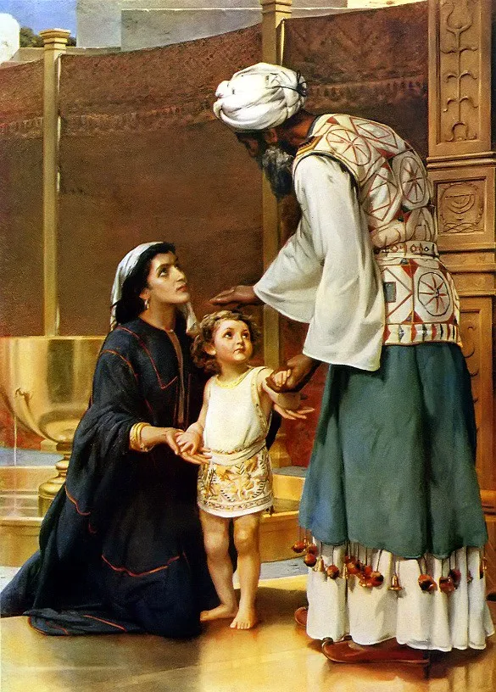
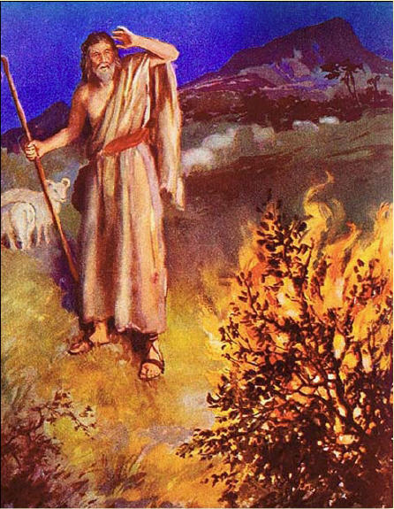
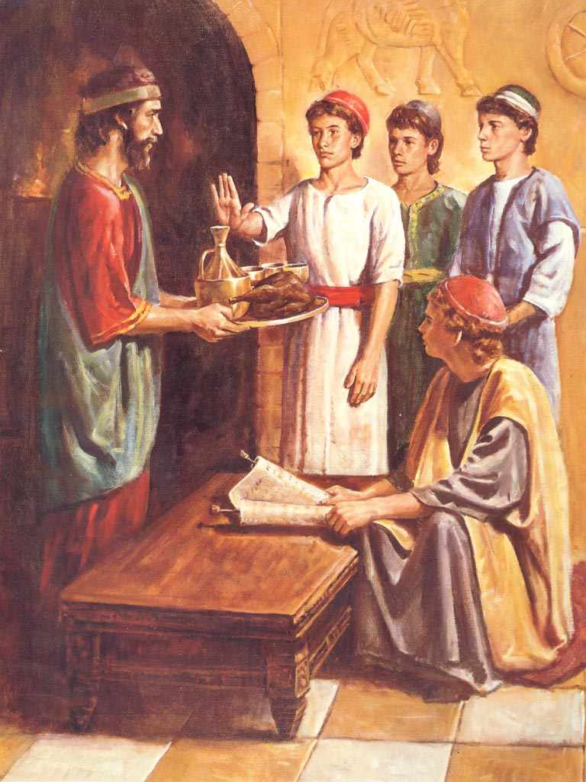
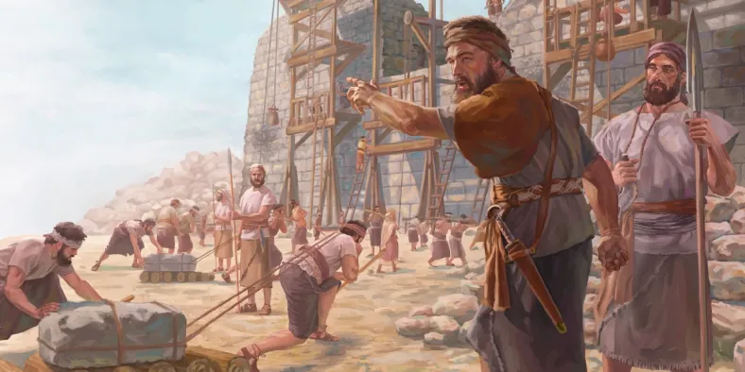

Slide 8
Becoming Tomorrow’s Leaders, Today
~ Ephesians 4:1-16

