Slide 1
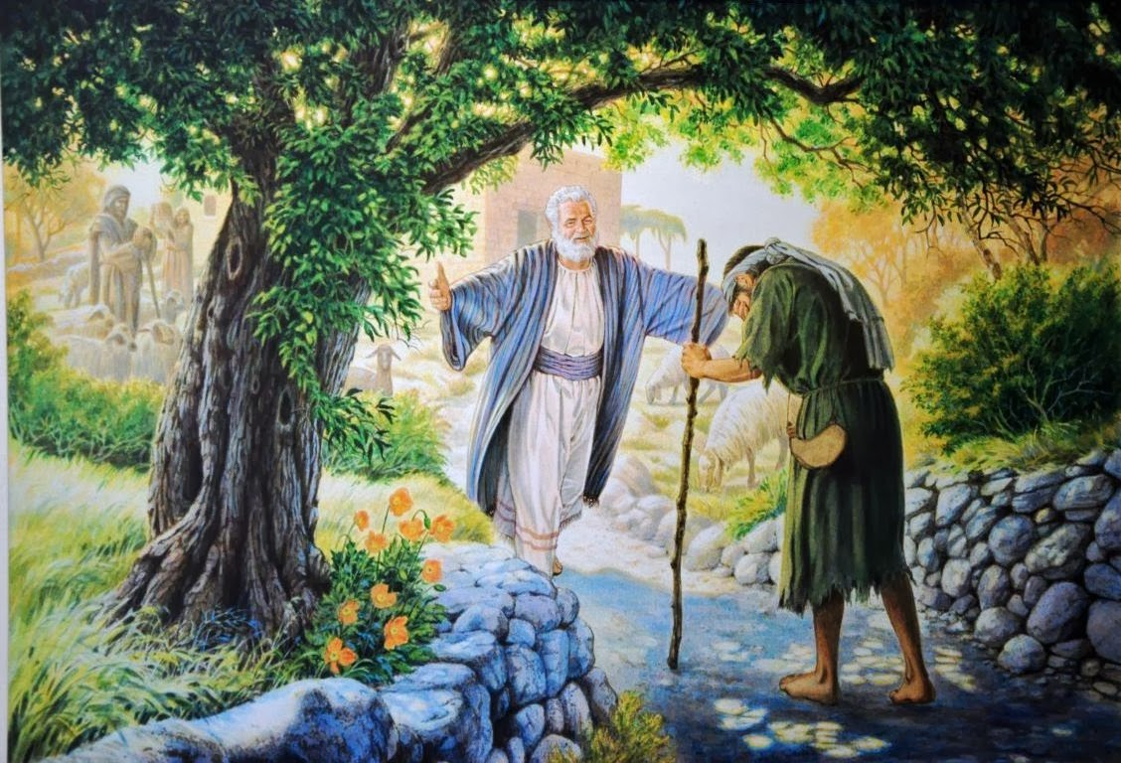
Some Lessons From the Lost Sons
~ Luke 15:11–32

Slide 2
Two Sons, One Father, & the Hearts of Men
Luke 15:11–32
Told in response to criticism (Luke 15:1–2)
Pharisees upset Jesus receives sinners
This parable answers:
  How sinners return
  How the self-righteous refuse

Slide 3
Drifting begins in the heart
Sin promises freedom; results in slavery
Repentance requires clarity
Grace is greater than man’s expectations
Possible to be close, yet far off
Lessons From the Lost Sons

Slide 4
Some Lessons From the Lost Sons
~ Luke 15:11–32

