Slide 1
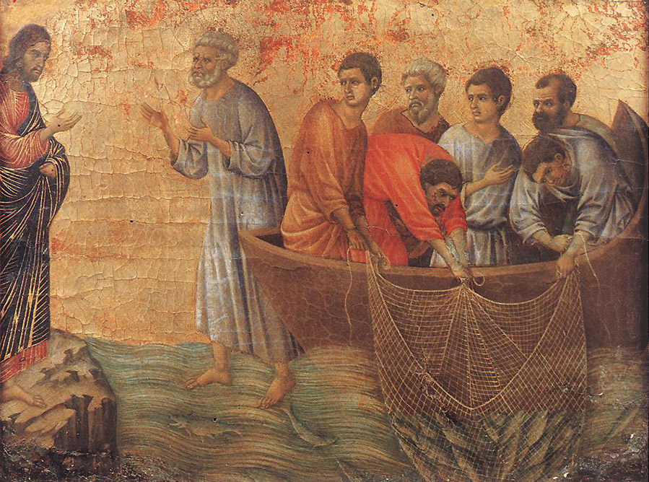
When You Fail & Christ Restores:
The Restoration of Peter
~ John 21:1–19

Slide 2
How Do We Face the One We Have Failed?
Peter once claimed he would die before denying Jesus (Matt. 26:35)
Yet he denied Him 3x under pressure (Lk. 22:57–60)
Failure does not have to be final
But restoration is not automatic
What can we learn from this passage (Jn. 21:1-19)?

Slide 3
How Do We Face the One We Have Failed?
After failure, it is easier to go backward than to go forward.
Jesus meets failure, then demands change.
Honesty (not feelings) leads to restoration.
Restoration can spur greater sense of purpose!
Following Christ after failure has potential to lead unto greater faithfulness!!

Slide 4
When You Fail & Christ Restores:
The Restoration of Peter
~ John 21:1–19

