Slide 1
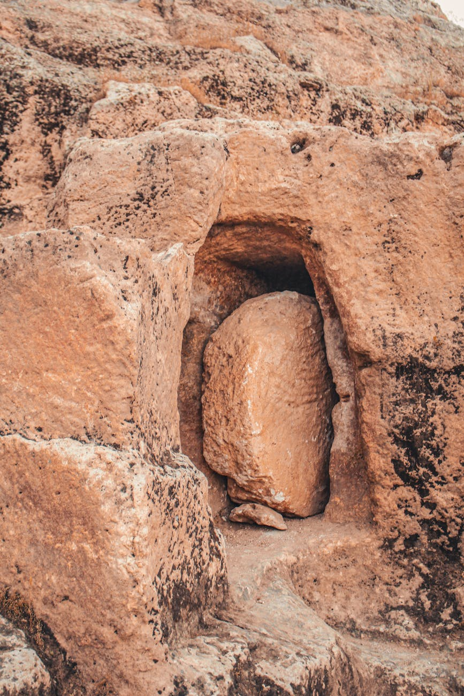

When You’ve Decided Nothing Will Change
John 11:38-40

Slide 2
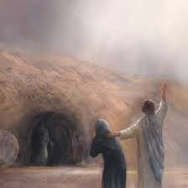
When You’ve Decided Nothing Will Change

Slide 3
When You’ve Decided Nothing Will Change
When we, too soon, decide it’s over.
  Jn. 11:21-25; 2 Ki. 6:24-7:2; Mk. 9:23

Slide 4
When You’ve Decided Nothing Will Change
When we, too soon, decide it’s over.
Trust God over what you perceive.
  Jn. 11:39-40; Prov. 3:5-6; 1 Sam. 14:1-14

Slide 5
When You’ve Decided Nothing Will Change
When we, too soon, decide it’s over.
Trust God over what you perceive.
New life still needs help.
  Jn. 11:43-44; Gal. 6:2; Jer. 38:7-13; Rom. 6:1-23

Slide 6
When You’ve Decided Nothing Will Change
John 11:38-40

