Slide 1
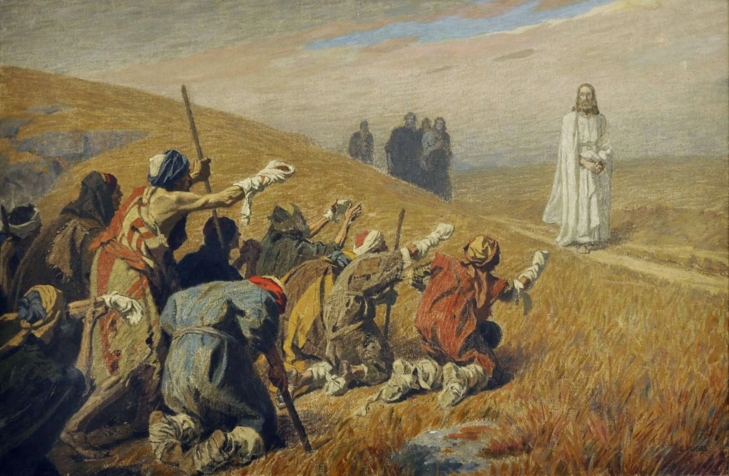
The One Who Came Back
~ Luke 17:11-19

Slide 2
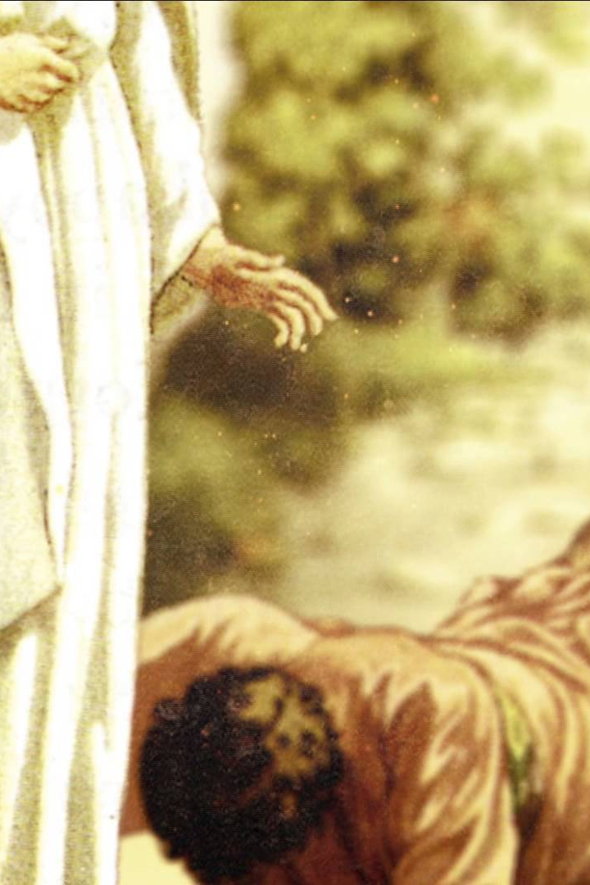
The One
Who Came Back

Slide 3
The One
Who Came Back
Mercy was received by those who knew they needed it.
  Lk. 17:12-13; Lev. 13:45-46; Rom. 3:23; Tit. 3:5; Eph. 2:4-5; Lk. 18:9-14

Slide 4
The One
Who Came Back
Mercy was received by those who knew they needed it.
Faith obeyed before it saw the outcome.
  Lk. 17:14; Lev. 14; Heb. 11:1; Jas. 2:17; Lk. 6:46; 2 Ki. 5:14; Acts 2:38; 22:16; Col. 3:13; Matt. 6:33

Slide 5
The One
Who Came Back
Mercy was received by those who knew they needed it.
Faith obeyed before it saw the outcome.
Gratitude brought the Samaritan to the feet of Jesus.
  Lk. 17:15-18; Psa. 103:2; Col. 3:15; 1 Thess. 5:18; Rom. 1:21; 1 Sam. 1:27-28; 2:1; Eph. 1:3, 7

Slide 6
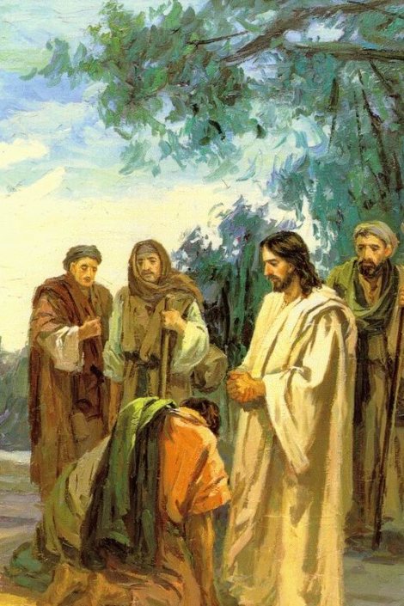
The One Who Came Back
Do I recognize how much I need God's mercy?
Do I trust God enough to obey Him before I can see the outcome?
When God blesses me, do His blessings bring me closer to Him?

