Slide 1

Learn From History
Every generation of God’s people will face challenges
  Some aspects are like prior generations
  Others are unique to a generation
  The aim of this study is for us to begin a series of lessons that deal with the “Sins of Our Generation”

Slide 2

Sins of Our Generation

Slide 3
Sins of Our Generation
American Psychological Association says of marriage, “They are also good for children; growing up in a happy home protects children from mental, physical, educational and social problems. However, about 40 to 50 percent of married couples in the United States divorce.” https://www.apa.org/topics/divorce

Slide 4
Sins of Our Generation
American Psychological Association says of marriage, “They are also good for children; growing up in a happy home protects children from mental, physical, educational and social problems. However, about 40 to 50 percent of married couples in the United States divorce.” https://www.apa.org/topics/divorce

Slide 5
Sins of Our Generation

Slide 6
Sins of Our Generation
High Divorce Rates Continue
  Mt. 19:3-9; Rom. 7:1-3; 1 Tim. 5:14; 1 Cor. 7:11-13

Slide 7
Sins of Our Generation
As marriage rates have fallen, the number of U.S. adults in cohabiting relationships has continued to climb, reaching about 18 million in 2016. This is up 29% since 2007, when 14 million adults were cohabiting, according to U.S. Census Bureau data. Roughly half of cohabiters – those living with an unmarried partner – are younger than 35. Since 2007, the number of cohabiting adults ages 50 and older grew by 75%. https://www.pewresearch.org/fact-tank/2017/04/06/number-of-u-s-adults-cohabiting-with-a-partner-continues-to-rise-especially-among-those-50-and-older/

Slide 8
Sins of Our Generation
As marriage rates have fallen, the number of U.S. adults in cohabiting relationships has continued to climb, reaching about 18 million in 2016. This is up 29% since 2007, when 14 million adults were cohabiting, according to U.S. Census Bureau data. Roughly half of cohabiters – those living with an unmarried partner – are younger than 35. Since 2007, the number of cohabiting adults ages 50 and older grew by 75%. https://www.pewresearch.org/fact-tank/2017/04/06/number-of-u-s-adults-cohabiting-with-a-partner-continues-to-rise-especially-among-those-50-and-older/

Slide 9
Sins of Our Generation
High Divorce Rates Continue
The Unmarried and Immorality
  Heb. 13:4; 1 Cor. 7:2-4; Gal. 5:19-21; 2 Cor. 6:16-7:1

Slide 10
Sins of Our Generation
1973, In a historic decision, the U.S. Supreme Court ruled in Roe v. Wade that women, as part of their constitutional right to privacy, can terminate a pregnancy during its first two trimesters. https://www.history.com/this-day-in-history/supreme-court-legalizes-abortion

Slide 11
Sins of Our Generation
1973, In a historic decision, the U.S. Supreme Court ruled in Roe v. Wade that women, as part of their constitutional right to privacy, can terminate a pregnancy during its first two trimesters. https://www.history.com/this-day-in-history/supreme-court-legalizes-abortion

Slide 12
Sins of Our Generation
The supreme court has ruled there is no constitutional right to abortion in the United States, upending the landmark Roe v Wade case from nearly 50 years ago in a rare reversal of long-settled law that will fracture reproductive rights in America.
Joe Biden called the ruling a “tragic error” and the Republicans celebrating it “wrong, extreme and out of touch”.
The court, the president said, had pointed America down “an extreme and dangerous path”. Sounding an alarm over a concurring opinion by the conservative justice Clarence Thomas, Biden said key rights including same-sex marriage and access to contraception could now be targeted by the rightwing court.
https://www.theguardian.com/world/2022/jun/24/roe-v-wade-overturned-abortion-summary-supreme-court

Slide 13
Sins of Our Generation
The supreme court has ruled there is no constitutional right to abortion in the United States, upending the landmark Roe v Wade case from nearly 50 years ago in a rare reversal of long-settled law that will fracture reproductive rights in America.
Joe Biden called the ruling a “tragic error” and the Republicans celebrating it “wrong, extreme and out of touch”.
The court, the president said, had pointed America down “an extreme and dangerous path”. Sounding an alarm over a concurring opinion by the conservative justice Clarence Thomas, Biden said key rights including same-sex marriage and access to contraception could now be targeted by the rightwing court.
https://www.theguardian.com/world/2022/jun/24/roe-v-wade-overturned-abortion-summary-supreme-court

Slide 14
Sins of Our Generation
High Divorce Rates Continue
The Unmarried and Immorality
Abortion Viewed as a Woman’s Right
  Gen. 1-2; Exod. 21:22-23; Lk. 1-2; Rom. 1:28-32

Slide 15
Sins of Our Generation
In Obergefell v. Hodges, decided June 26, 2015, the U.S. Supreme Court held that the Fourteenth Amendment requires states both to license marriages between same-sex couples and to recognize same-sex marriages lawfully performed in other states, effectively legalizing same-sex marriage nationwide.
https://www.oyez.org/cases/2014/14-556

Slide 16
Sins of Our Generation
In Obergefell v. Hodges, decided June 26, 2015, the U.S. Supreme Court held that the Fourteenth Amendment requires states both to license marriages between same-sex couples and to recognize same-sex marriages lawfully performed in other states, effectively legalizing same-sex marriage nationwide.
https://www.oyez.org/cases/2014/14-556

Slide 17
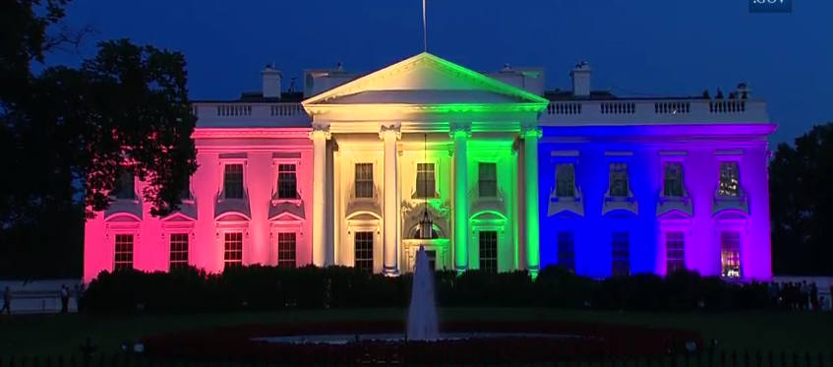
Sins of Our Generation

Slide 18
Sins of Our Generation
High Divorce Rates Continue
The Unmarried and Immorality
Abortion Viewed as a Woman’s Right
Homosexuality
  Rom. 1:26-27; Ezek. 18:20; 1 Cor. 6:9-11

Slide 19
Sins of Our Generation
As of February 2019, the federal government has not codified any laws specifically protecting transgender people from discrimination in employment, housing, healthcare, and adoption, but some lawsuits argue that the Equal Protection Clause of the federal constitution or federal laws prohibiting discrimination based on gender should be interpreted to include transgender people and discrimination based on gender identity. https://en.wikipedia.org/wiki/Transgender_rights_in_the_United_States

Slide 20
Sins of Our Generation
As of February 2019, the federal government has not codified any laws specifically protecting transgender people from discrimination in employment, housing, healthcare, and adoption, but some lawsuits argue that the Equal Protection Clause of the federal constitution or federal laws prohibiting discrimination based on gender should be interpreted to include transgender people and discrimination based on gender identity. https://en.wikipedia.org/wiki/Transgender_rights_in_the_United_States

Slide 21
Sins of Our Generation
High Divorce Rates Continue
The Unmarried and Immorality
Abortion Viewed as a Woman’s Right
Homosexuality
Transgender Acceptance
  Gen. 1-2; Dt. 22:5; 1 Cor. 6:9-11, 19-20; 11:14-15

Slide 22
Learn From History
Every generation of God’s people will face challenges
  Some aspects are like prior generations
  Others are unique to a generation
  The aim of this study is for us to begin a series of lessons that deal with the “Sins of Our Generation”

Slide 23
Sins of Our Generation

Slide 24
Sins of Our Generation

