Slide 1

Learn From History
Every generation of God’s people will face challenges
  Some aspects are like prior generations
  Others are unique to a generation
  The aim of this study: continuation of lessons that deal with the “Sins of Our Generation”

Slide 2

Sins of Our Generation

Slide 3
Sins of Our Generation

Slide 4




Accepted hypocrisy for those in one’s party;
Politics seem to be America’s “new religion”
Some act like the world (Cf. Job. 13:8, 10, 32:21; Psa. 82:2; Prov. 18:5)
Israel’s sins included her ritualism (Isa. 1:10-20)
Christians should not have blind loyalty/animosity toward any man (Deut. 1:17; 1 Tim. 5:21; Jas. 3:17)

Slide 5



Society Given Over to Pleasure
Israel’s sins included her immorality (Isa. 3:9-11; 5:8-11)
Israel’s sins also included the vanity of lifestyle (Isa. 3:16-24; 5:11-13; Cf. Col. 3:5)

Slide 6


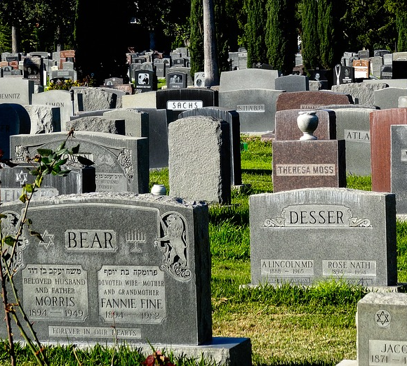
Neither Life Nor Death Revered
The Law of Moses taught the value of both life and death (Deut. 21:1-9; 19:11-13)
God’s people must emulate Him regarding perspective (Ezek. 33:11; Psa. 116:15)

Slide 7
Learn From History
Every generation of God’s people will face challenges
  Some aspects are like prior generations
  Others are unique to a generation
  The aim of this study: continuation of lessons that deal with the “Sins of Our Generation”

Slide 8
Sins of Our Generation

Slide 9
Sins of Our Generation

