Slide 1
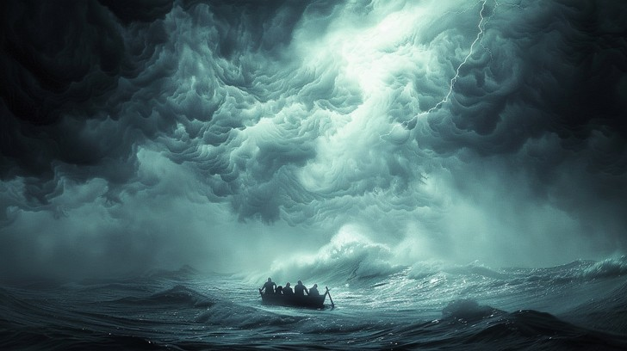
Who Can This Be?
Mark 4:35-41

Slide 2
Who Can This Be?
This account is about more than getting through the “storms of life.”
The disciples had already seen Jesus heal the sick, cast out demons, and forgive sins.
On the Sea of Galilee, they would see something more… Jesus rebuked the wind and said to the sea, “Peace, be still!” (v. 39)
“Who can this be, that even the wind and the sea obey Him!”
~ Mark 4:41

Slide 3
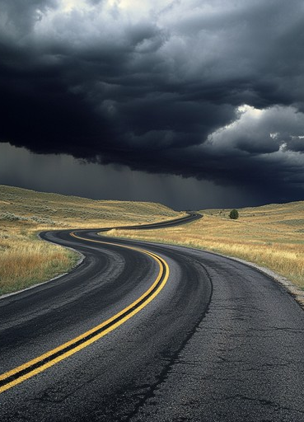
Being Where Jesus Wants Us Does Not Mean Life Will Be Easy
The disciples faced the storm while obeying Jesus — “Let us cross over to the other side.” (Mark 4:35)
Israel was where God led them, yet found the Red Sea ahead and Pharaoh behind (Exod. 13:18; 14:11–13).
Do not judge God’s will by circumstances. Doing right can still bring hardship, loss, or opposition (1 Pet. 4:16).
Difficulty does not mean God has abandoned us or that we have taken the wrong road.
Sometimes the storm comes on the very road Jesus wills for us to take.

Slide 4

Fear May Cause Us to Forget What We Already Know About God
The disciples: “Teacher, do You not care that we are perishing?” (Mark 4:38)
Israel at Rephidim: After everything God had already done, they still asked, “Is the LORD among us or not?” (Exod. 17:7)
Elijah: After witnessing God’s power, the threat from Jezebel left him discouraged (1 Kings 19:4).
Emotions can make present circumstances seem greater than what we already know about God (1 Pet. 5:7; Heb. 13:5).
Do not interpret God through your circumstances; interpret circumstances through what you know of God!

Slide 5
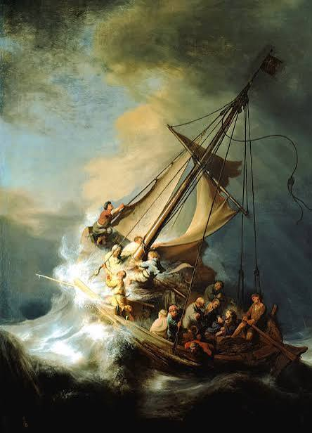
The Storm Ultimately Revealed Who Jesus Is
Jesus spoke: “Peace, be still!” and the wind and sea obeyed Him (Mark 4:39).
The OT describes the LORD as the One who rules the sea (Ps. 107:29; 89:9).
Jonah 1: a storm, frightened sailors, a sleeping passenger, and a calm sea. But when Jesus speaks— the sea obeys.
“Who can this be, that even the wind and the sea obey Him!” (Mark 4:41)
Sometimes God stops the storm; sometimes He carries us through it… Either way, our confidence is in Christ!!

Slide 6
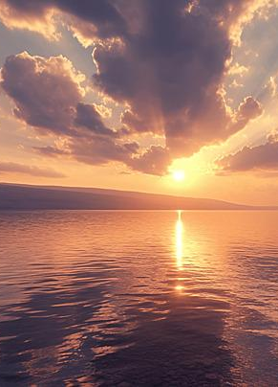
Who Can This Be?
The disciples began the account afraid of the storm. They ended it asking, “Who can this be?”
Our faith cannot depend on how quickly our circumstances change. It must depend on who Jesus is!
Mark continues to answer the question: Jesus commands the sea, casts out demons, heals the sick, raises the dead—and ultimately dies and rises again!
When we do not know what to do, we need to remember what we already know about Jesus!!!

